Slide 1
ACCESSING
HEALTH CARE
Danielle, Nurse Practitioner

Slide 2
INTRODUCTION
My name is Danielle and I am the Nurse Practitioner at Student Health Services
Drop-in group is every other Thursday 5-7pm on the 1st floor boardroom
Group norms include
  Respect for opinions, beliefs, views of others
  Confidentiality
  Being aware of the space you are taking up and making sure there is space for others
Notes:
Will try my best to find answers when I don’t know

Slide 3
OBJECTIVES
01.
UHIP
02.
STUDENT BENEFITS
03.
STUDENT HEALTH SERVICES
04.
OFF CAMPUS HEALTHCARE
University Health Insurance Program
Medications, vision, paramedical, other
Primary health care clinic
Hospital, Walk-in clinics, specialists
Notes:
Next session - #3 and #4

Slide 4
01
UHIP
University Health Insurance Plan
https://uhip.ca/
Policy year: September 1 – August 31
Coverage starts on the date you arrive in Canada, or the 10th of the month before your studies or employment starts, whichever is later.

Slide 5
UHIP
The plan provides medical services and supplies that OHIP covers for Ontario residents. These include:
In-patient and out-patient hospital services.
Physician services.
Lab and diagnostic testing.
Home care services.
Some other specific programs available to an Ontario resident by the Ministry of Health (for example, Assistive Devices Program (ADP)).
Physician services that need pre-approval (except in an emergency)
Elective in-patient and out-patient surgery (for example, rotator cuff surgery) or treatment (for example, cancer, inpatient/outpatient psychiatric program).
  Please email Cowan at case.mgmt@cowangroup.ca.
  Find out which services and treatments need pre-approval from Cowan.
Medically necessary MRIs and CAT scans or referrals to a surgeon don’t need preauthorization.
Notes:
You need Cowan’s pre-approval for:
Surgery or treatment that is not for a medical emergency (such as dialysis and cancer treatment).
Semi-private or private room accommodation.

Slide 6
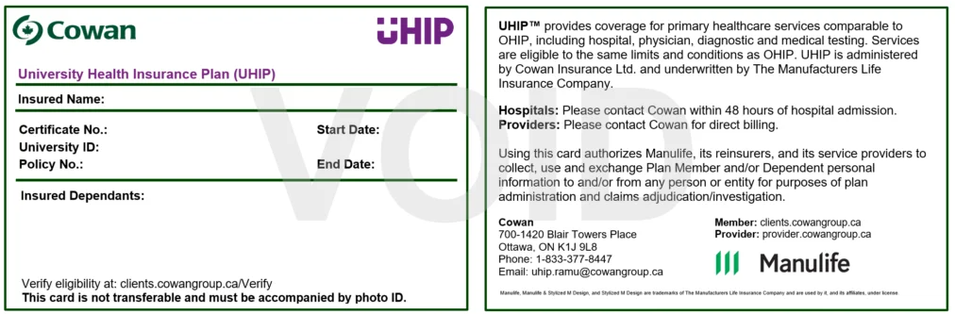
UHIP
Bring your UHIP card with you to all medical appointments, lab visits, imaging appointments
It is best to print off a copy of your UHIP card in case they need a photocopy of it

Slide 7
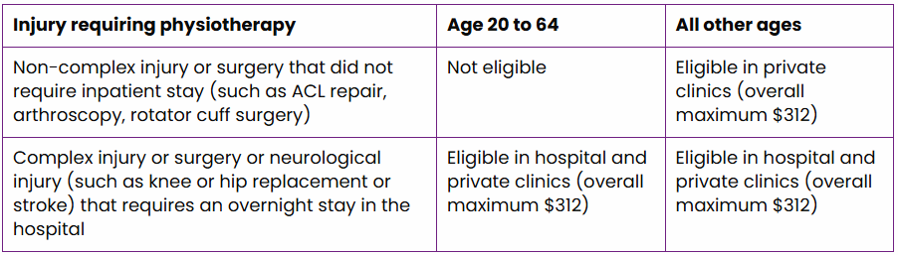
UHIP
What is covered? https://uhip.ca/uhip-services/coverage-details/#what-is-covered
Some highlights
Hospitalization IMPORTANT: You must notify Cowan within 48 hours of your admission to hospital. Some services and treatments need to be approved by Cowan before they happen.
Services of physicians and nurse practitioners (including specialists)
Eye exams – for under age 19 and over 65 OR (with preapproval) if you have certain medical conditions (diabetes, glaucoma, cataracts, etc)
Services of podiatrist (not including surgery)
Services of physiotherapist under certain circumstances and when preapproved

Slide 8
UHIP
What is covered? https://uhip.ca/uhip-services/coverage-details/#what-is-covered
More highlights
Lab and diagnostic services when ordered by a physician or nurse practitioner
Air and ground ambulance when deemed necessary (you pay $45, rest is covered)
Oral and maxillofacial surgery such as corrective or reconstructive jaw surgery that can only be performed in hospital when pre-approved by Cowan
The services of a medical professional to provide home care (includes nursing, personal support, supplies, occupational therapists, physiotherapists), when pre-approved by Cowan.
Specialized medical devices and aids such as home oxygen, and respiratory equipment and supplies when pre-approved by Cowan.
  https://www.ontario.ca/page/assistive-devices-program
Emergencies outside of Ontario, inside Canada (this means that your condition requires immediate medical attention to relieve acute pain and suffering). You must notify Cowan within 48 hours of your admission to hospital. Some services and treatments need to be approved by Cowan before they happen.
Outside of Canada – extremely limited coverage, emergencies only. They strongly advise that you buy travel insurance to avoid significant out-of-pocket expenses.

Slide 9
DEPENDENTS
You must get coverage for dependents who are living with you here in Canada
Spouses and children
They are not automatically enrolled!
If you do not enroll them within 30 days of their eligibility date, there is a $500 fee
Renew every year for dependents (your enrollment and renewal is automatic)
Notes:
Spouse – at least 12 month common law
Child - The natural or legally adopted child, stepchild, or child for whom the eligible student or employee has been appointed legal guardian, whose primary residence is with the student or employee, is unmarried, dependent on the student or employee for support, and under age 22 (under age 25 if studying full-time at an accredited educational institution, or any age if mentally or physically disabled.

Slide 10
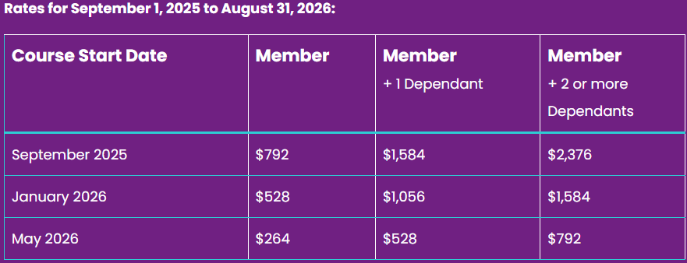
UHIP - DEPENDENTS
Fill out an application and bring to UHIP office on campus (bring passports)
Use the same form for renewals (renew at least 30 days before it expires)
https://uhip.ca/wp-content/uploads/2022/08/UHIP-Application-Form-aGL5725E-E_0722.pdf

Slide 11
UHIP - CLAIMS
If you paid for medical services, keep your receipts and submit a claim
If you received an invoice, keep your invoice and submit a claim (fill out part B in section 3)
  https://uhip.ca/submit-a-claim/
Claim form:
  https://uhip.ca/wp-content/uploads/2022/08/UHIP-Claim-Form-aGL5728E-E_0722.pdf
Submit at:
  clients.cowangroup.ca
Or by mail
  Cowan Insurance Group
  700-1420 Blair Towers Place
  Ottawa, Ontario
  K1J 9L8
Submit all receipts and keep copies for your records

Slide 12
https://www.uoguelph.ca/studentexperience/international/health/

Slide 13
02
STUDENT BENEFITS

Slide 14
STUDENT BENEFITS
your student benefit plan covers many medical expenses not covered by your UHIP
It is mandatory (you cannot opt out of medical, but you can opt out of dental)
  To opt out of dental https://www.mystudentplan.ca/uofguelph/en/forms/opt-out
These include eye care, dental care, prescription medications, paramedical services, medical devices
You are automatically enrolled in this plan
If you are in your first year, you cannot bill direct (meaning you have to pay out of pocket) until you are enrolled in October, then you can submit a claim for previous expenses
  Validation Period
Make sure you keep all your receipts and prescriptions/letters for submitting claims
Plan number: 330820
Certificate number: Your student ID number without letters and leading zeros

Slide 15
COORDINATION OF BENEFITS
You cannot opt out of medical benefits, even if you already have coverage through another plan.
Scenario 1: You are covered under a parent's or spouse's plan as a dependent. The primary payor is the Student Benefits Plan and the second payor is the other benefits plan.
Scenario 2: You are covered under your employer, government or band's benefits plan. The primary payor is the one you have had the longest.

Slide 16
BENEFITS - DEPENDENTS
Students with families can also add their dependents to their Student Health and Dental Plans for a fee. Contact the Student Benefits Plan Office in the University Centre (UC Room 108A) for more information and deadlines.
Complete the form on this page: https://www.mystudentplan.ca/uofguelph/en/forms/family-addon
There are 4 circumstances in which students enrolled in the Student Health and Dental Plan may add dependents to their plan:
when they are starting the fall term,
when they are new winter students,
when they are new spring-summer students or
when they have a lifestyle change.
Lifestyle change means getting married, meeting the co-habitation requirement for common law status, or birth/adoption of a child; and
Must submit their family add-on application within 30 days of the lifestyle change
Email documents to guelphplan@mystudentplan.ca

Slide 17
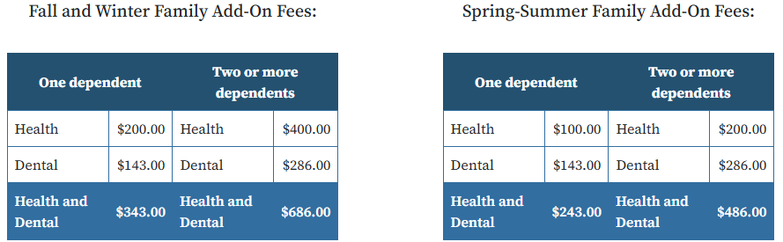
BENEFITS - DEPENDENTS
Re-apply every fall. Dependents are not automatically renewed.
Coverage is provided until August 31st.
You can only add as a dependent to your Student Benefits Plan your spouse or common-law partner and your children. Parents, grandparents, and siblings do not qualify as dependents

Slide 18
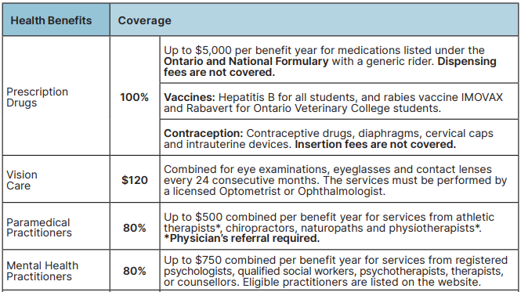
STUDENT BENEFITS – what is covered?

Slide 19
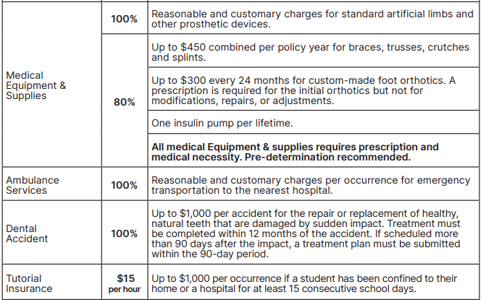
STUDENT BENEFITS – what is covered?

Slide 20
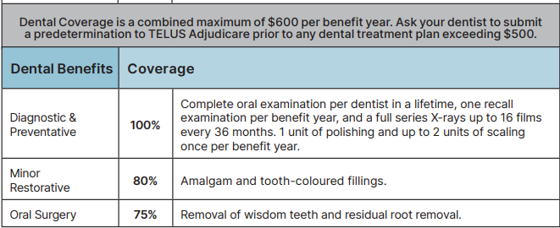
STUDENT BENEFITS – what is covered?

Slide 21
BENEFITS
For the specifics of what is covered by your plan: https://www.mystudentplan.ca/uofguelph/en/studentplan
To generate benefits cards:
https://www.mystudentplan.ca/uofguelph/en/benefit-cards
(or pick up your myBenefits card from the Student Benefits Plan Office in the University Centre (UC Room 108A)
Note that you may have 3 cards – drug, health and dental.
Your dependents use the same cards as you do. They do not have their own.

Slide 22
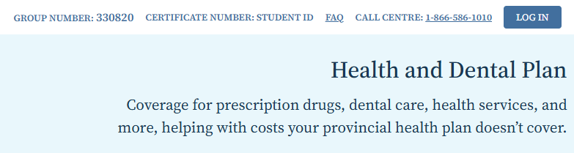
CLAIMS
https://www.mystudentplan.ca/uofguelph/en/claims
There are videos on this page that walk you through registering for benefits and how to submit claims if you have paid for a covered health expense out of pocket.
Click on the LOG IN button on the top right corner of the webpage to get started with this.

Slide 23
CLAIMS
All the information you need to submit a claim should be found on your receipts.
Make sure you keep all your receipts as you will need to upload them when you submit a claim.
You may also need to upload other documents, such as a provider’s referral. Check under the specific service for whether this is required. Obtain this before receiving services.
You can also make paper claims, but they take 4-6 weeks to get reimbursement

Slide 24
CLAIMS
You can also submit preauthorization forms to pre-determine is something is covered by your benefits plan https://mystudentplan.blob.core.windows.net/documents/mystudentplan/forms/benefitsapp/healthcareClaimForm-330820-UofGuelph.pdf
Drug Prior Authorization - Use this form to request coverage of a drug that is covered by the plan but has a note advising you that prior authorization is required after using the Prescription Drug Search Tool. https://www.telus.com/en/health/prior-authorization-forms
Drug Exception Request - Download and complete the Drug Exception Request Form to request coverage of a drug that is not automatically covered under the drug plan. Before downloading and completing this form, please use our Prescription Drug Search Tool to find out if your medication is covered by the plan. https://mystudentplan.blob.core.windows.net/documents/mystudentplan/forms/benefitsapp/drugExceptionForm-330820-UofGuelph.pdf

Slide 25
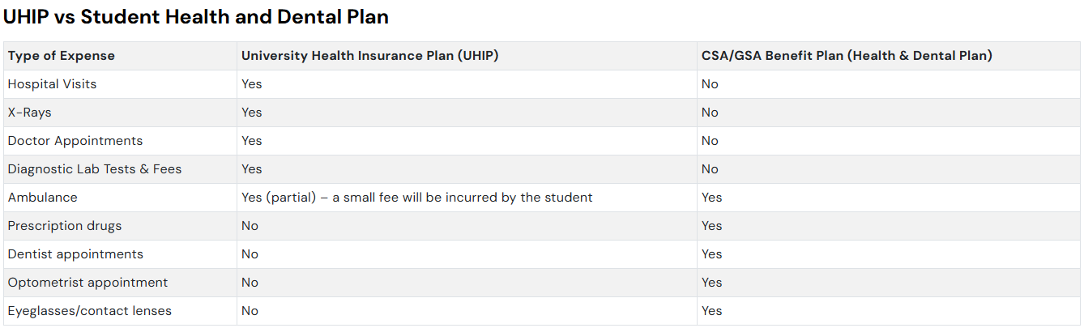

Slide 26
RESOURCES
Questions about your Student Benefits?
https://www.mystudentplan.ca/uofguelph/en/studentplan
guelphplan@mystudentplan.ca
Questions about your UHIP plan or what to do in terms of medical help, please contact one of our International Student Advisors.
https://uhip.ca/
https://www.uoguelph.ca/studentexperience/international/health/
This group’s webpage https://wellness.uoguelph.ca/services/health-services/all-health-services/health-services-international-students/international
International Students Health webpage (see link to HERE webinar and guidebook) https://wellness.uoguelph.ca/services/health-services/all-health-services/health-services-international-students

Slide 27

ANY QUESTIONS?

Slide 28



Slide 29
Rooted and Rising
A Healing Group for Black and Racialized Students. This in-person wellness group is a supportive space for University of Guelph students who self-identify as Black and/or racialized to come together in community, reflect, and build tools for wellness. We'll be exploring topics such as self-worth and identity in a predominantly white institution (PWI), navigating intergenerational and racial trauma, and rest as resistance.
Tuesday, Jan 20 to March 3 (break for reading week) this form to register

