Slide 1
Immunizations
Danielle Castledine, Nurse Practitioner
Sherri Shantz, Registered Nurse

Slide 2
Objectives
Understand what vaccines are and how they work
Understand why vaccines matter on and off campus
Know which vaccines are recommended in Ontario/Canada
Discuss vaccine safety
Learn how to access vaccines
Address common questions and myths
Give you some resources for learning about vaccines and getting your questions answered

Slide 3
Immunizations
Immunizations are sometimes called vaccines or vaccinations
Some offer protection for a short period of time, and some protect you for life
They offer protection against viruses and bacteria that cause respiratory infections, childhood diseases, gastrointestinal infections, chronic diseases, systemic infections and even cancer.
They are not 100% effective but are highly effective in preventing disease as well as decreasing the severity of illness should you contract the illness
Different countries have different immunization recommendations and schedules based on their local rates of disease, accessibility and priorities
Make sure you are getting your immunization information from evidence-based, scientific sources.
  Public Health Agency of Canada, National Advisory Committee on Immunization

Slide 4
How do vaccines work?
Vaccines train your immune system to recognize infection
  Your immune system learns by practice. The first time it sees a new virus or bacteria, it takes time to respond. Vaccines are like a practice run.
  Vaccines show your immune system a safe version or piece of the virus/bacteria and this teaches your body how to recognize and fight it
  Memory cells are created by your immune system following immunization so if you are exposed later, you will respond faster and stronger
  You gain the benefits of exposure without the risk of full infection (like severe illness)
There are different types of vaccines
  Some are live attenuated (weakened vaccines)
  Some are inactivated
  Some are protein/subunit
  Some are mRNA
Vaccines do not stay in your body permanently. Your body clears the vaccine ingredients after it has learned from them.
Vaccines do not change your DNA.
https://www.chop.edu/sites/default/files/2024-11/types-of-vaccines.pdf
Notes:
Some vaccines use a small piece of a virus or bacteria
Some use a weakened or inactive version
Some (like mRNA vaccines) give instructions that help your body make a harmless protein piece so your immune system can practice

Slide 5
Why do immunizations matter?
Vaccination has prevented hundreds of millions of people from disease and saved hundreds of millions of lives
It protects you
It protects everyone around you – not everyone can take vaccines but still need protection
Prevents outbreaks in communities
Prevents the return of previously eradicated disease
They are required for some academic programs (health care, placements)

Slide 6
Commonly recommended vaccines
Routine or commonly recommended immunizations for university students include:
  MMR (measles, mumps, rubella)
  Tdap (tetanus, diphtheria, pertussis)
  Meningococcal
  HPV
  Influenza (annually)
  Covid-19
  Varicella (chicken pox)
  Hepatitis B (especially for healthcare programs)
  Rabies (if part of animal related studies/research)
Publicly Funded Immunization Schedules for Ontario https://www.ontario.ca/files/2024-01/moh-publicly-funded-immunization-schedule-en-2024-01-23.pdf
These are the guidelines that we follow for determining which immunizations are publicly funded for which people and what schedule to follow

Slide 7
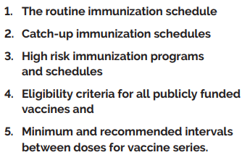
Publicly Funded Immunization Schedules for Ontario
https://www.ontario.ca/files/2024-01/moh-publicly-funded-immunization-schedule-en-2024-01-23.pdf
Includes:

Slide 8
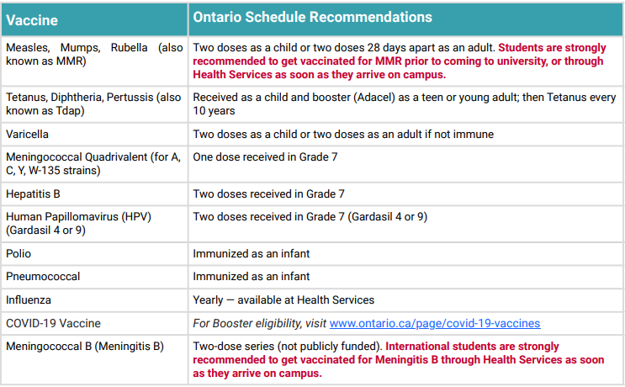
Recommended immunizations
We carry all these vaccines at Student Health Services, as well as others.

Slide 9
HPV/Gardasil 9 vaccine
There about a hundred of different strains of human papilloma viruses. Most are harmless and your body is able to clear them over time. Some can cause cancer or warts when they are not cleared.
Gardasil protects you from strains 6, 11 (cause >90% of genital warts) and 16, 18, 31, 33, 45, 52 & 58 (cause >90% of cancers).
Currently a 3-dose series for anyone over 15 years old (although this is changing).
Is ideally given before exposure to HPV but continues to be recommended for adults up to age 45 even after exposure (arguably older than this).
Is highly effective in preventing various types of cancers caused by HPV – cervical, anal, penile, mouth, throat, vaginal, vulvar.
Unfortunately, cervical cancer is the only one of these with effective screening methods, so prevention with vaccination is the most significant thing you can do to avoid negative outcomes from these cancers.
This vaccine is covered (no cost) for men who have sex with men until age 26 and for all youth in high school. Otherwise, it is $200/dose.
https://www.chop.edu/sites/default/files/2024-08/human-papillomavirus-infographic.pdf
Notes:
9-20 year olds – 1 dose
21 and over – 2 doses
(NACI and Health Canada guidelines)
https://www.canada.ca/en/public-health/services/publications/healthy-living/canadian-immunization-guide-part-4-active-vaccines/page-9-human-papillomavirus-vaccine.html#a5_f

Slide 10
Pregnancy considerations
If you are pregnant, please access health care as soon as possible to begin prenatal care.
As part of your prenatal bloodwork, you will have your immunity checked for specific diseases that can present significant risks to you and/or the fetus if contracted during pregnancy.
It is important to know if you are not immune to these diseases in case you have exposure to them during pregnancy. There are medications we can use to prevent infection if you are exposed but these need to be given quickly.
If you are considering pregnancy, make sure your immunizations are up to date prior to conception. Some vaccines (live ones) cannot be given during pregnancy so need to be given before.
Other vaccines are considered safe in pregnancy. In fact, some are recommended to also protect the baby for the first few months after birth until their immune system begins to function and they can start to receive vaccines themselves (RSV, influenza, Covid-19).
A dose of Adacel (Tdap) is recommended during weeks 27-32 of every pregnancy to protect the baby from pertussis (whooping cough) after birth by transferring antibodies to the baby (can be given up to 36 weeks).
Influenza and Covid-19 vaccines are also recommended during pregnancy as pregnancy presents increased risk of complications and severe illness from these infections (and preterm labour in the case of Covid-19).
We carry all immunizations that are recommended for you and your baby starting at 2 months old at Student Health Services.
https://www.chop.edu/sites/default/files/2025-01/vec-vaccine-preg-infographic.pdf

Slide 11
Are vaccines safe in Canada?
Vaccines in Canada undergo rigorous testing prior to approval for use in Canada
After approval, ongoing safety monitoring continues through national vaccine safety surveillance systems
The benefits greatly outweigh the risks of vaccine
  Risks of disease vs risks of the vaccines for the disease https://immunisationhandbook.health.gov.au/resources/tables/table-comparison-of-the-effects-of-diseases-and-the-side-effects-of-vaccines-on-the-national-immunisation-program
Understand the risks – generally mild (sore arm, low grade fever)
Serious side effects are rare and monitored closely but they do happen
Vaccines do not cause disease (you cannot get the flu from the flu vaccine)
Any specific questions about vaccine safety? Vaccine Safety | Children's Hospital of Philadelphia
0.007% rate of adverse events following immunization – 96.3% of which were non-serious (injection site pain, swelling, redness, rash, other skin reactions). Rates are higher in infants and children under 3.
  https://www.publichealthontario.ca/-/media/Documents/V/24/vaccine-safety-surveillance-tool-infographic.pdf?rev=d55c4d0309184d09bc04882a5f07a83b&sc_lang=en
Notes:
Comparison chart

Slide 12
Common questions & myths
Common questions about immunizations
  Do vaccines cause autism?
    Extensive international research involving millions of children shows no link between vaccines and autism. The original study suggesting this was withdrawn and discredited.
  Is natural immunity better?
    While infection can create immunity, it also carries real risks — including hospitalization, long-term complications, and spreading illness to others. Vaccines provide protection without the same level of risk.
  I’m young and healthy – do I need them?
    Healthy young adults can still get seriously ill. University and college settings increase exposure risk due to shared housing and classrooms.
  Are vaccines mandatory?
    Not typically, but can be in some circumstances.
  What about aluminum exposure? https://www.chop.edu/sites/default/files/vec-aluminum-qa-infographic.pdf
Notes:
Myth 4: Vaccines are rushed or not tested properly
Fact:
In Canada, vaccines go through:
Laboratory testing
Clinical trials
Health Canada review
Ongoing safety monitoring
Safety continues to be monitored after approval.
Myth 5: Vaccines will affect my immigration status
Fact:
Your vaccination status is confidential medical information. It is not shared with immigration authorities.
Myth 6: If I don’t have my records, I can’t get vaccinated
Fact:
You can:
Provide translated records
Have blood tests (titres)
Follow a catch-up schedule
Safely repeat vaccines if needed

Slide 13
Accessing immunizations
Student health Services
  Meet with a nurse to review your immunization records
Many routine vaccines are publicly funded (no cost to you)
Some vaccines require payment (but they are offered at cost at SHS and can be a cost-effective investment in your health)
Check your immunization records and book an appointment with the nurses for more information
Be sure to keep copies of your records for any vaccines you receive
Vaccine information is confidential. You must give consent before receiving a vaccine. You can ask any questions you have before receiving a vaccine.
Immunization checklist https://wellness.uoguelph.ca/system/files/Immunization%20Checklist%202025%20for%20International%20Students%20%28Health%20Services%29.pdf
We can also complete any immunization forms you require for school placements/employment, including doing TB skin testing.

Slide 14
Vaccine records
International students have some common concerns about their immunization records. Some examples include:
  Records are not in English
  They have different vaccine schedules
  They are missing their childhood vaccine records
Please note that:
  Records can be translated
  Blood tests can be used to check your immunity levels for some diseases (titres)
  Catch up schedules are available in Ontario and at SHS
  If you are unsure, it is safe to repeat most vaccines

Slide 15
Trusted resources
NACI
WHO
Local public health unit
Public health agency of Canada
No longer US government health agencies – like the CDC for example (no longer evidence based)
Vaccine Education Centre at Children’s Hospital of Philadelphia http://www.chop.edu/vaccine-education-center
  You can ask them about any concerns you have, they will answer you.

Slide 16
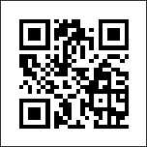
Thank you!
Questions?

