Slide 1
Food security
Danielle Castledine, Nurse Practitioner

Slide 2
Food security
Food security means having sufficient physical, social and economic access to safe and nutritious food
Many post secondary students experience food insecurity
Food insecurity can negatively impact health, well-being and academic performance
Food security includes:
  Understanding food and nutrition
  Having enough food to eat
  Having financial security

Slide 3

Dietician and nutrition services
Understand Food and Nutrition
Learn how to prepare food
https://wellness.uoguelph.ca/nutrition
Group Nutrition Workshops
Nutrition Services on Demand
One-to-One Nutrition Appointments
Nutrition FAQs
Recipes
Additional Resources

Slide 4
table of contents
01
02
03
04
05
Guelph student food bank
On campus sliding scale market
Meal care community fridge
Grocery apps
Food access guides

Slide 5
01
Guelph student food bank
https://csaonline.ca/services/guelph-student-foodbank/

Slide 6
Guelph student foodbank
Provides University of Guelph students access to emergency food, anti-poverty resources, and referrals to other food security, anti-poverty and financial assistance groups
UofG students who have paid the Foodbank fee as part of their current semesterly tuition are eligible to access the Food Bank.
Provides a maximum of 30 items per registered UofG student per month
Visits are limited to 2 per month
Register on their website
Email foodbank@uoguelph.ca with questions

Slide 7
02
On campus sliding scale market
https://www.cesinstitute.ca/u-g-food-market-sliding-scale-market-university-guelph

Slide 8
Sliding scale market
Fresh produce and other items available at sliding scale prices
Pay what you can within a set range, no questions asked
Lower end is about 33% of regular retail prices
At various locations on campus, different days of the week – currently 3 days/week
Stay up to date on Instagram
  https://www.instagram.com/uofgfoodmarket/

Slide 9
03
Meal care Guelph community fridge
https://mealcare.org/#guelph
https://www.instagram.com/mealcare_guelph/

Slide 10
Community fridge
Run by MealCare Guelph
Diverts food waste
Located in the UC, near the microwaves, beside Subway
Open Monday to Friday 8am-5pm
No registration necessary, scan the QR code and follow instructions
Stay up to date by following them on Instagram
  https://www.instagram.com/mealcare_guelph/
Join their email list to be notified when the fridge is restocked
  http://forms.gle/qbVDx7mvpgcqgibc6

Slide 11
04
Food access guides
https://www.gwpoverty.ca/access-guides/
Guelph and Wellington County

Slide 12
Food access guides
Free and low-cost food options available in Guelph and Wellington County
Neighbourhood groups support those living in their areas
The SEED, Guelph Food Bank, Hope House, Chalmers
Guide is updated regularly
Details and contact information for each provider in Guide
Interactive map to find food provider closest to you
  https://www.gwpoverty.ca/foodaccessmap/

Slide 13
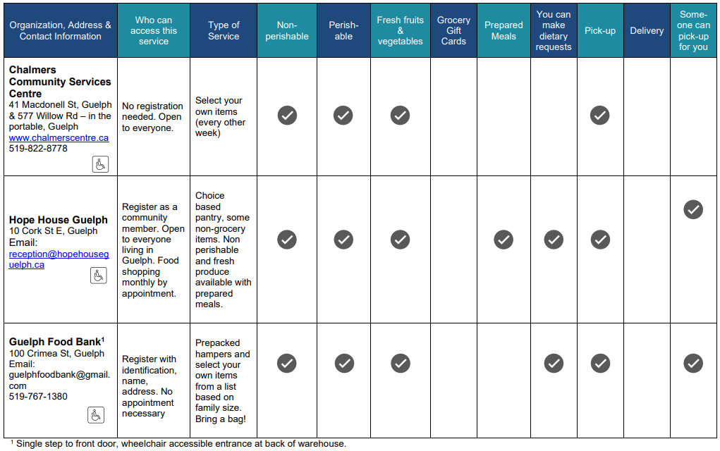

Slide 14
05
Grocery apps
Download Flash Food and Too Good to Go on your devices for low-cost foods
Various businesses post foods they are looking to sell at a fraction of the regular cost
You need to pick up the foods at a certain time

Slide 15
Financial support and literacy resources
Student Financial Services
Emergency Financial Counselling
Robert Auger Humanitarian Bursary
Scholarships and Financial Aid
Budgeting and Financial Literacy Resources

Slide 16
RESOURCES
https://www.uoguelph.ca/healthy-campus/food-security/
https://wellness.uoguelph.ca/nutrition
https://www.gwpoverty.ca/foodaccessmap/
https://www.gwpoverty.ca/wp-content/uploads/2025/12/Guelph-Food-Access-Guide-December-18th-2025.pdf
https://www.gwpoverty.ca/access-guides/
https://csaonline.ca/services/guelph-student-foodbank/
https://www.cesinstitute.ca/u-g-food-market-sliding-scale-market-university-guelph
https://wellness.uoguelph.ca/system/files/Campus%20Food%20Access%20Guide%20%282025%29.pdf
https://theseedguelph.ca/

Slide 17
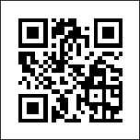
Thanks!

