Slide 1
Welcome!
If you are seeing this message, it means I am here but possibly working on other things as I wait for people to arrive. If you unmute yourself and say hello, I will hear you and be able to respond.
- Barry (presenter)

Slide 2
Registration Workshop
Barry Praamsma-Townshend, Manager (Accessibility Services)

Slide 3
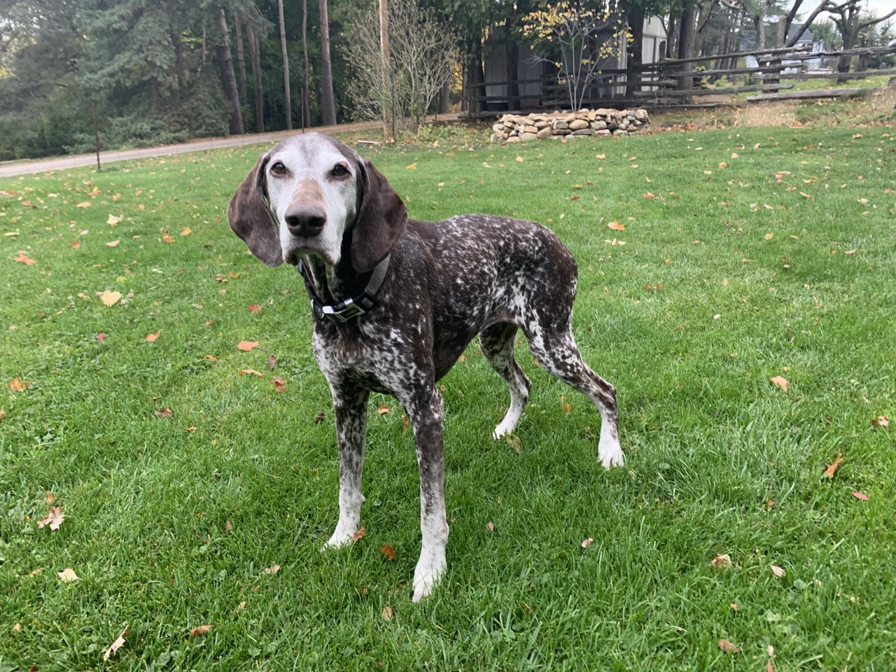
Notes:
Part of what makes Guelph special is its unique sense of community. Here you are a whole person and not just a number. This is a photograph from one of Barry’s camping trips in Killarney Provincial Park.

Slide 4
Overview
Important Principles
Practical stuff
Accessibility Online
Online quizzes, tests and exams
Note taking
Other considerations
Working Together
Notes:
This presentation will cover these topics. You’ll hear us use the word “disability” quite often. We acknowledge that this isn’t always a comfortable word, so we try to use other terminology too. This word specifically references your rights under the Ontario Human Rights Code.

Slide 5
Important Principles

Slide 6
What is an Accommodation?
Modification of a policy, procedure or requirement to remove barriers to participation in the academic environment.
Does not reduce academic standards. The student must demonstrate that they have achieved the essential learning outcomes.
Notes:
Complete information on the mandate of SAS and relevant policy and procedures has been approved by Senate and is available on our website: https://wellness.uoguelph.ca/accessibility/about-us/policy-procedures

Slide 7
Approval Types
SAS Approved: no additional negotiating required
Student to Follow-up: contact your prof and copy your SAS Advisor
Advisor to Follow-up: ask your advisor to reach out to your prof
Administrative: items not related to faculty
Notes:
There are three types of accommodations. If you have an “student to follow-up” accommodations, if you feel uncomfortable reaching out to your prof, please speak with your SAS advisor. The ones marked as “advisor to follow-up” often require more discussion with profs. Let us know for which courses you’ll need it, and we’ll reach out on your behalf.

Slide 8
Shared Responsibility
Student: provide information, learn content, follow-up on procedures
Course Instructors: content experts
Student Accessibility Services: accommodation experts
Notes:
We take a collaborative approach to accommodations. Our goal is consensus whenever possible.

Slide 9
Accessibility Online (AO)
Notes:
Accessibility Online (or “AO”) is our system for tracking accommodations.

Slide 10
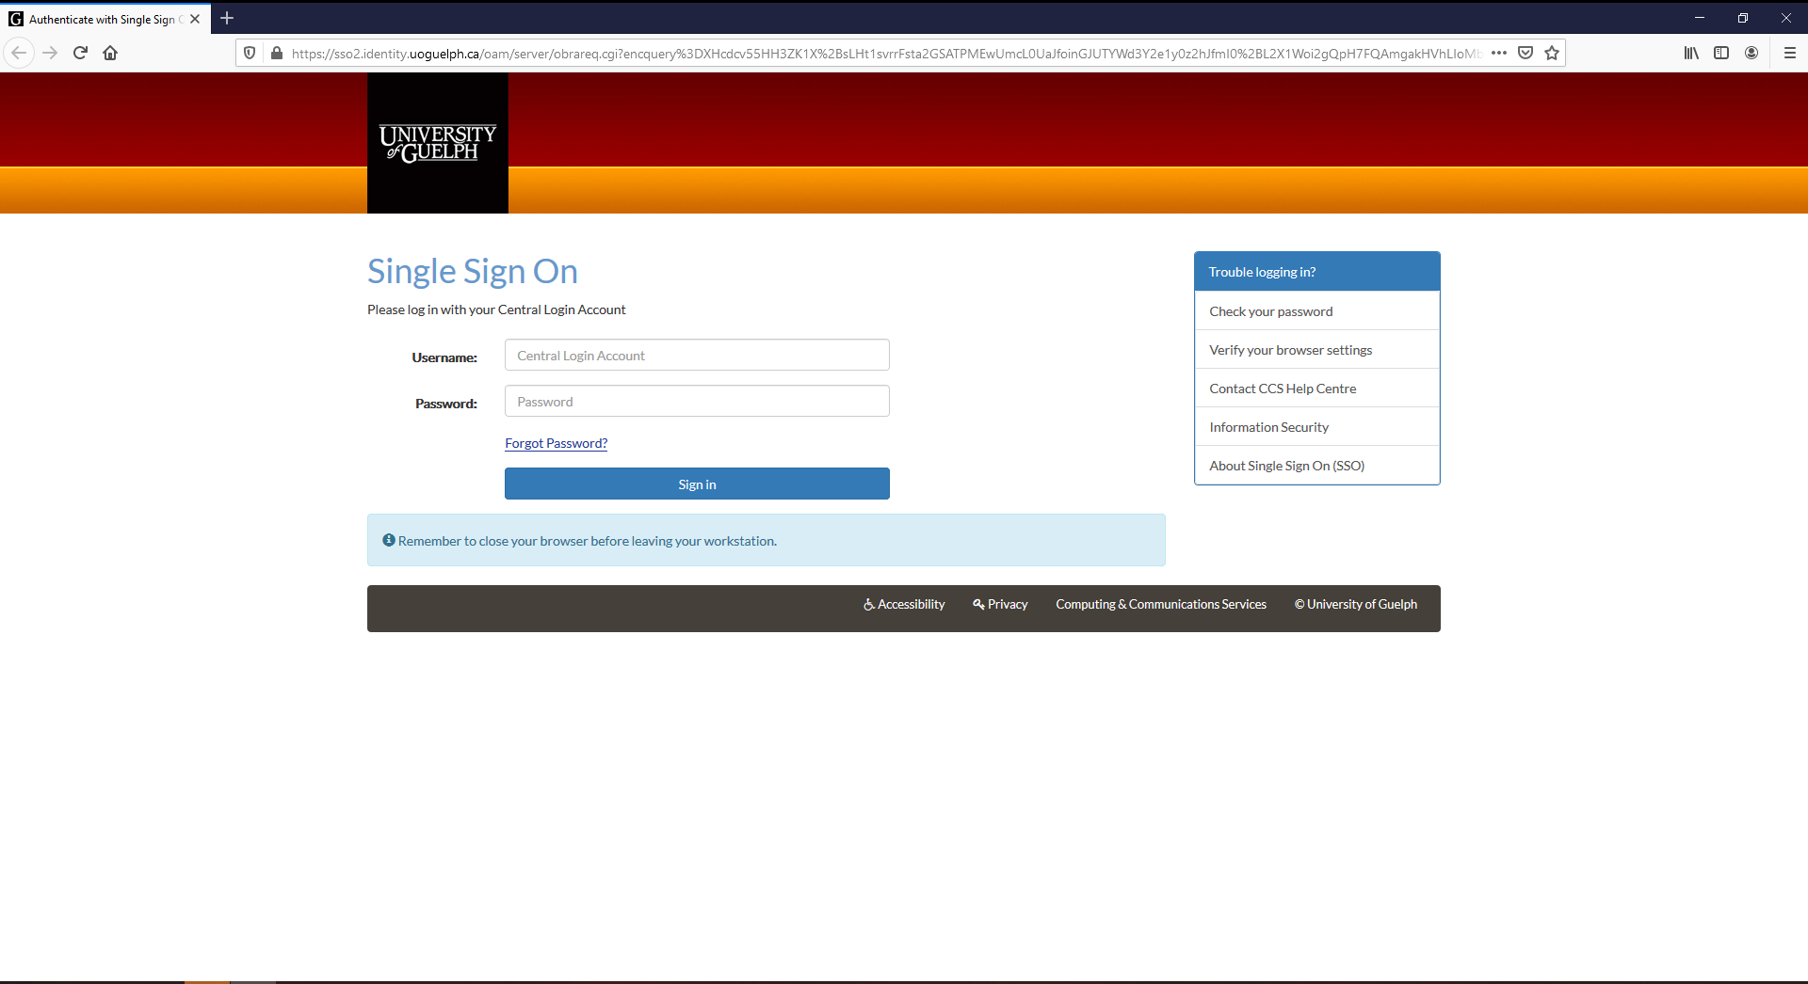
Review & Consent
wellness.uoguelph.ca/accessibility/online
Notes:
You can login using your University of Guelph “central ID” – the same ones you use for email, WebAdvisor, CourseLink, and many other systems.

Slide 11
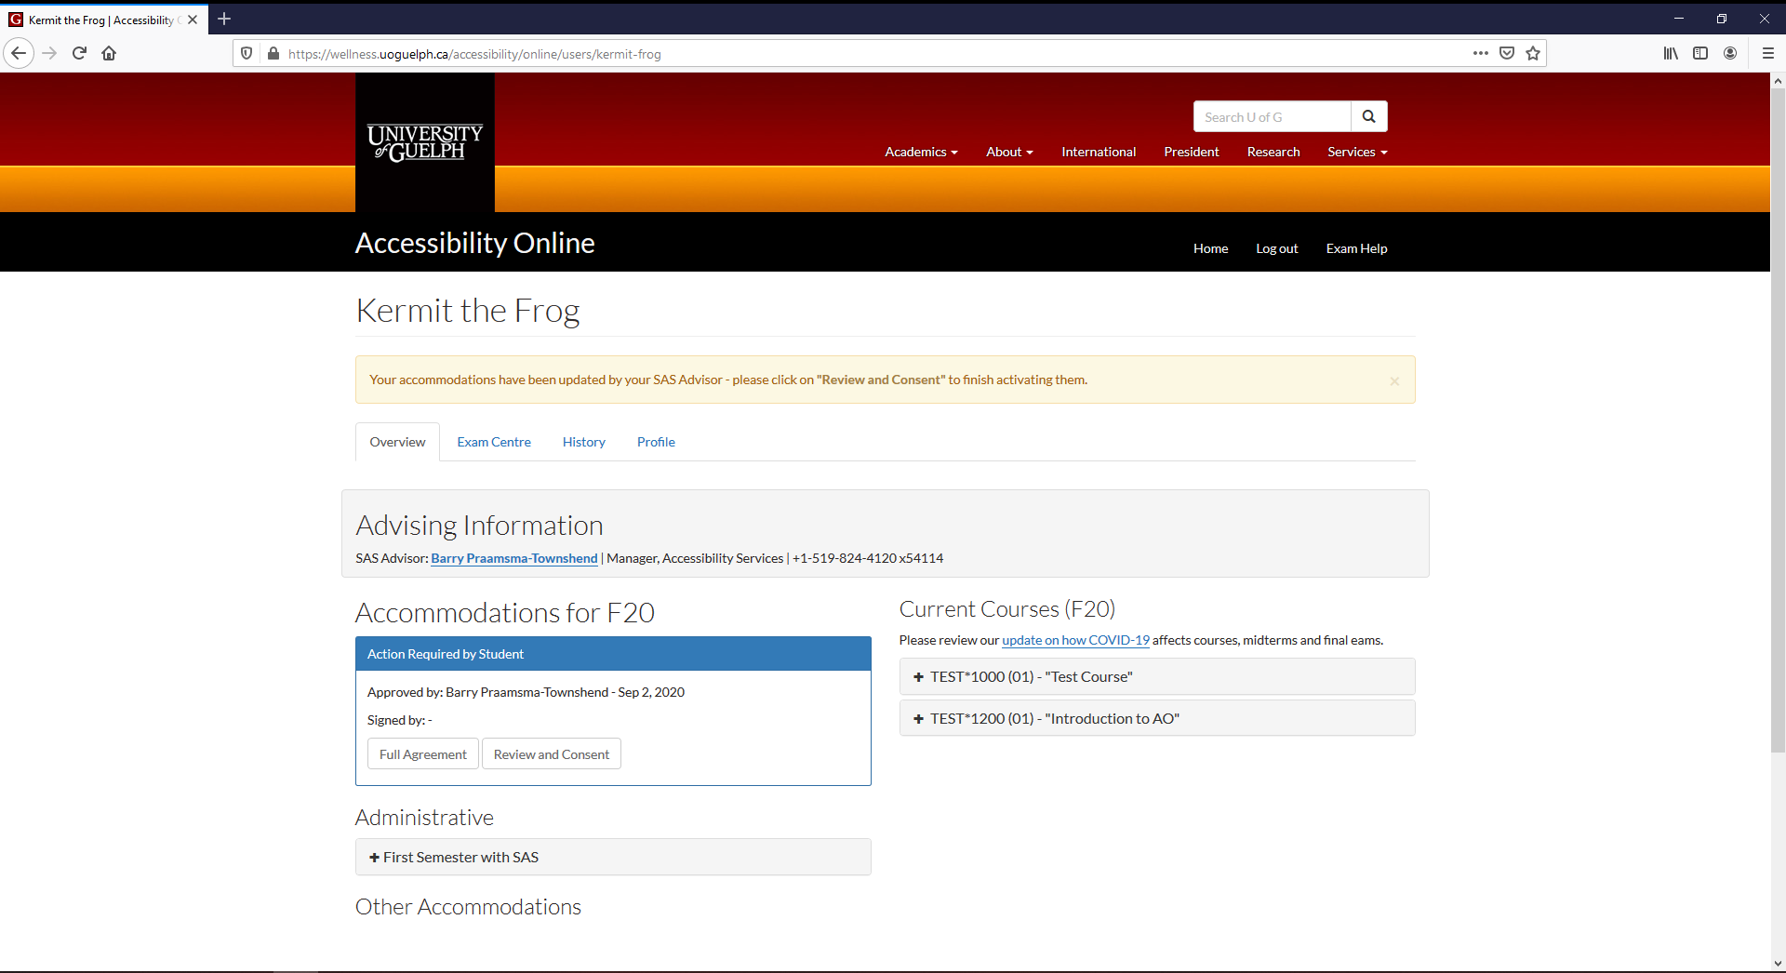
Review & Consent
Notes:
After your advisor has approved your accommodations for the semester, you need to “review and consent” on Accessibility Online. This ensures you know how your accommodations work.

Slide 12
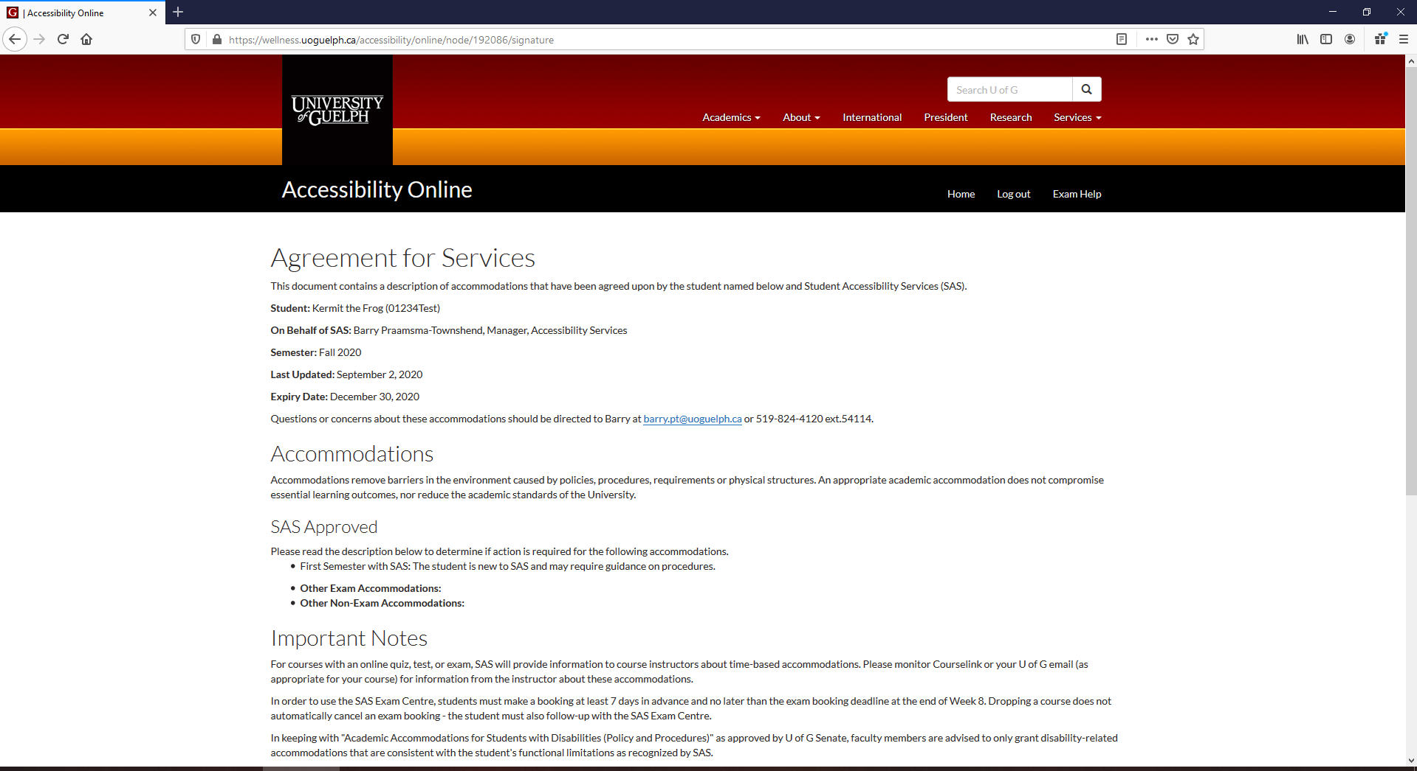
Review & Consent
Notes:
We’ve tried to use simple language to explain how your accommodations work.

Slide 13
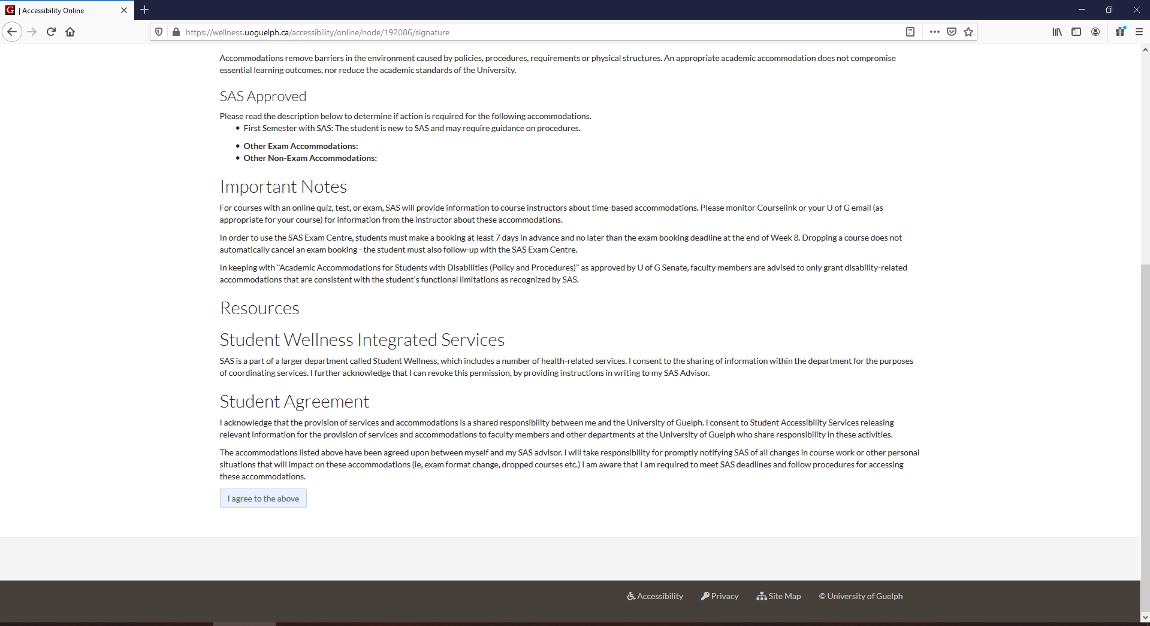
Review & Consent
Notes:
Once you have reviewed your accommodations, click on “I agree to the above” at the bottom.

Slide 14
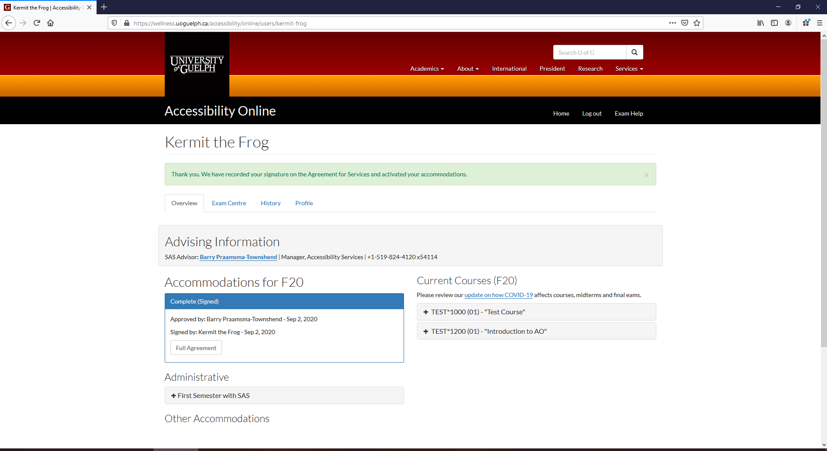
Review & Consent
Notes:
Once you have agreed, you’ll get a confirmation message (green box). You can always go back and review all of the details by clicking on “full agreement”.

Slide 15
Semester Request
At the start of every semester, you must renew your accommodations.
Has anything changed? Disability? Academic requirements?

Slide 16
Online Quizzes, Tests & Exams
Exam Centre Key Info
Notes:
Most courses use CourseLink for online quizzes, test and exams. However, there are some courses that use a different platform. Your instructors will provide you with specific information for each of your courses. This section deals specifically with those that use CourseLink. Note that some CourseLink tests and exams use virtual proctoring software called “Respondus” and this section deals with this too.

Slide 17
Exam Booking
14 days in advance AND no later than November 1
Guide to booking exams

Slide 18
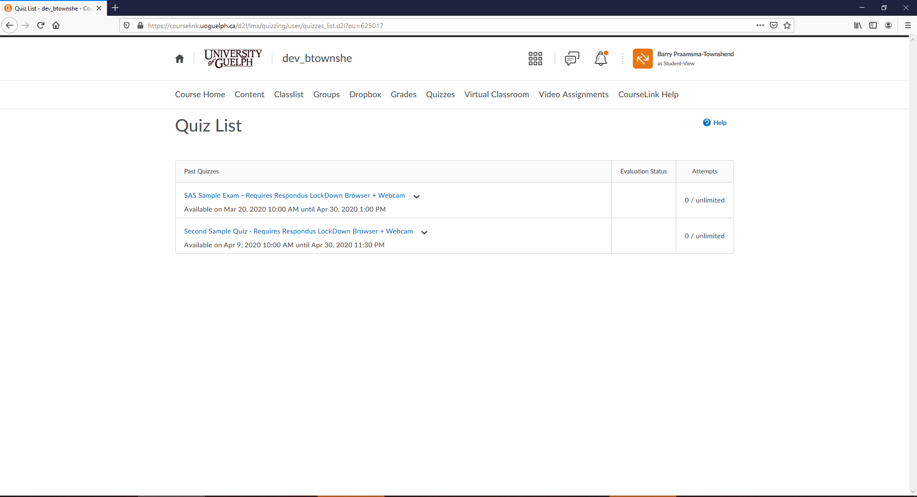
CourseLink Quizzes
Notes:
Click on the “quizzes” button in the horizontal toolbar. Then click on the test or exam you want to start.

Slide 19
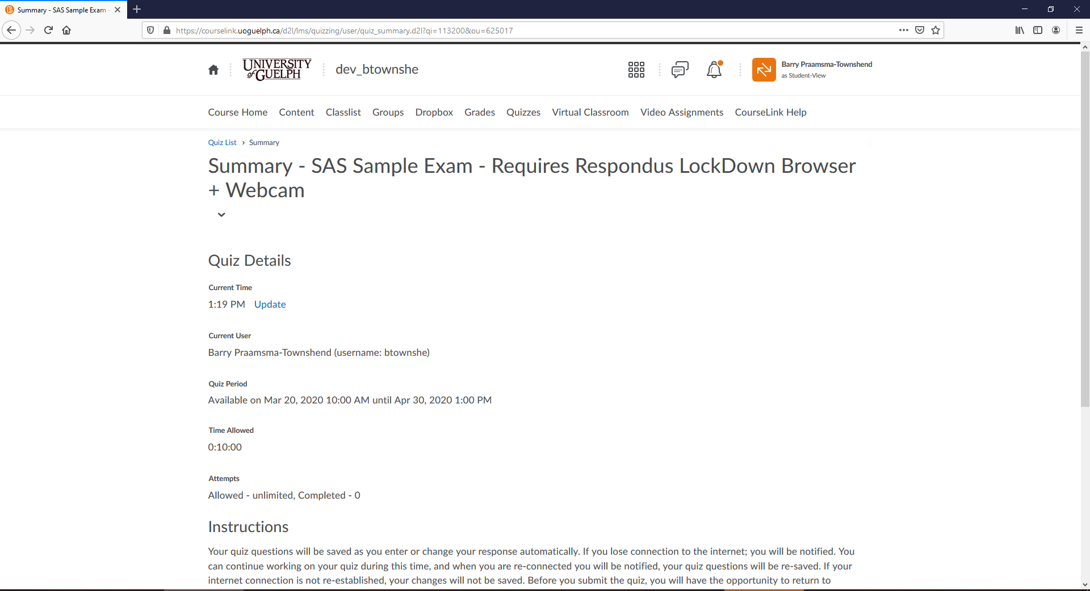
CourseLink Quizzes
Notes:
The “quiz period” tells you when it will be available to you. The “time allotted” shows how much time you have to write. If you have time-based accommodations, this will be reflected here.

Slide 20
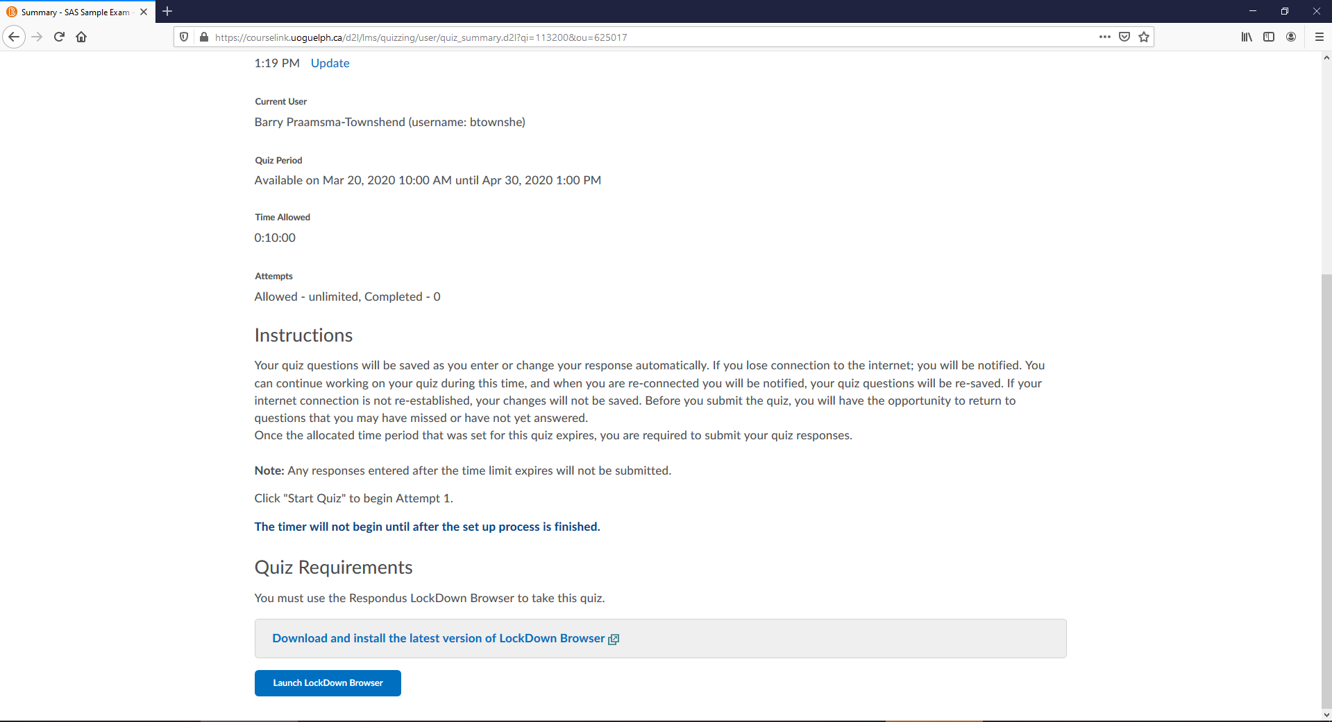
CourseLink Quizzes
Notes:
For Respondus, there is a set-up process. Your time won’t start until you’ve done the setup process. If your prof provides you with a sample quiz, do that ahead of time so that you are comfortable with the setup.

Slide 21
How do Profs Know?
SAS Exam Centre will provide information to instructors about which students require time-based accommodations.
Instructor requests list from SAS Exam Centre
Exam centre provides list to instructor about a week ahead of the test/exam.

Slide 22
Breaks: Online Exams
Stay within the field of view of your camera
Talk with your SAS advisor if you need something more
Notes:
If the exam uses Respondus, you must stay within the field of view of your webcam.

Slide 23
Practical Stuff: Note Taking

Slide 24
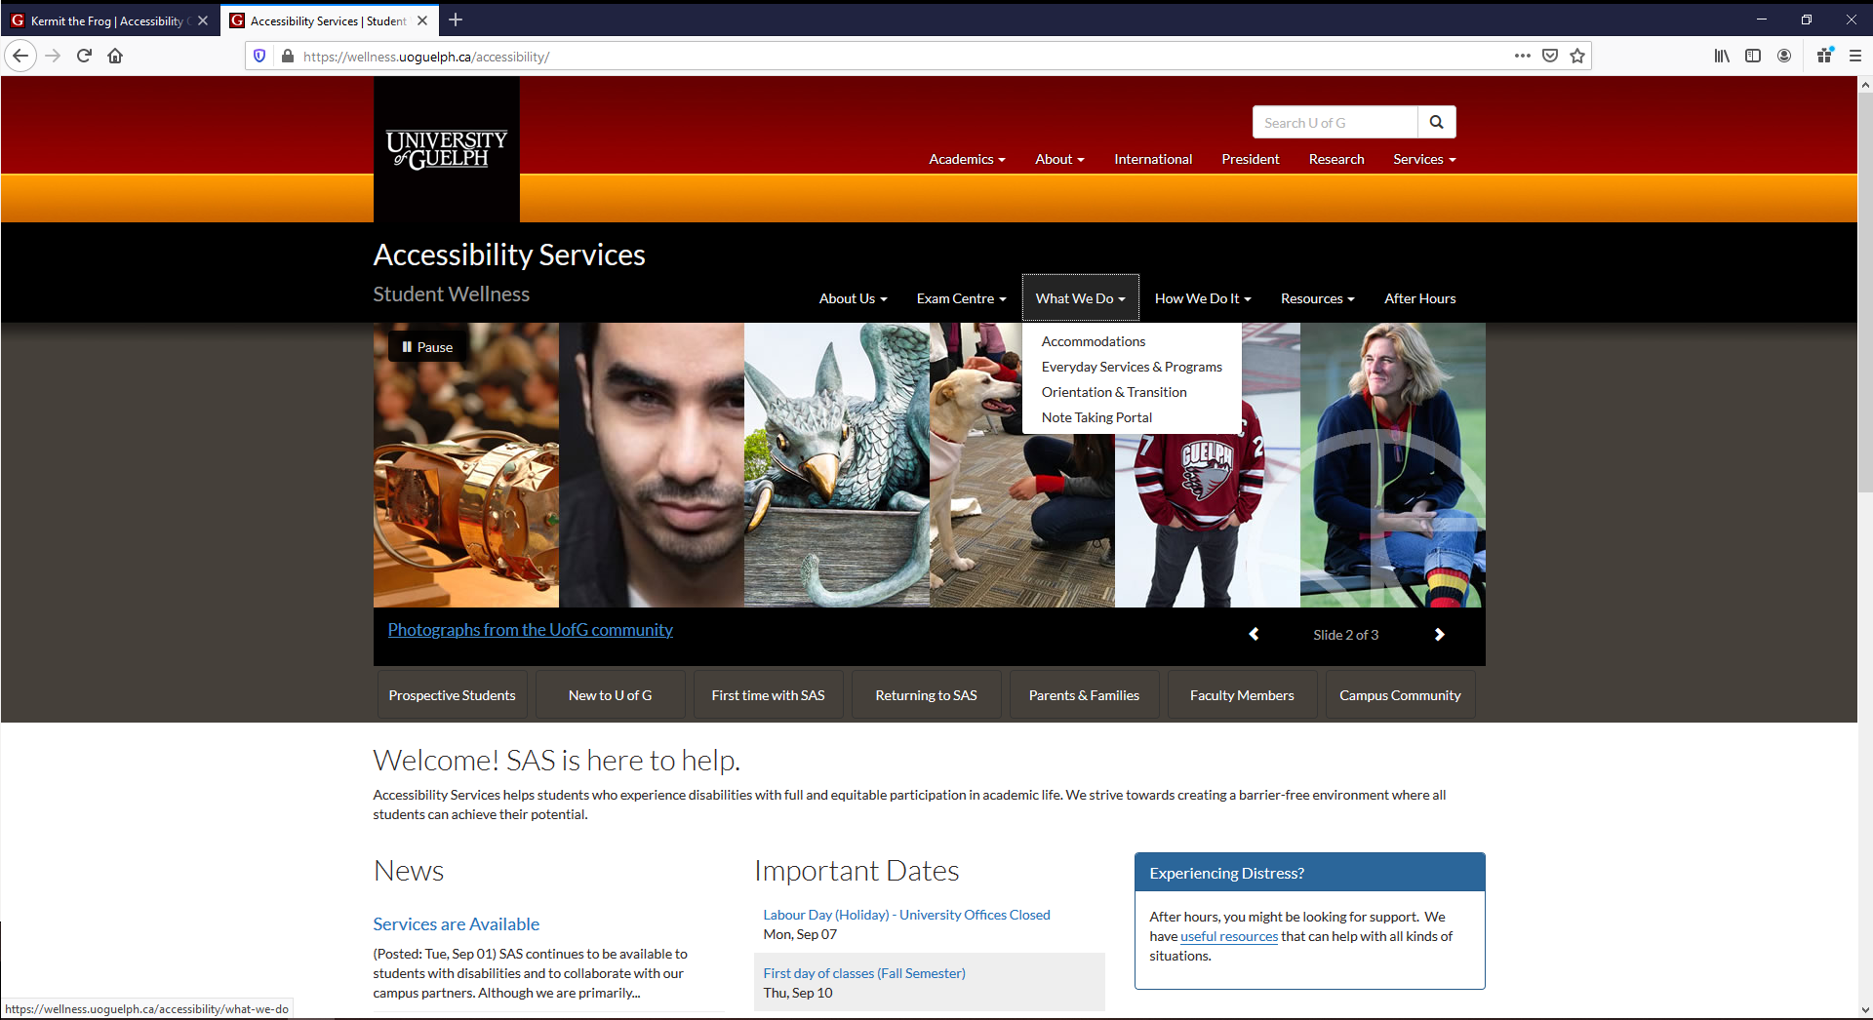
Note Taking Portal
Notes:
A link to the Note Taking Portal can be found in the “what we do” menu on the SAS website. Email sasnotes@uoguelph.ca if you need assistance.

Slide 25
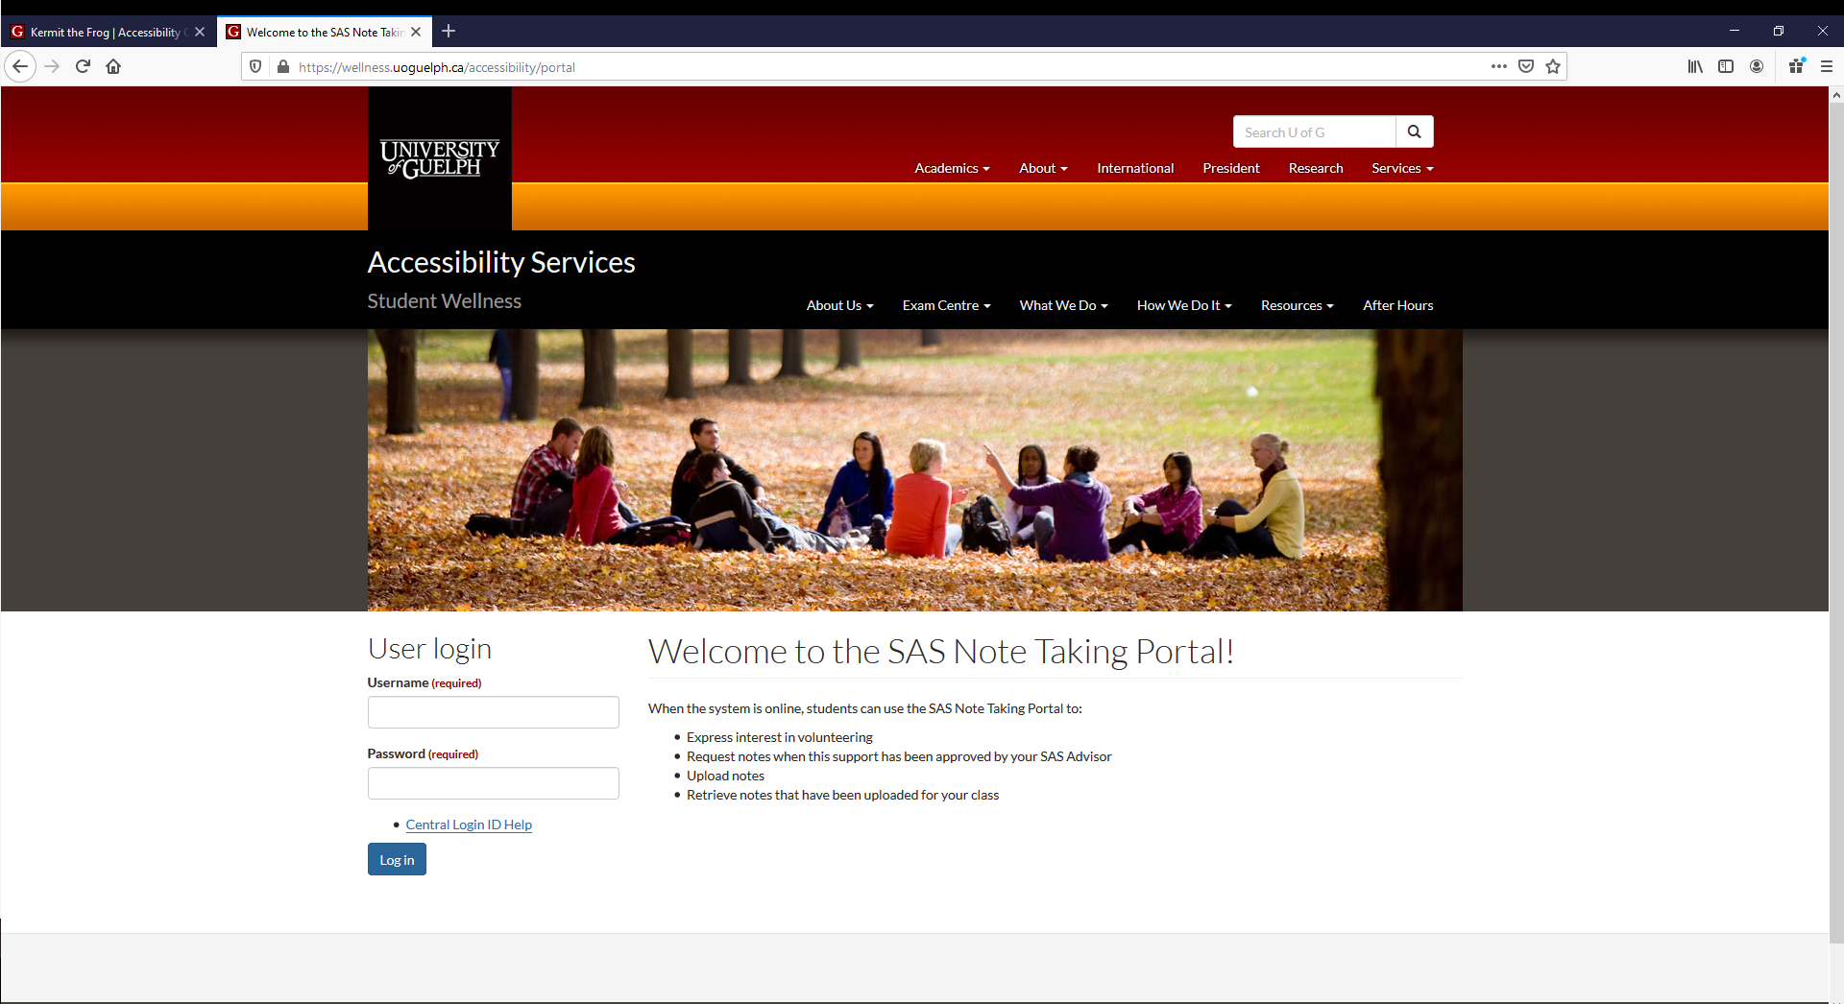
Note Taking Portal
Notes:
Login using your U of G central ID.

Slide 26
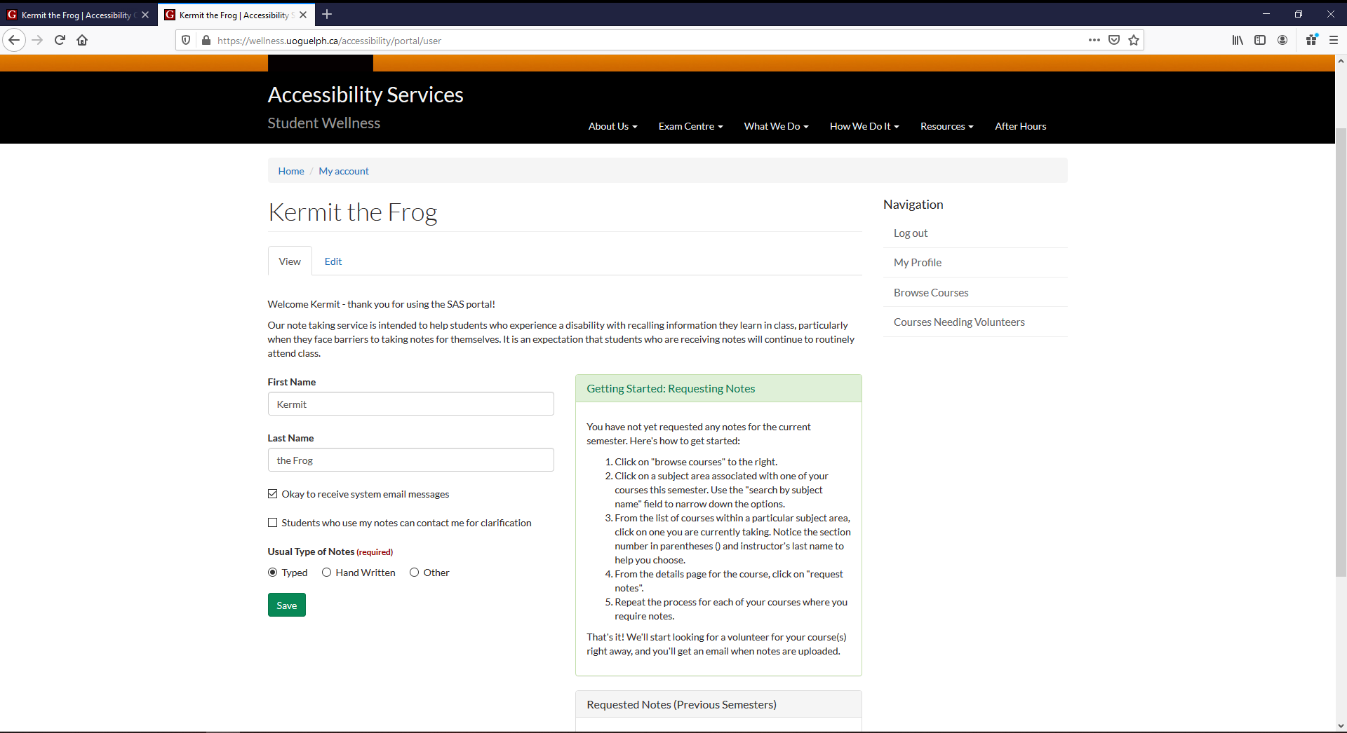
Note Taking Portal
Click here to visit
Starting on Sept 10
Notes:
Once you are setup to request notes, you’ll see a green box with step-by-step instructions on what to do. Start by clicking on “browse courses”

Slide 27
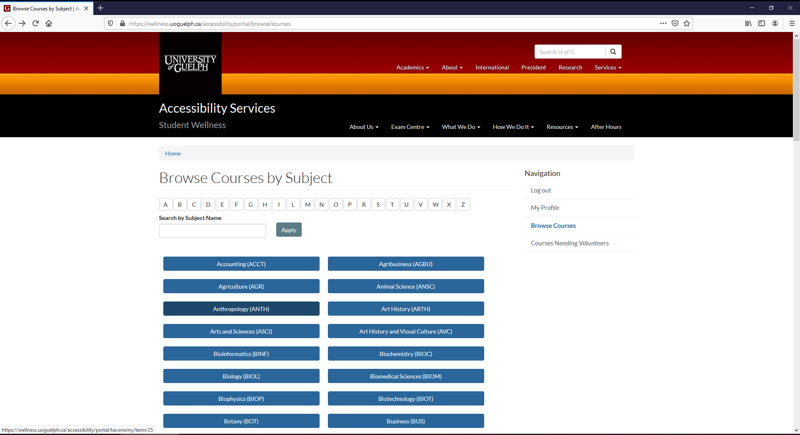
Note Taking Portal
Notes:
The list of subject areas is quite long. You can narrow it down by clicking on a letter. In this example, we click on the letter T.

Slide 28
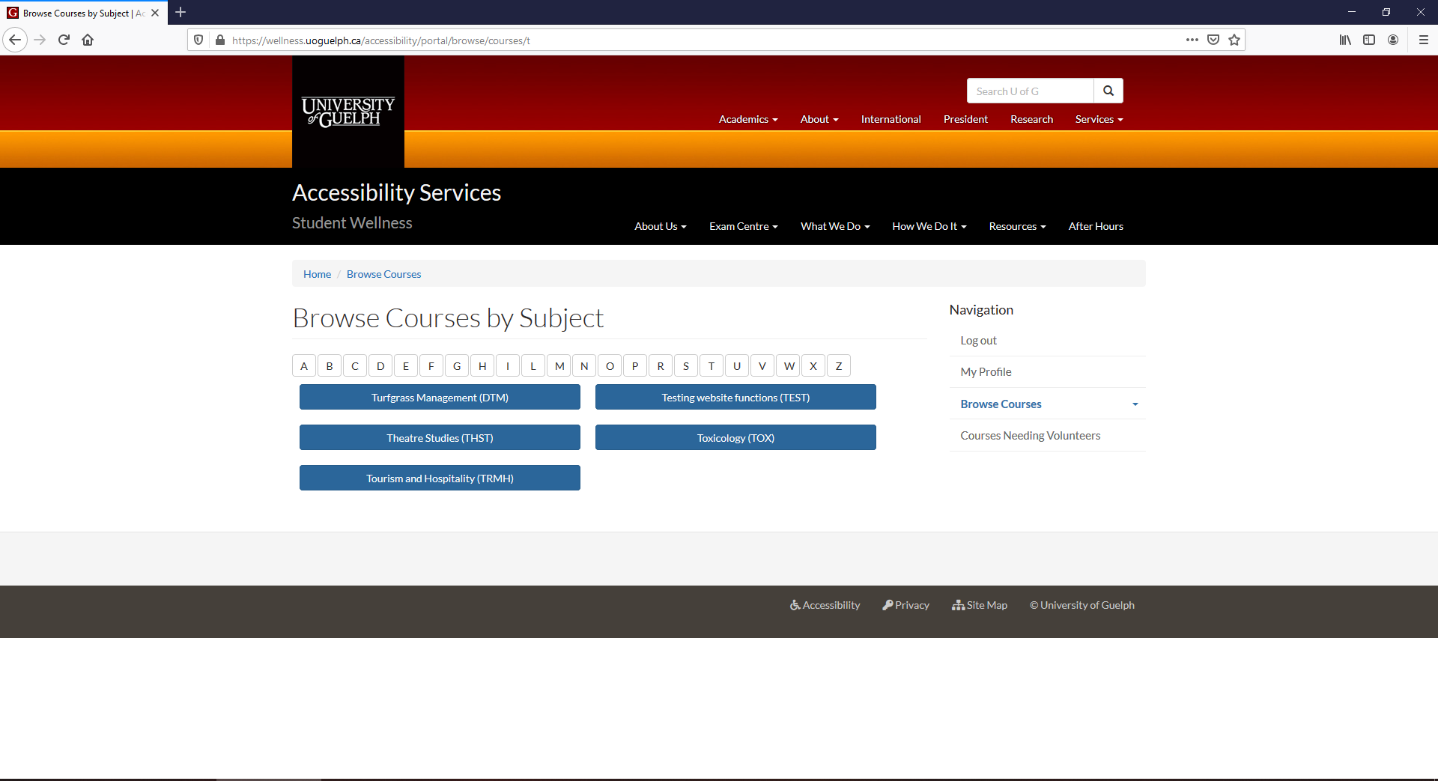
Note Taking Portal
Notes:
Chose the subject area. In this example, we click on “TEST”.

Slide 29
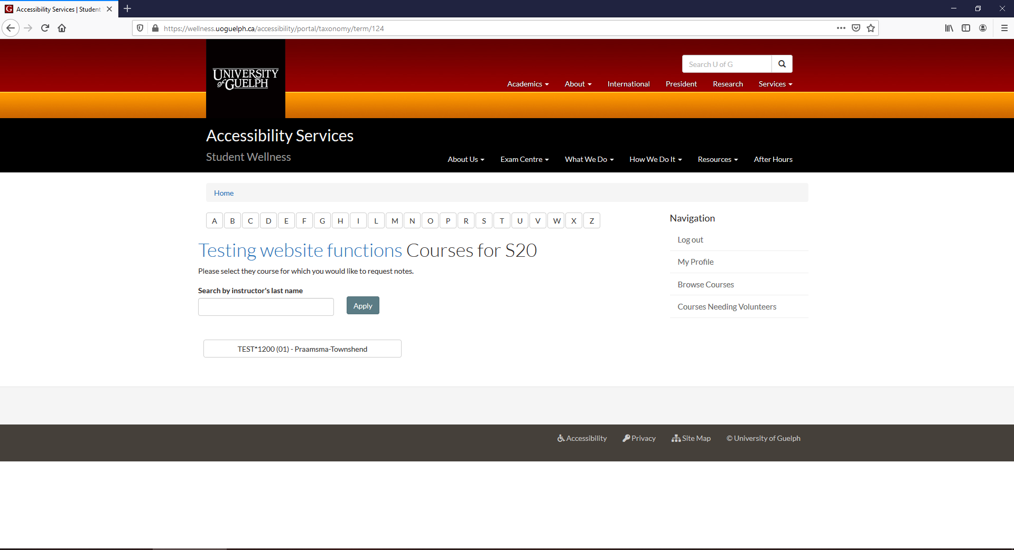
Note Taking Portal
Notes:
Select the specific course for which you need notes.

Slide 30
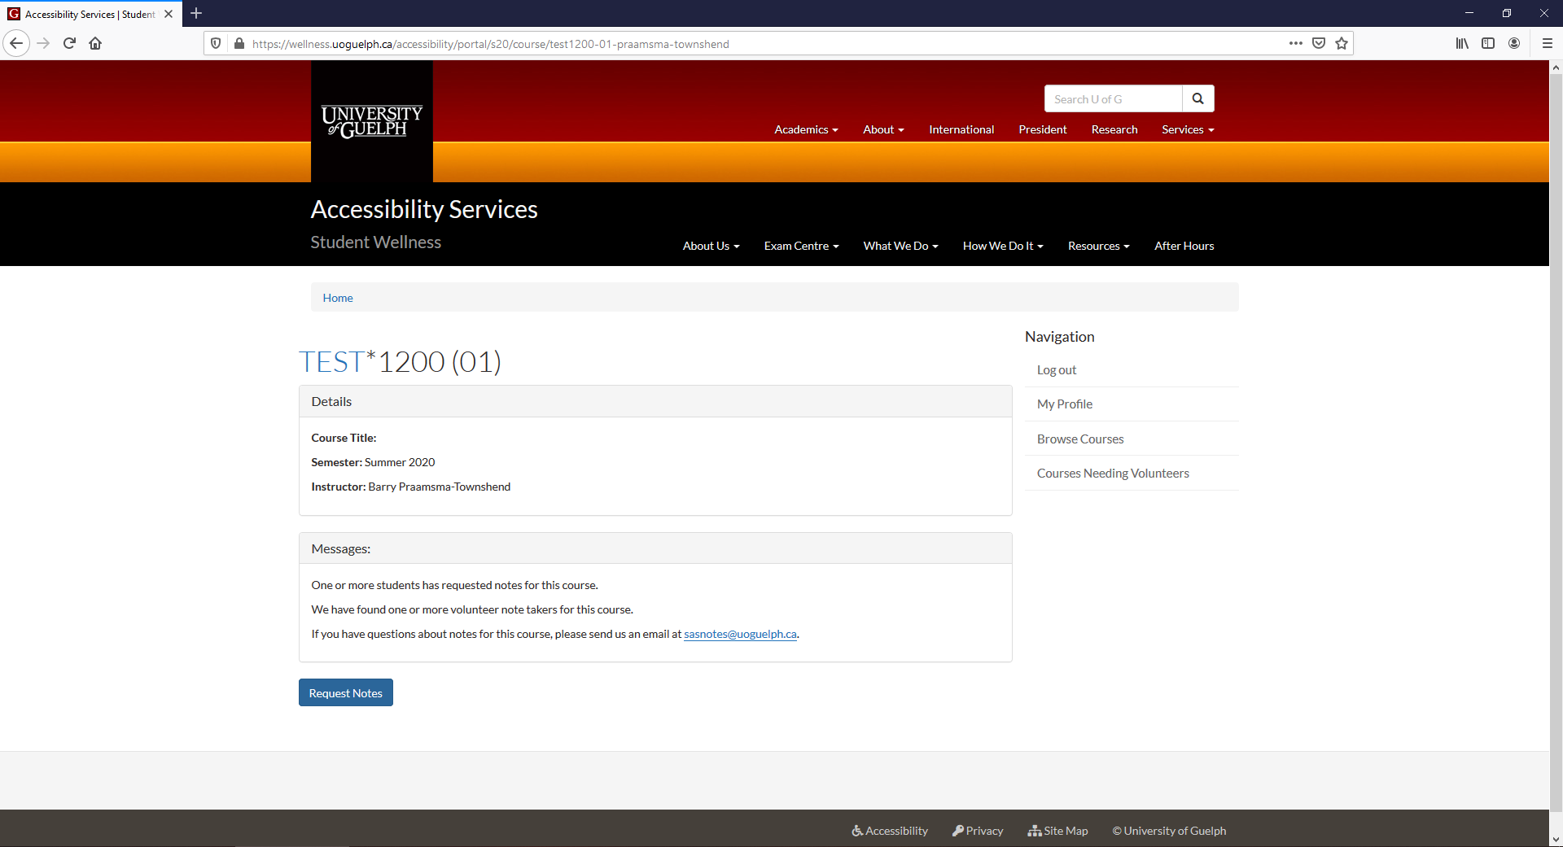
Note Taking Portal
Notes:
Click on the blue button labeled “Request Notes”.

Slide 31
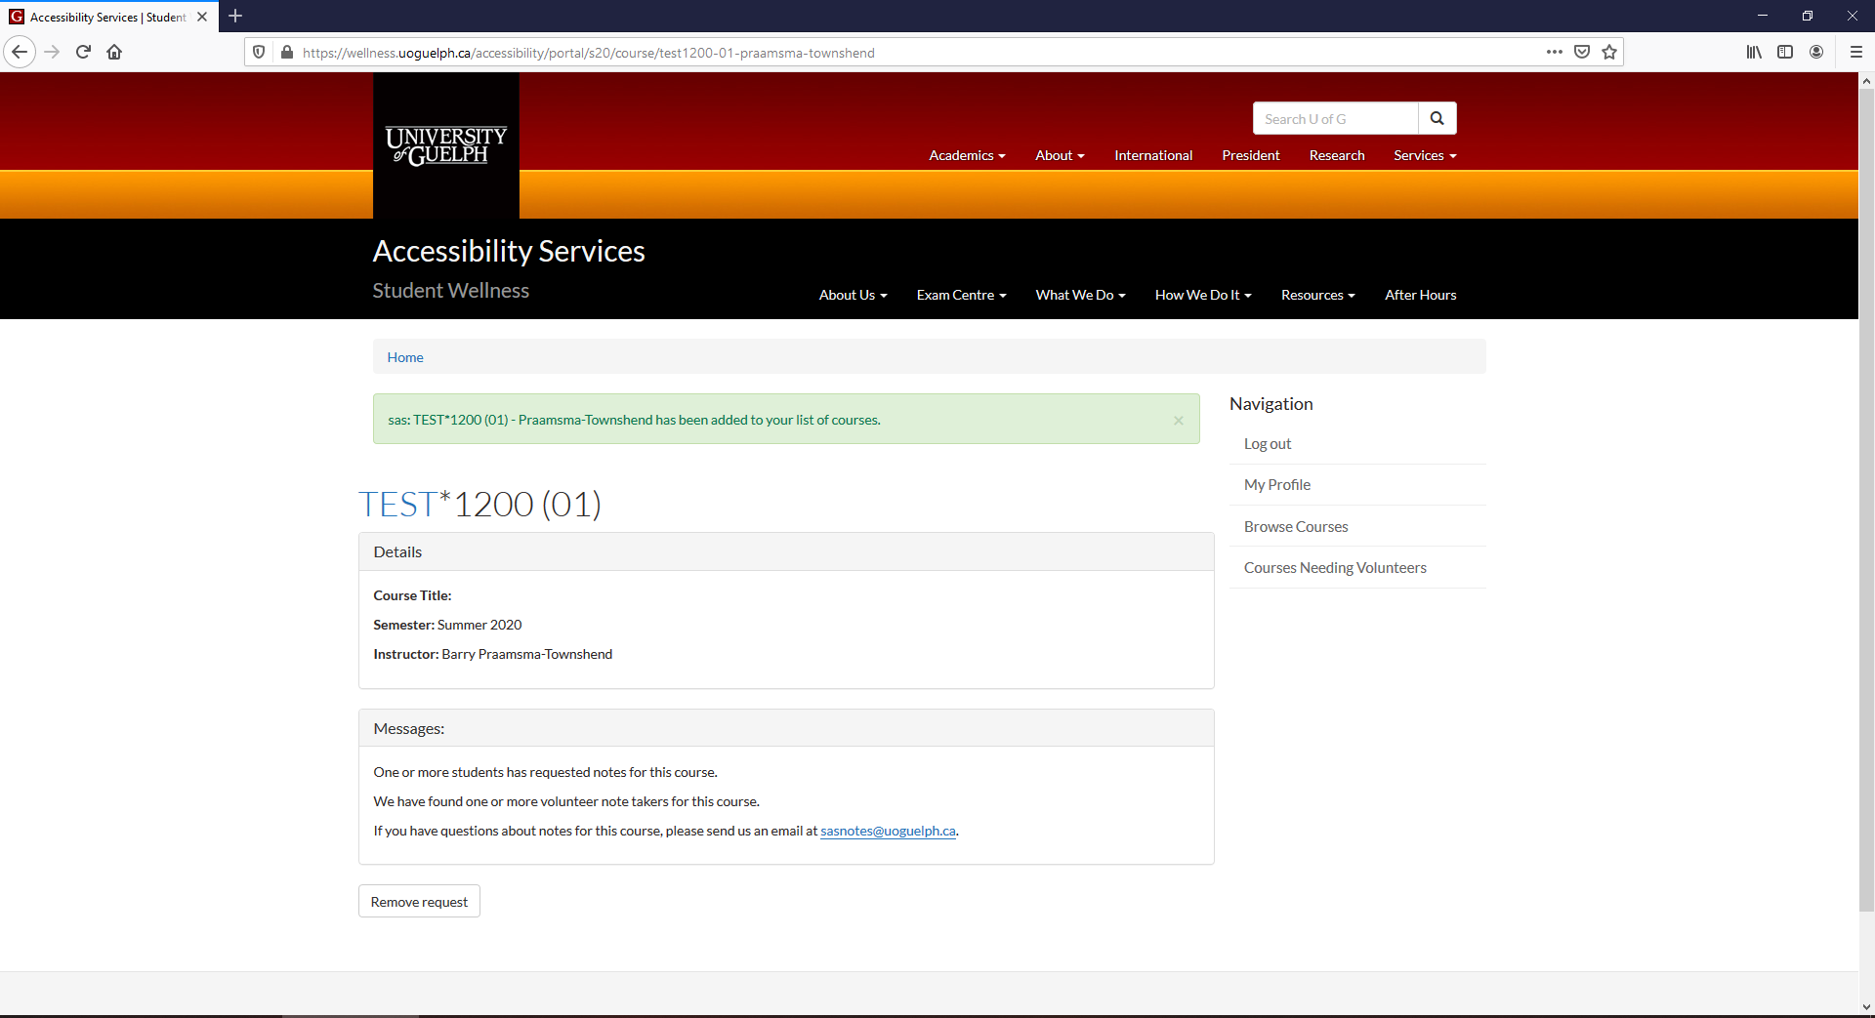
Note Taking Portal
Notes:
You’ll see a confirmation message showing that you’ve requested notes for this course. You can request notes for another course by clicking on “browse courses” again.

Slide 32
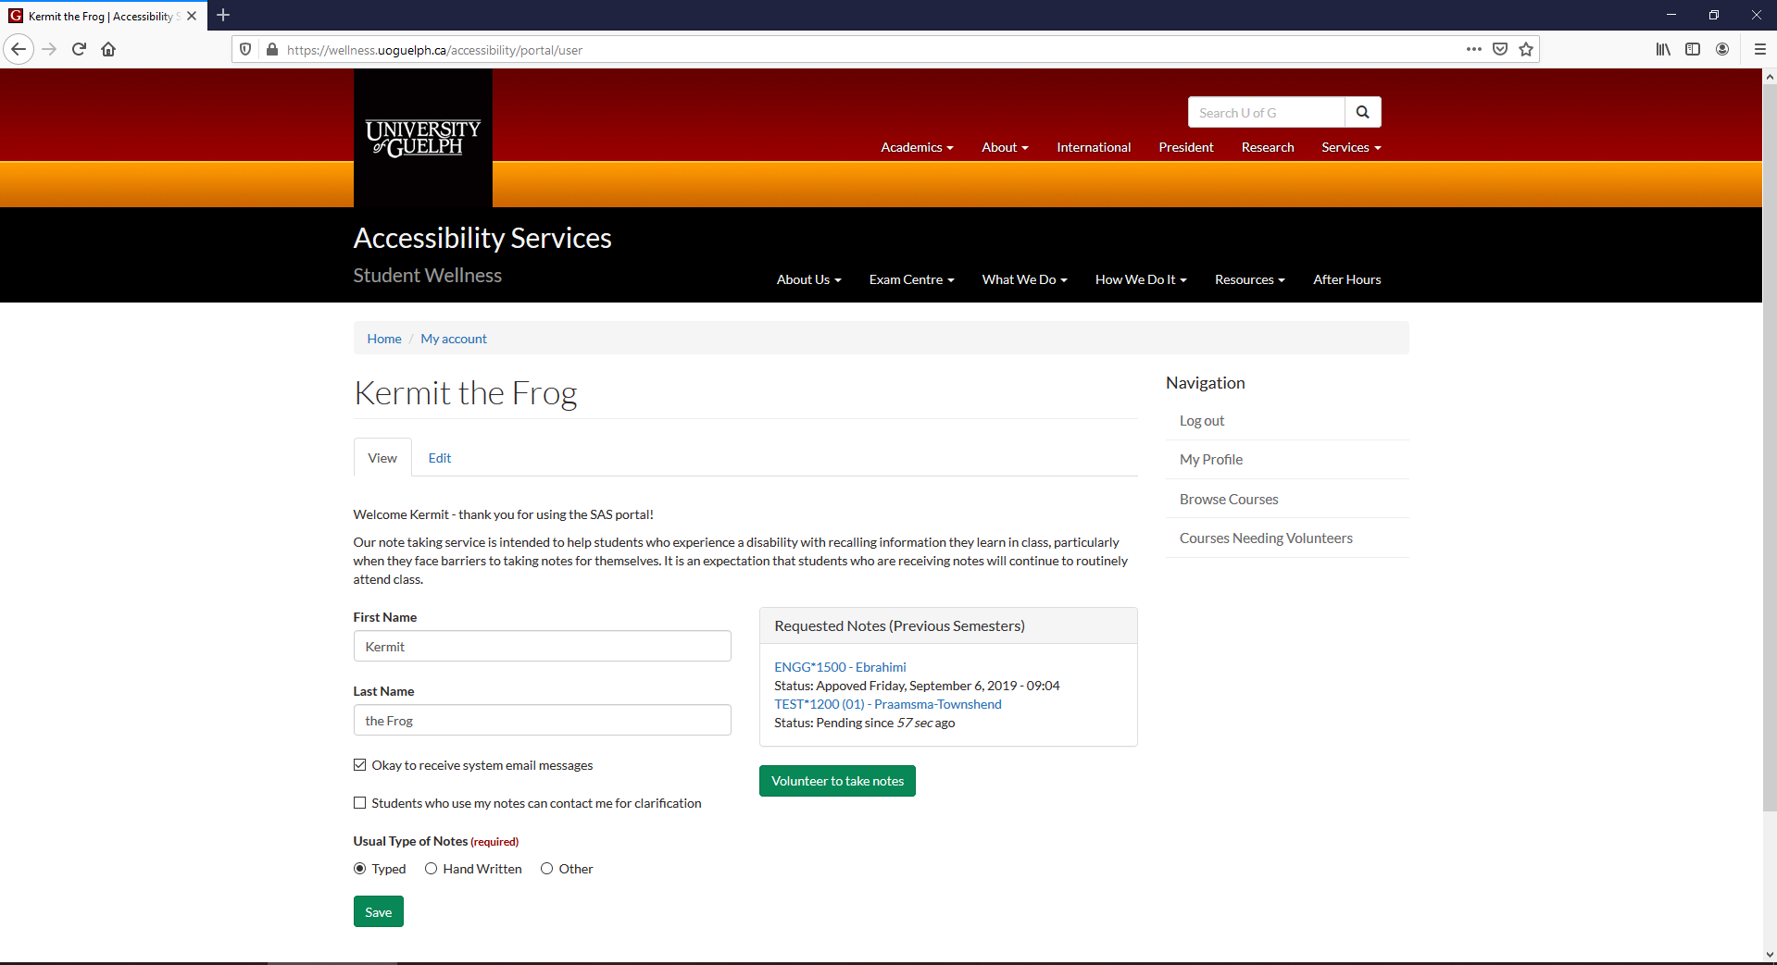
Note Taking Portal
Notes:
Requests for notes are approved by the Note Taking Office. Once approved, we’ll start searching for a volunteer to provide their notes. You can click on a course on your homepage once you’ve logged in to view the course details.

Slide 33
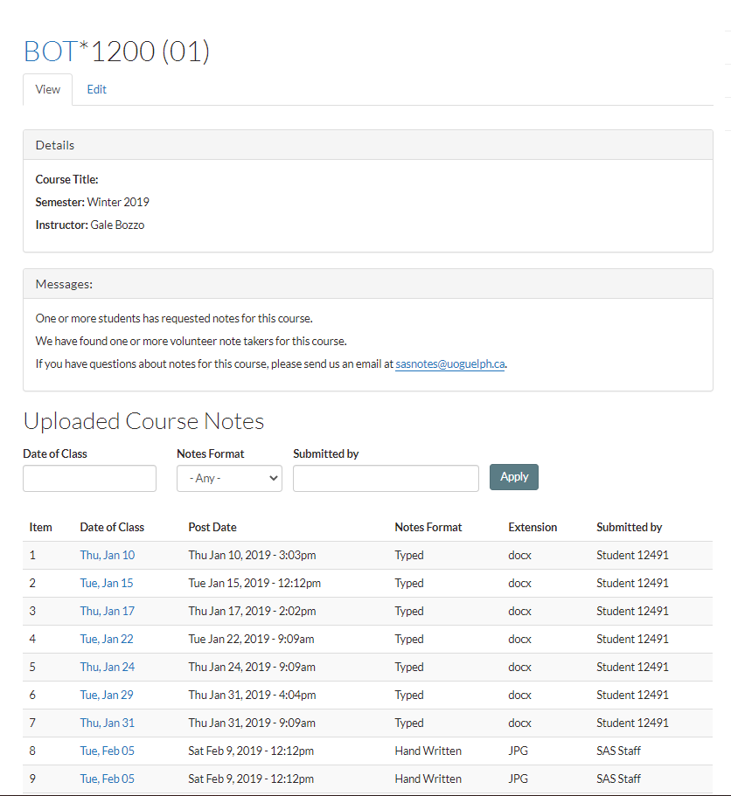
Note Taking Portal
Notes:
Notes that have been uploaded are visible on the course details page.

Slide 34
Other Considerations

Slide 35
Reduced Number of Courses
It is normal for lots of students
Decide by the end of the “add period” (first Friday)
Talk with your SAS Advisor about implications

Slide 36
Extended Absences
Missed opportunity for discussion or hands-on learning
Academic work is both (a) intellectual and (b) interactive
Important to have realistic expectations of what you can achieve under the circumstances.
Notes:
Sometimes the best option to make up for missed learning opportunities is to take the course at a later date.

Slide 37
Plan Your Semester
4-month planner
You’ll need your course outlines
Virtual workshop with anonymous option
Details on our homepage
Notes:
Normally we offer a workshop to help with planning out your semester, but this time we’re offering 1-on-1 meetings. Everyone needs to map out their assignment deadlines and exams for the whole semester. This is essential for managing your time efficiently.

Slide 38
Working Together

Slide 39
Course Outlines
Authoritative for academic requirements
Help us help you.

Slide 40
Appeal Mechanisms
You can ask
Information on our website
Depends on who is the decision-maker

Slide 41
wellness.uoguelph.ca /accessibility
Contact Information

