Slide 1
SAS Student Portal Agreements & Consents
Student Accessibility Services

Slide 2
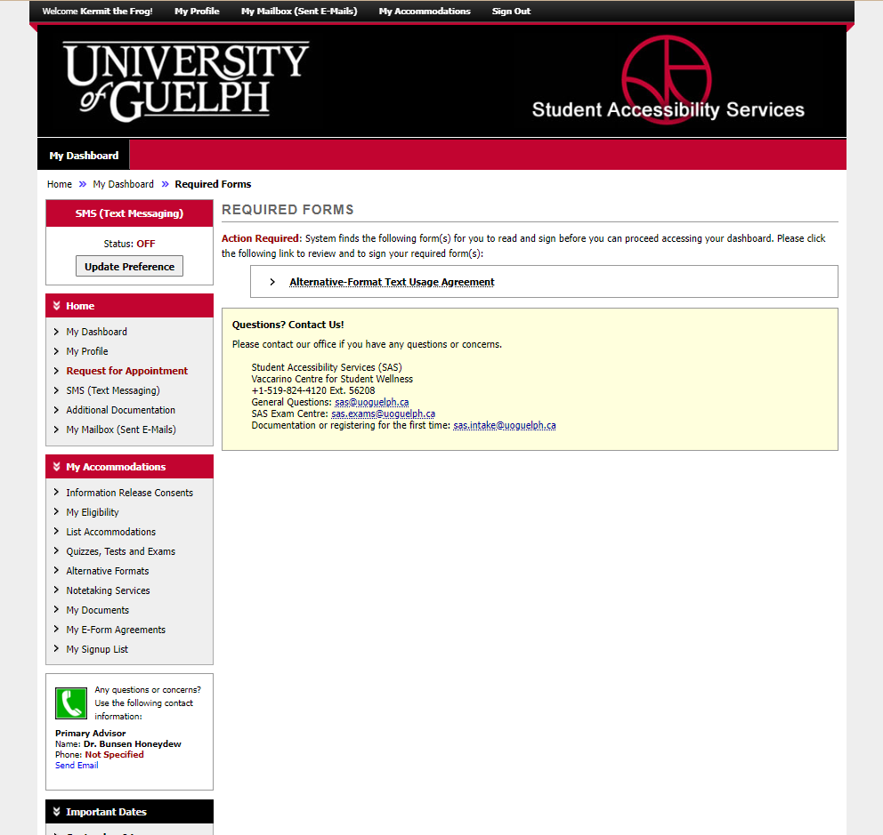
Notes:
Sometimes when you login, you’ll be prompted with one or more “required forms”. You will see this before you end up on your dashboard.

Slide 3
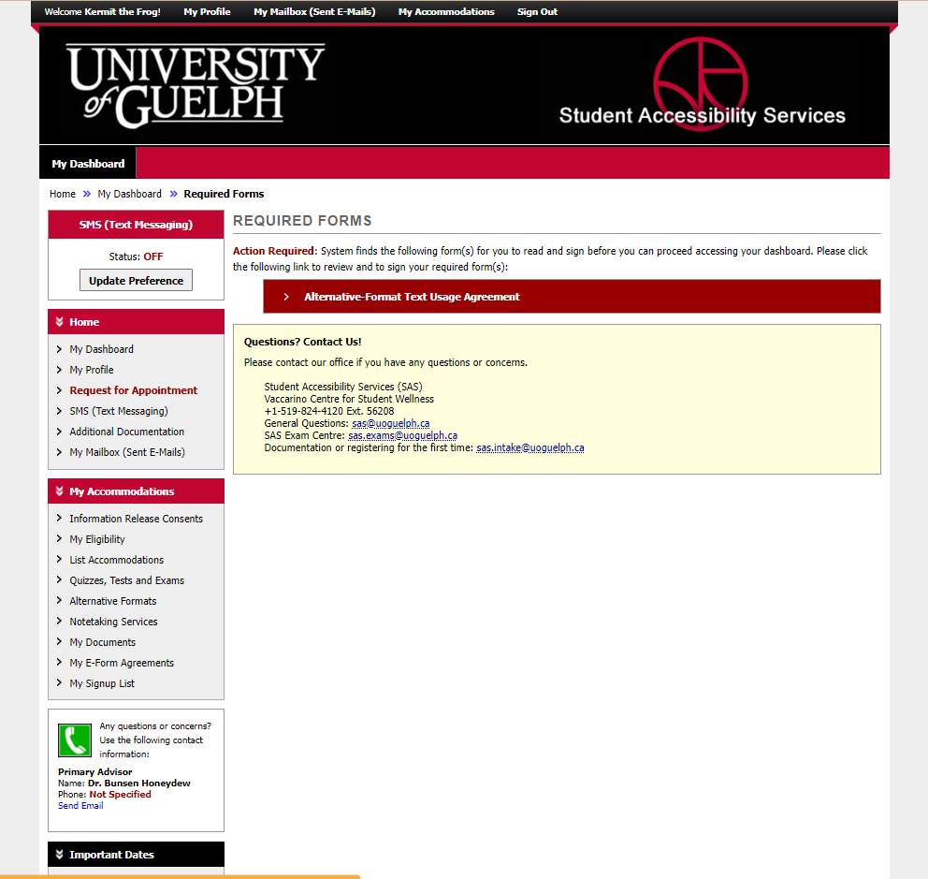
Notes:
Click on the name of the consent form to expand it and read the contents.

Slide 4
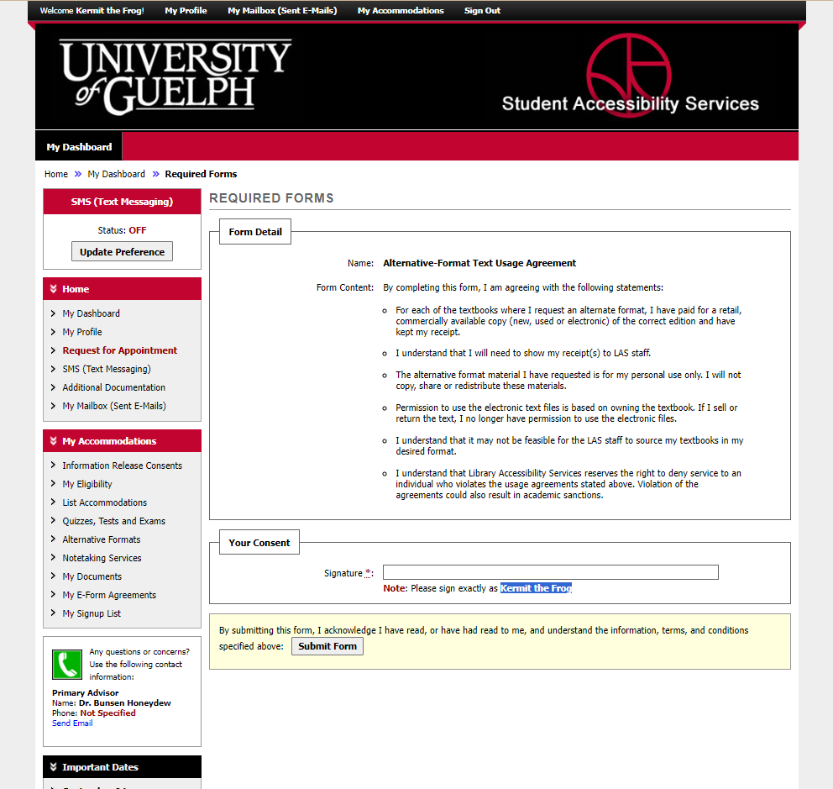
Notes:
When you have read the information, put your name in the “signature” box.

Slide 5
Notes:
Your signature must exactly match your name in the system, which is below the field. If you have problems, try copying and pasting.

Slide 6
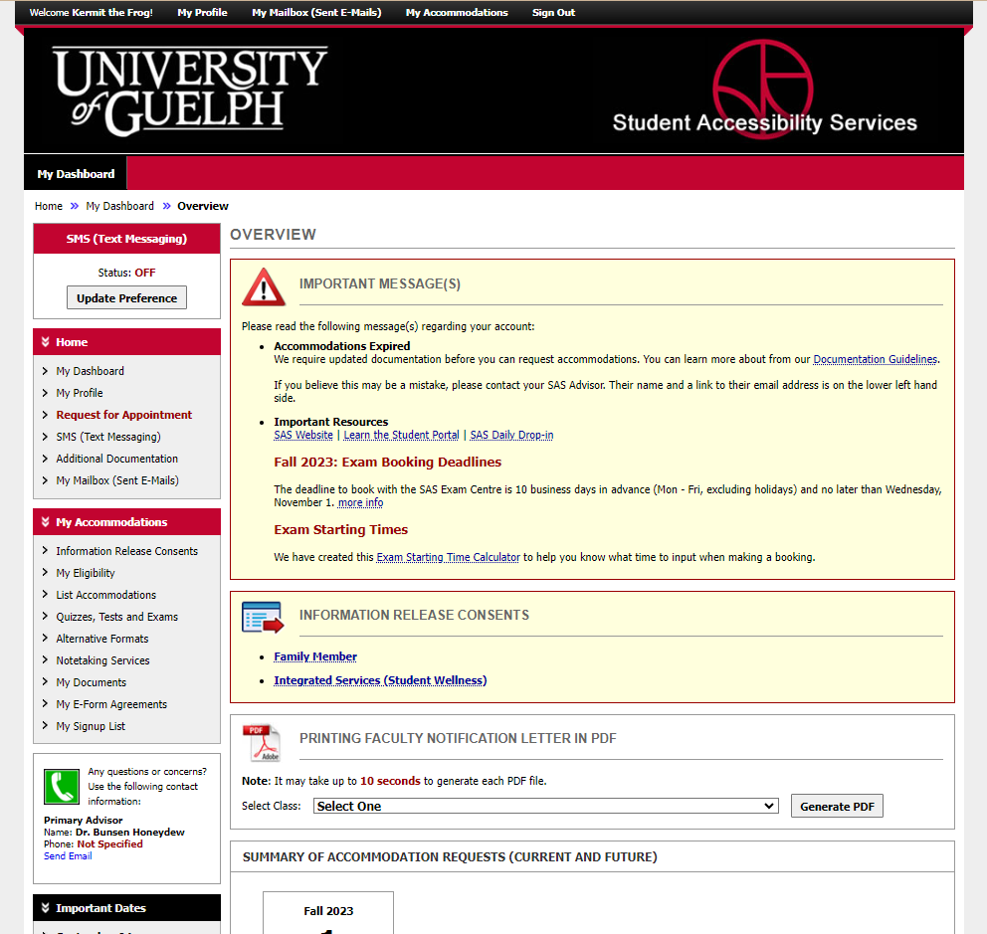
Notes:
Once you have successfully completed the form, you’ll be brought to your dashboard. Some forms need to be signed once a year, and others once a semester. You can review them by clicking on “my e-form agreements.”

Slide 7
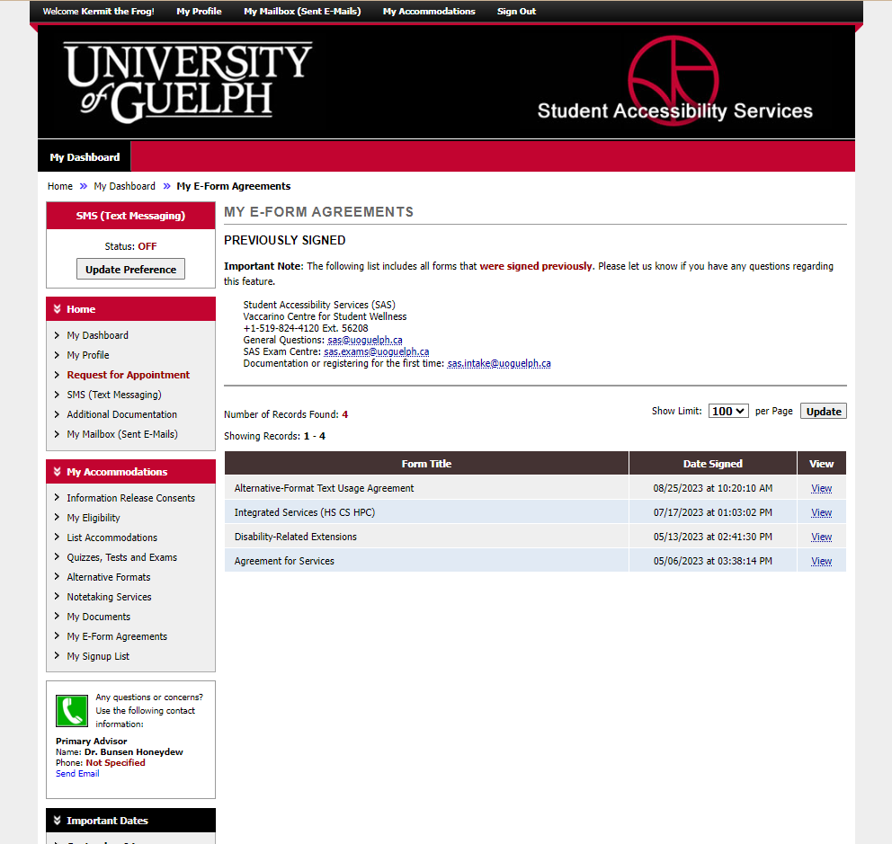
Notes:
You will then see a list of the agreements you’ve signed. Click on “view” next to any of them to review the details.

Slide 8
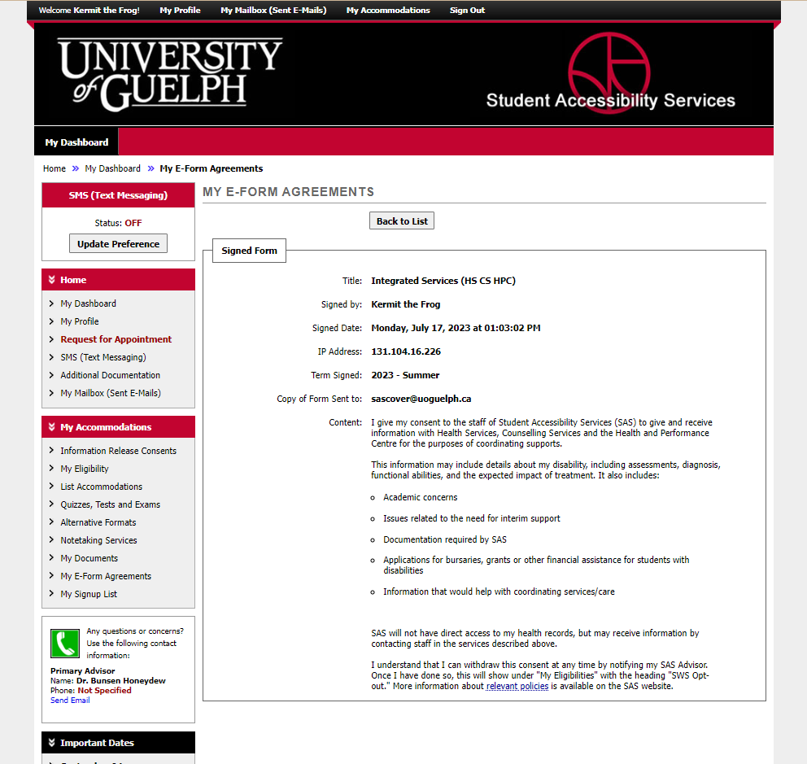
Notes:
Here are the details of the agreement we just signed.

Slide 9
Notes:
In some cases, you might want to give us permission to share information with a family member. Start by clicking on “Information release consents”.

Slide 10
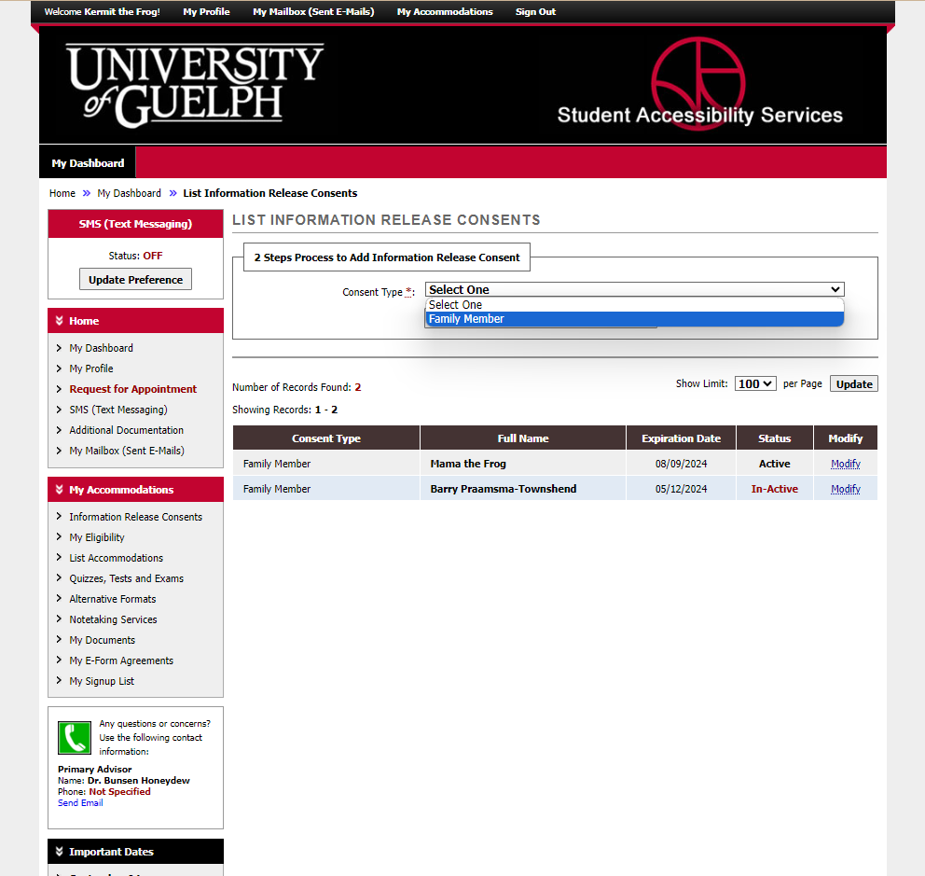
Notes:
Choose the consent type.

Slide 11
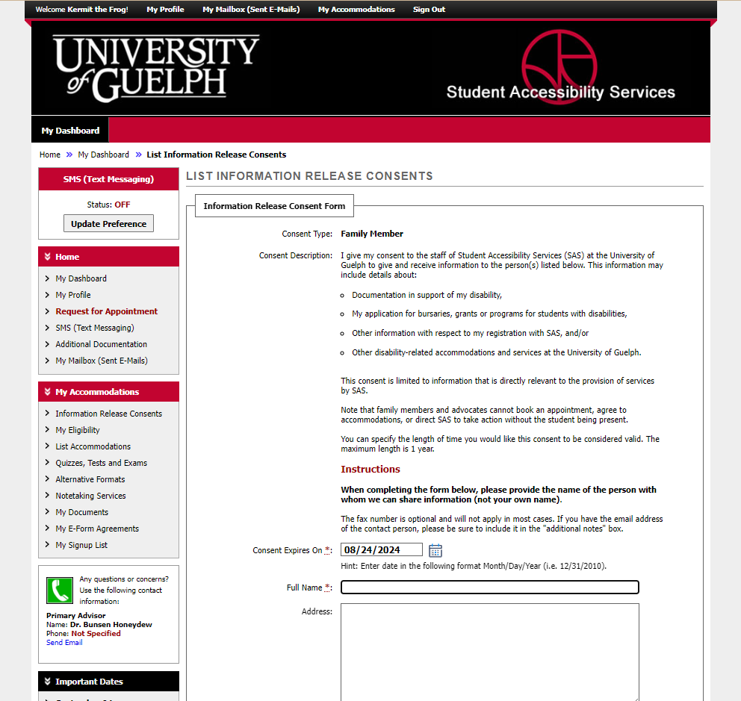
Notes:
Read through the information.

Slide 12
Notes:
By default, the form is dated for one year from the date you sign it. You can change it to anything you want, however, the maximum a form is considered valid for is one year.

Slide 13
The name of the person with whom we can share information, not your name!
Notes:
Provide the name of the person with whom we can share information.

Slide 14
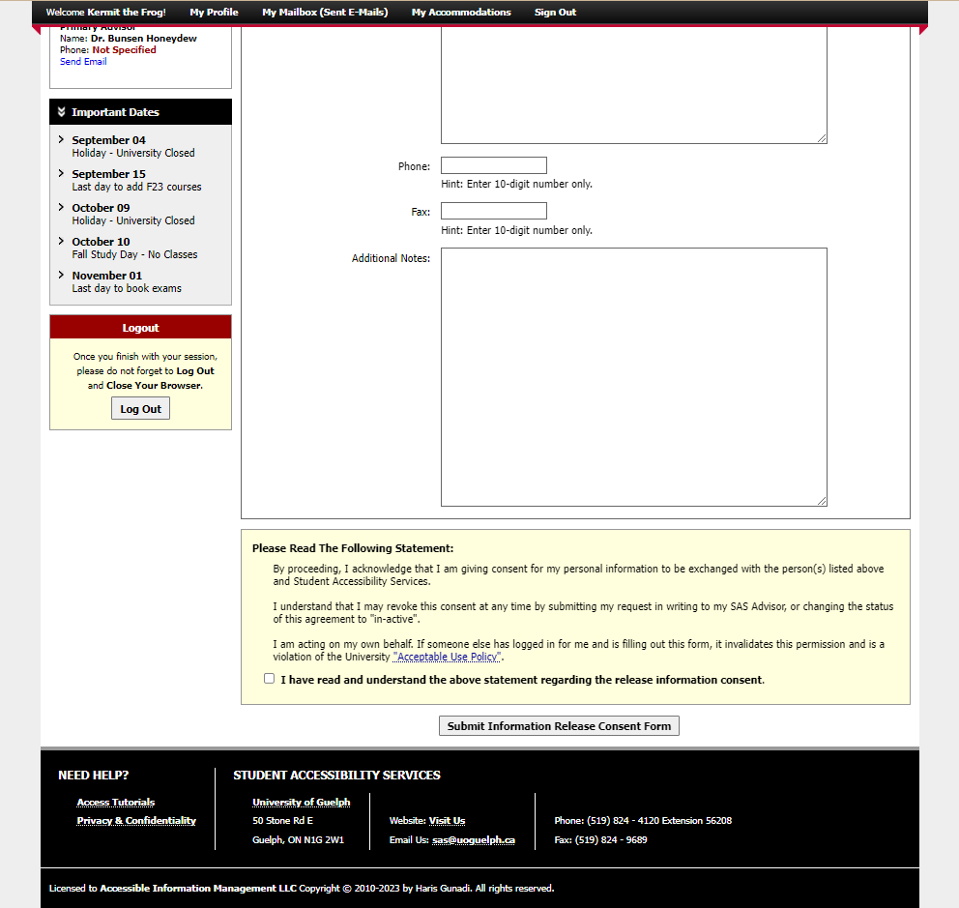
Notes:
It is important to provide the contact information for the person. Typically, a phone number and email address are sufficient.

Slide 15
Notes:
Make sure you read the final statements to acknowledge that you are giving us permission to share information. If you have shared your login information with a parent, family member or someone else, they should not sign this form on your behalf – this would be considered a very serious breach of university policy and there could be consequences for the student.

Slide 16
Notes:
Check this box to acknowledge the information.

Slide 17
Notes:
Click on the button that says “submit information release consent form”.

Slide 18
An Update is Coming
There will be some changes to colours and layout when the new version is released.
It will be mobile friendly and has some helpful new tools.
We don’t know the date yet.
When more information is available, it will be posted on the SAS website.

Slide 19
wellness.uoguelph.ca /accessibility
Contact Information

