Slide 1
SAS Student Portal Notetaking
Student Accessibility Services

Slide 2
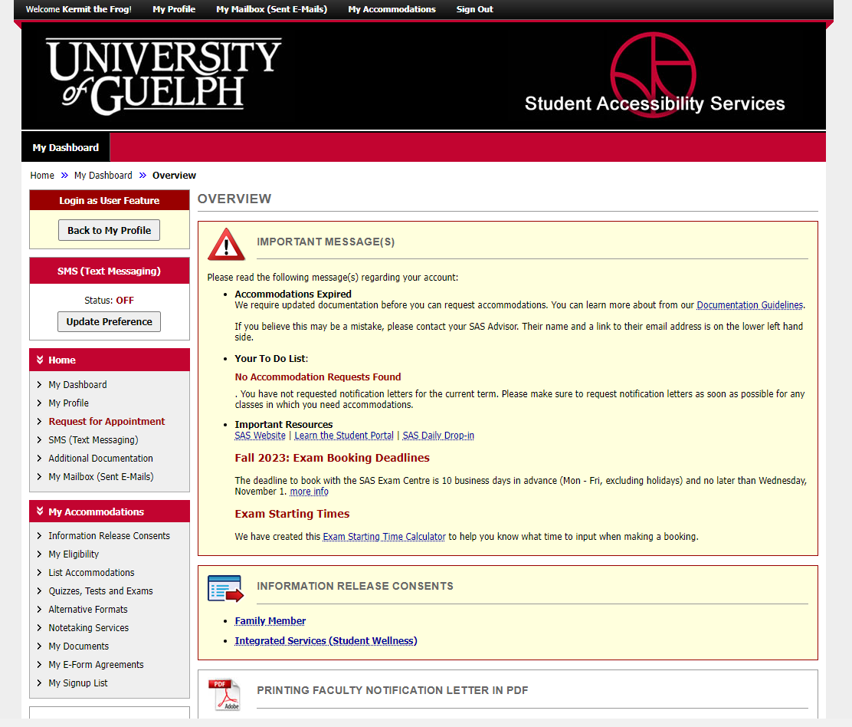
Notes:
This is the same dashboard you will always see when you login. In this video, I assume you have already requested your accommodations for the semester.
Under the heading, “My Accommodations” click on “Notetaking Services” in the navigation bar on the left.

Slide 3
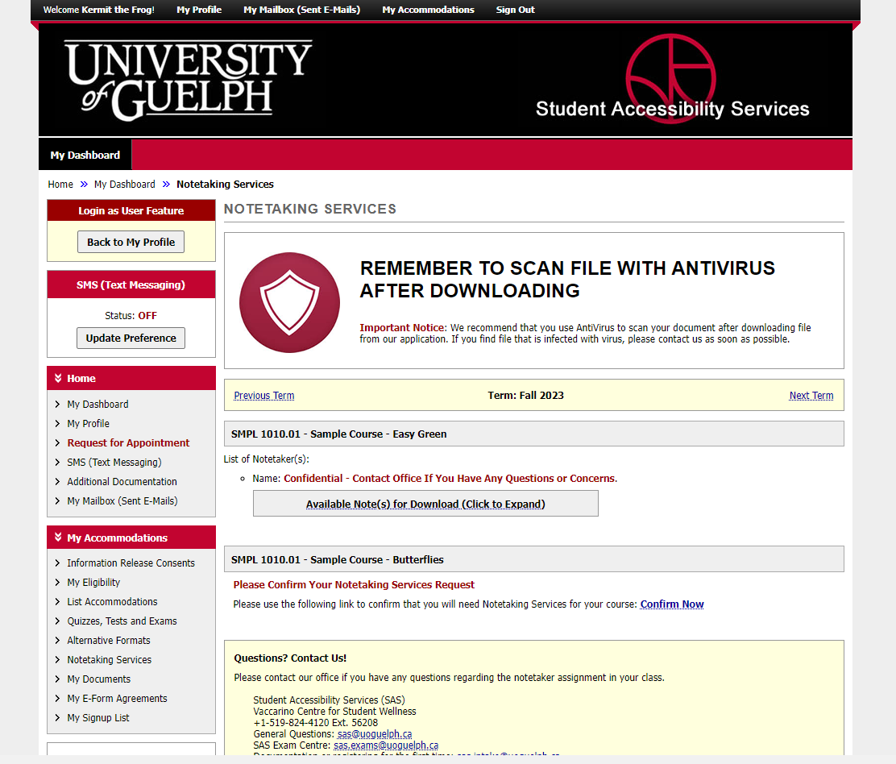
Notes:
Click on “Confirm Now” to indicate that you would like notes for this course.

Slide 4
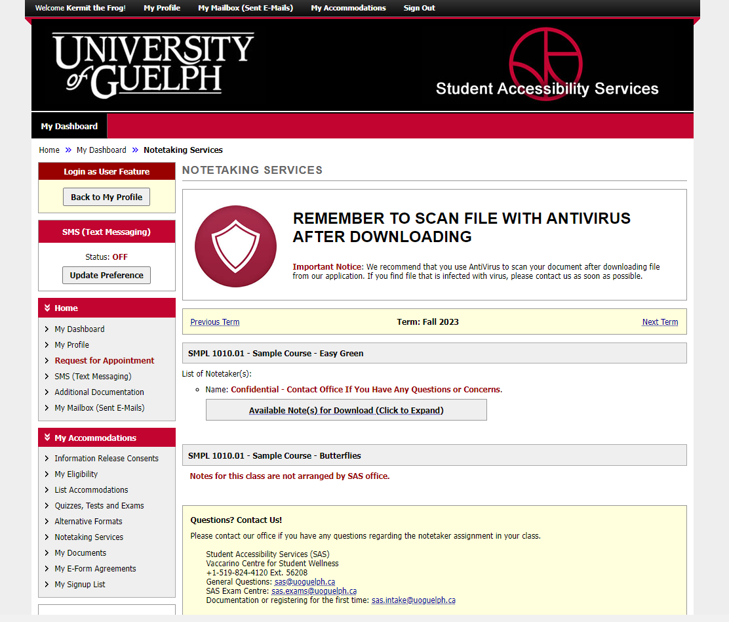
Notes:
You may occasionally see a message that says “notes for this class are not arranged by SAS Office”. Notetaking is specifically for lecture courses – distance education, seminars and hands-on learning are often not conducive to notetaking. Similarly, sometimes an instructor has made alternative arrangements such as putting detailed notes for each lecture on CourseLink. In any of these situations, if you are having difficulty accessing course content, please speak with your SAS Advisor.

Slide 5
Notes:
When we have notes, click on the “available note(s) for download” button.

Slide 6
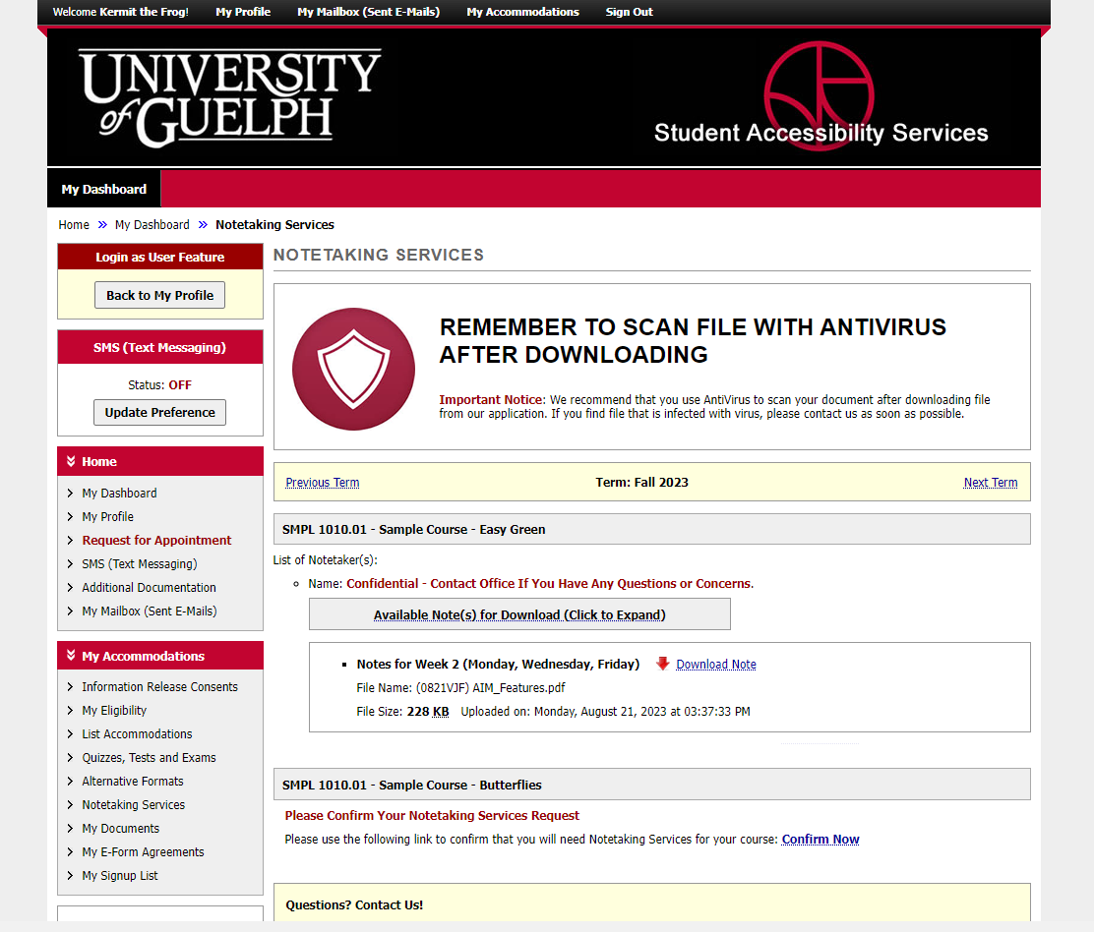
Notes:
You will then see details about the notes including a link to download them.

Slide 7
An Update is Coming
There will be some changes to colours and layout when the new version is released.
It will be mobile friendly and has some helpful new tools.
We don’t know the date yet.
When more information is available, it will be posted on the SAS website.

Slide 8
wellness.uoguelph.ca /accessibility
Contact Information

