Slide 1
SAS Student Portal Additional Doc
Student Accessibility Services

Slide 2
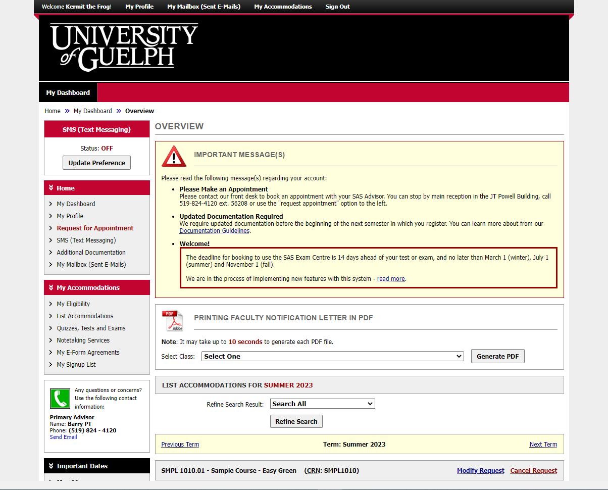
Notes:
This is the dashboard you see when you login.

Slide 3
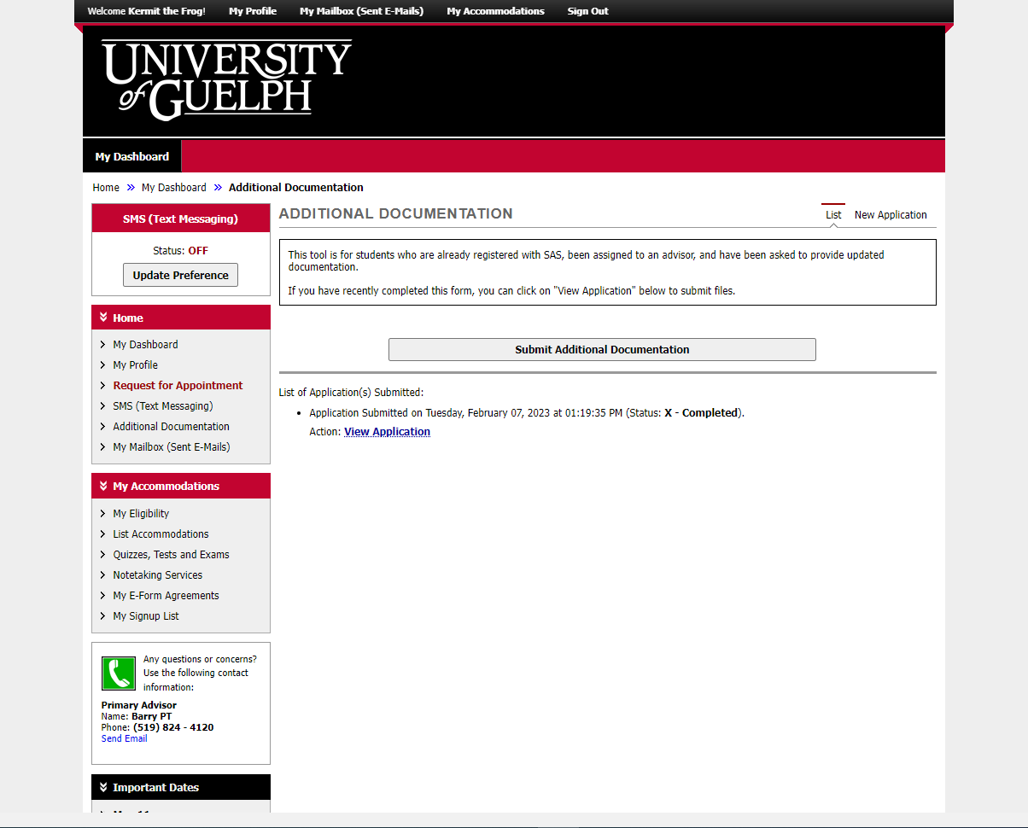
Notes:
The “Additional Documentation” page is for students who have already been assigned to an on-going SAS Advisor and have been asked to provide updated or additional documentation. Begin by licking on the “Submit Additional Documentation” button.

Slide 4
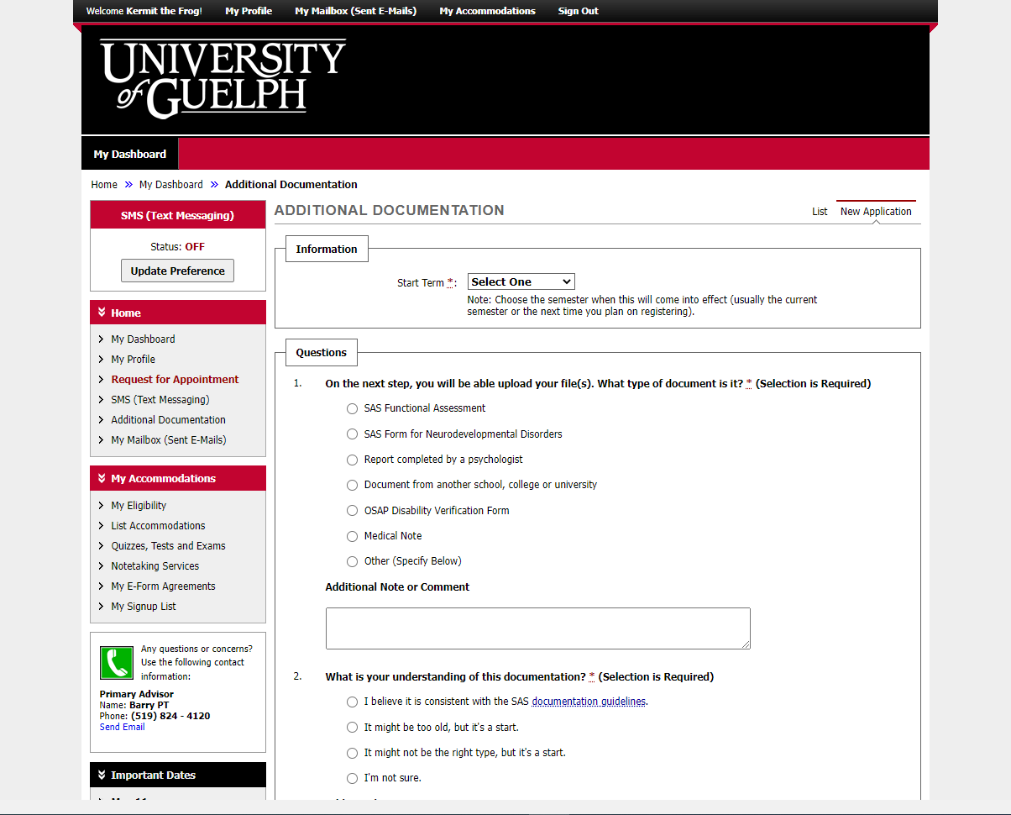
Notes:
There are two steps in this process. The first involves answering these questions.

Slide 5
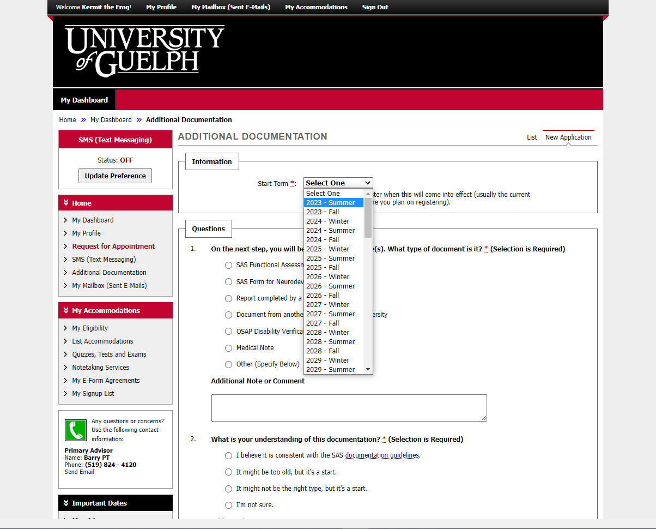
Notes:
Specify the semester when this document will be relevant. If you are currently in courses, you’ll likely chose the current semester. If not, choose the next semester when you intent to take courses.

Slide 6
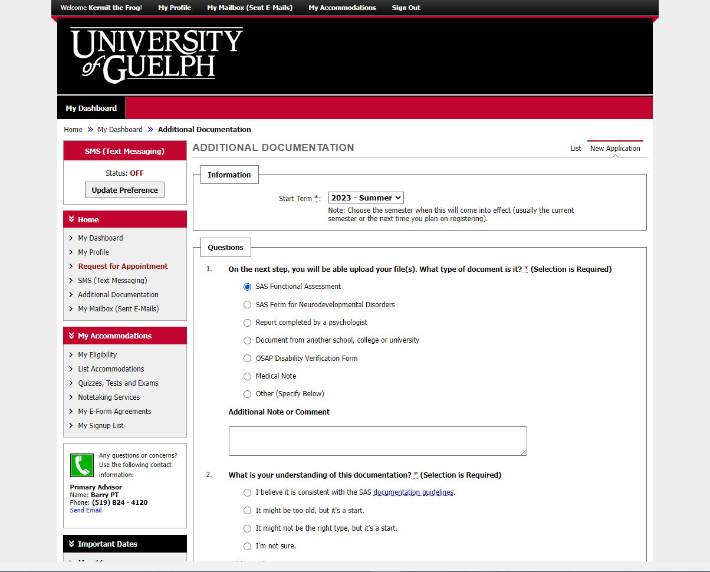
Notes:
Indicate what type of document you intent to provide.

Slide 7
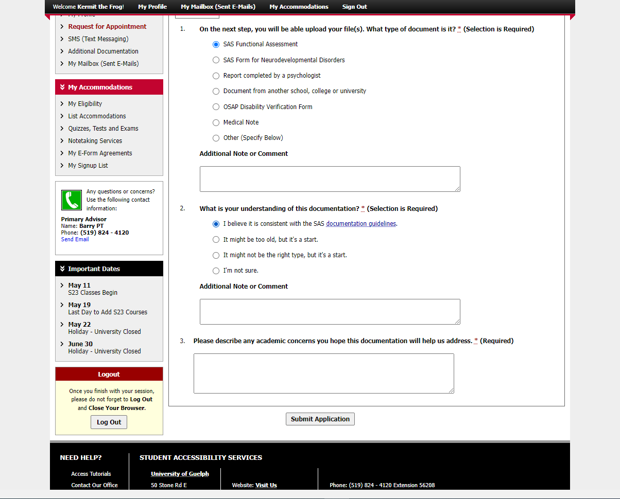
Notes:
Please indicate whether you believe the document you are going to provide is consistent with our documentation guidelines. If not, choose one of the other options.

Slide 8
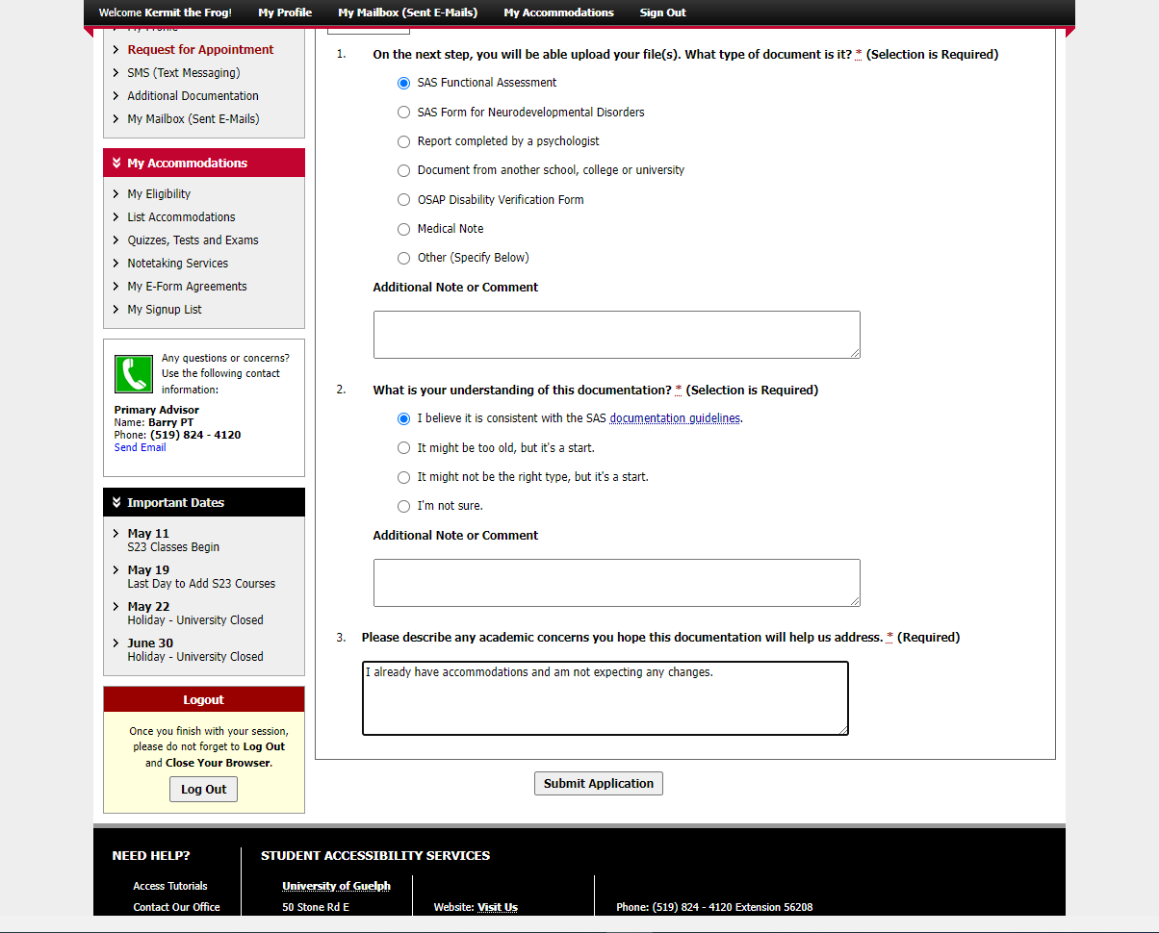
Notes:
Please tell us if there are any academic concerns you hope this document will help us address. You must type something in this box.

Slide 9
Notes:
Click “Submit Application”

Slide 10
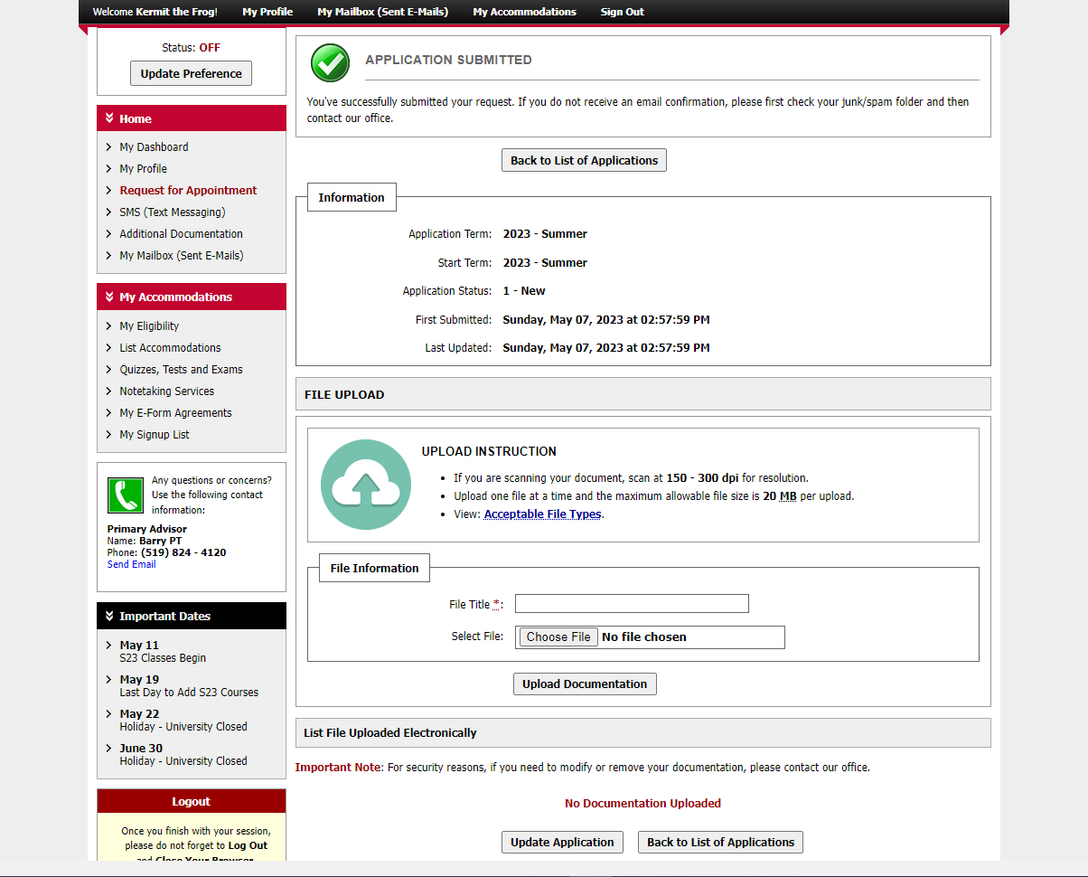
Notes:
This is the critical second step. You have successfully submitted the application, now you need to upload at least one file.

Slide 11
Preparing Your Document
If you have a document on paper, please ensure all pages are in the same file.
You can scan paper documents with an app on your phone. We recommend searching the App Store or Google Play for a PDF scanner such as Adobe Scan for Android and iOS (free).
More tips can be found at uoguel.ph/doc
Notes:
Scan everything into one PDF
Instructions at uoguel.ph/doc

Slide 12
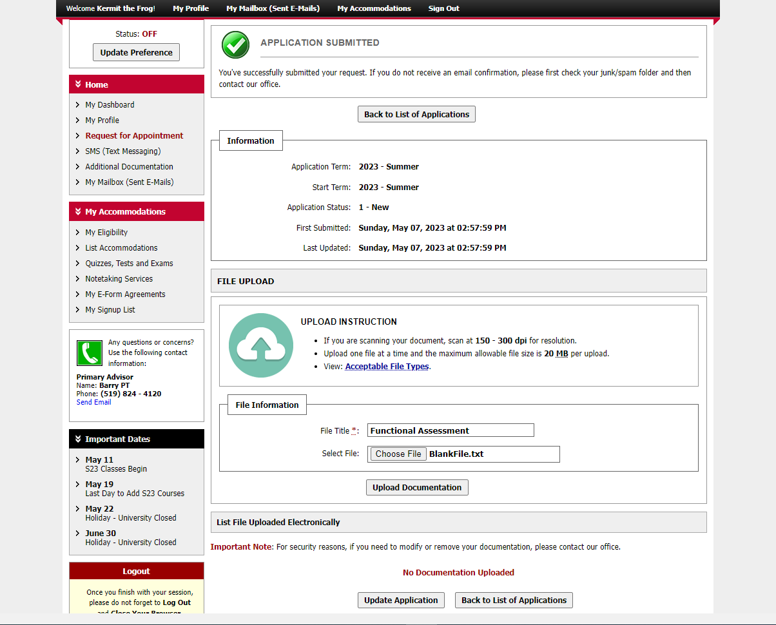
Notes:
Provide a file title that describes the type of document. Then use the “choose file” button to browse your computer and add the file. Finally, click on “upload documentation.

Slide 13
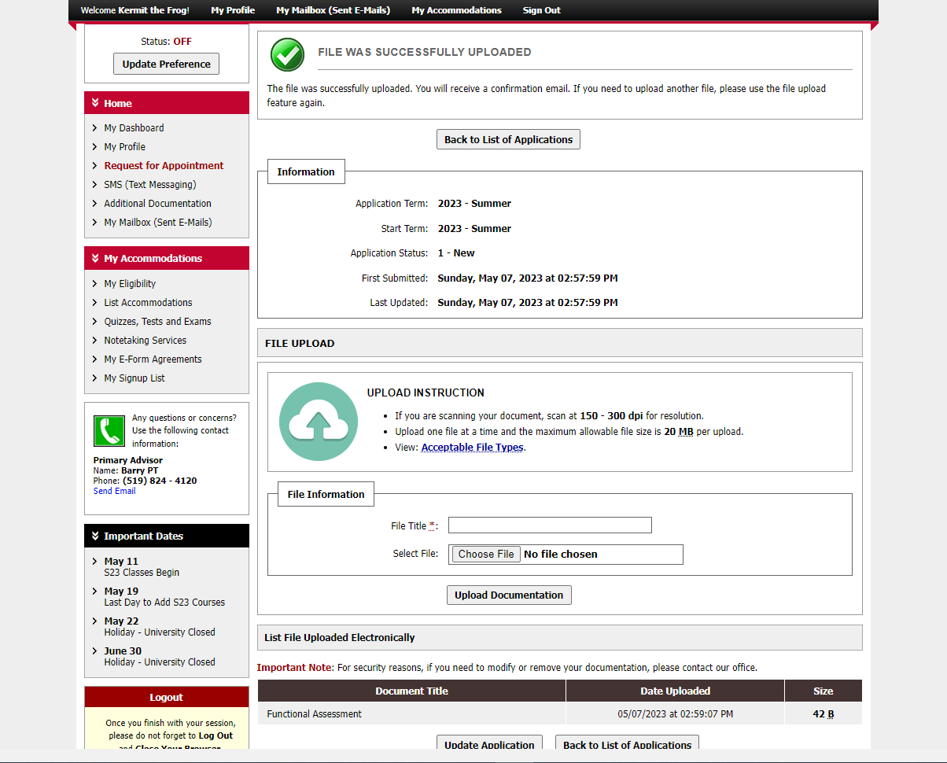
Notes:
You know you’ve been successful when you see the green checkmark and the message that says “file was successfully uploaded.” You can also see the file down towards the bottom of the page.

Slide 14
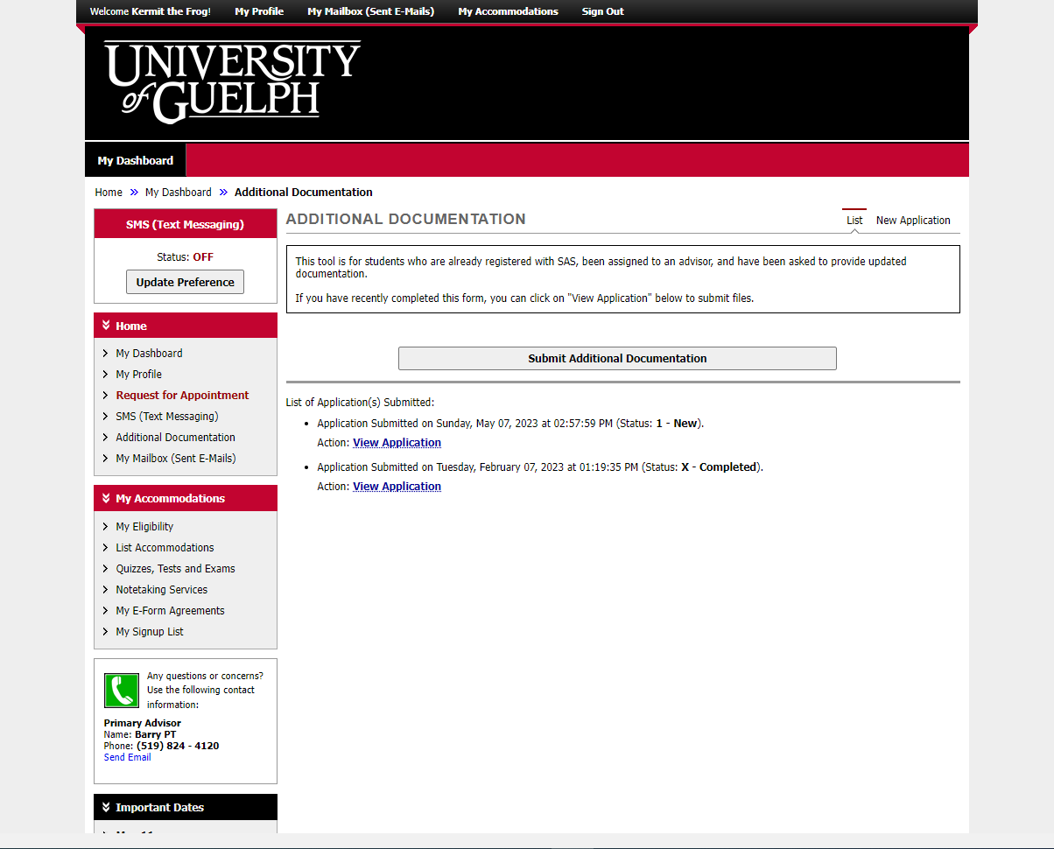
Notes:
Let’s go back to where we started by clicking on “additional documentation” in the navigation bar.

Slide 15
Notes:
You can change or add another file to any application that still has the status “new”.
Click on “view application” if you have returned at a later time to add another document.

Slide 16
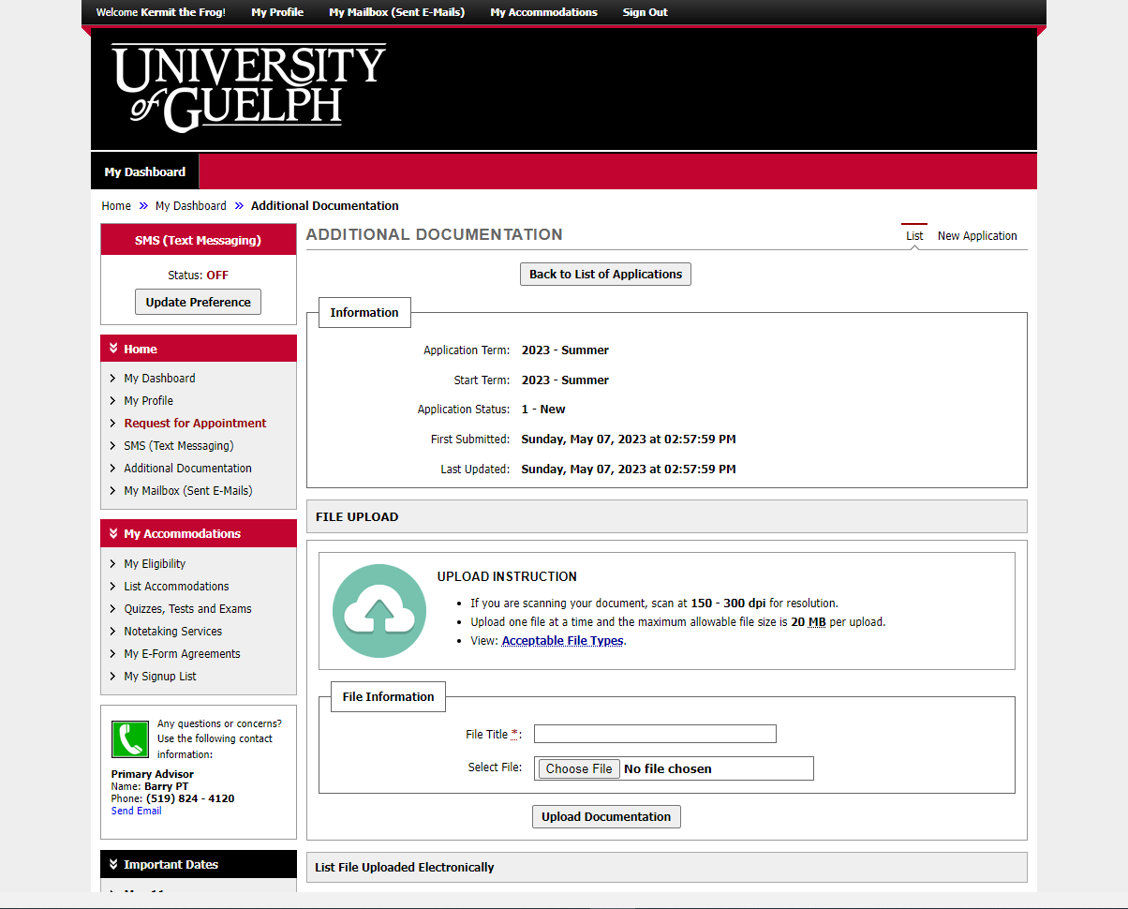
Notes:
Just like before, you can use the file information box to provide a file name and browse your computer for the file. Then click on “upload documentation.”

Slide 17
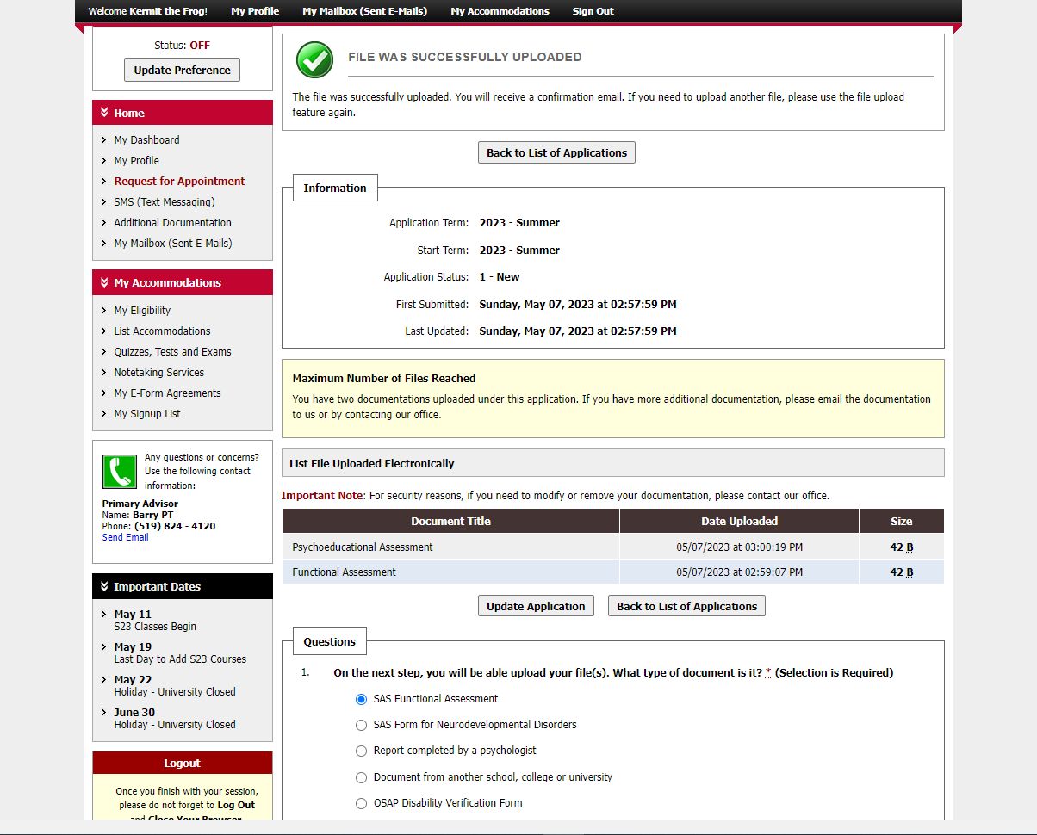
Notes:
Once again, we see the “file was successfully uploaded” message, and a list of the files that were submitted.

Slide 18
An Update is Coming
There will be some changes to colours and layout when the new version is released.
It will be mobile friendly and has some helpful new tools.
We don’t know the date yet.
When more information is available, it will be posted on the SAS website.

Slide 19
wellness.uoguelph.ca /accessibility
Contact Information

