Slide 1
SAS Student Portal Request Appointment
Student Accessibility Services

Slide 2
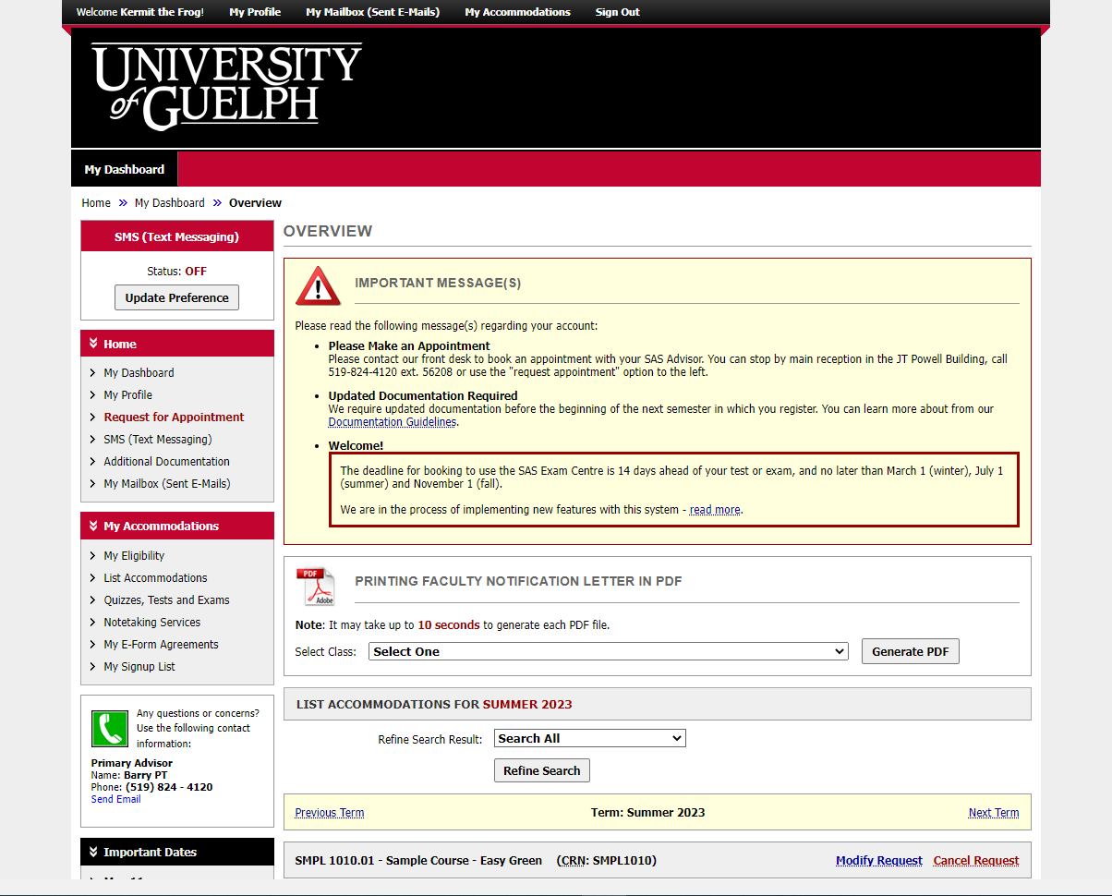
Notes:
This is the dashboard you see after logging in.

Slide 3
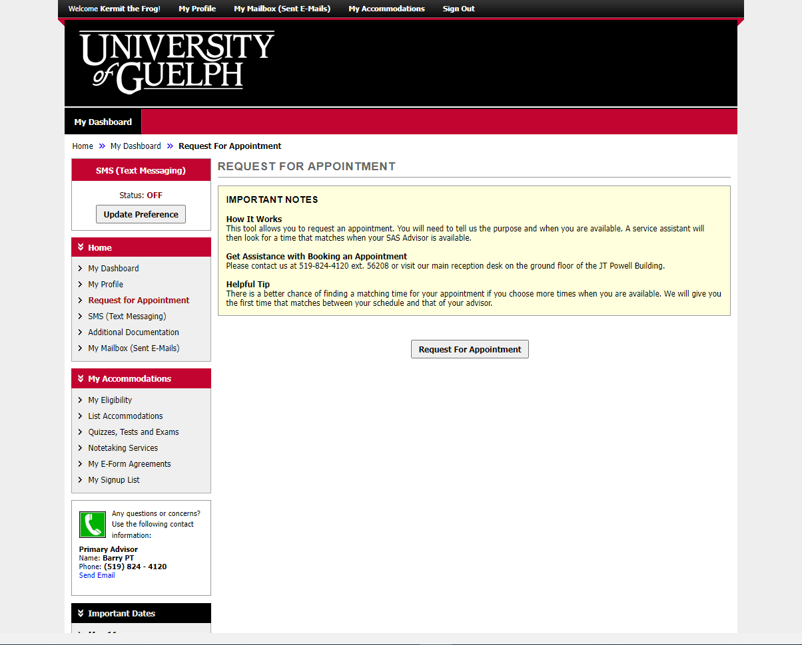
Notes:
The “request for appointments” page beings with an explanation that you will be required to provide a purpose for the appointment and indicate your availability.

Slide 4
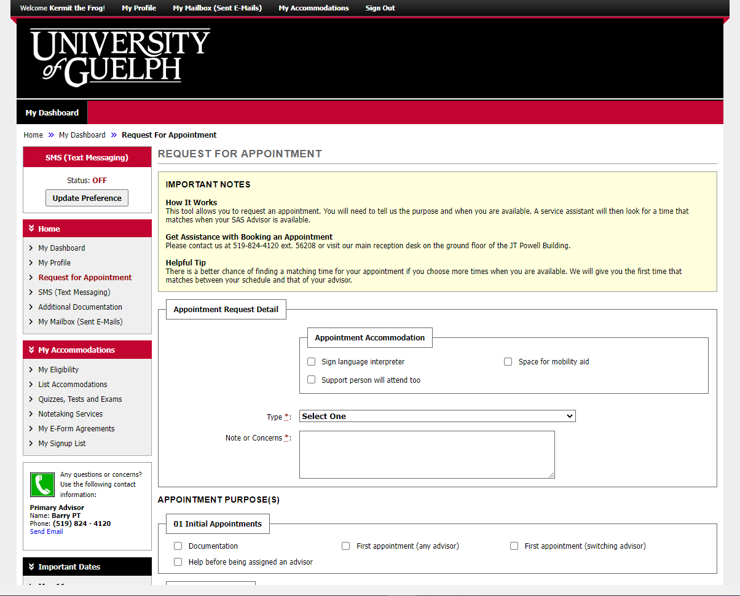
Notes:
If you require an accommodation for your appointment, such as a sign language interpreter, please indicate it in the first box.

Slide 5
Notes:
We ask that you tell us if a support person will be attending so that we know what to expect. When meeting in person, sometimes we need to arrange for a larger meeting room.

Slide 6
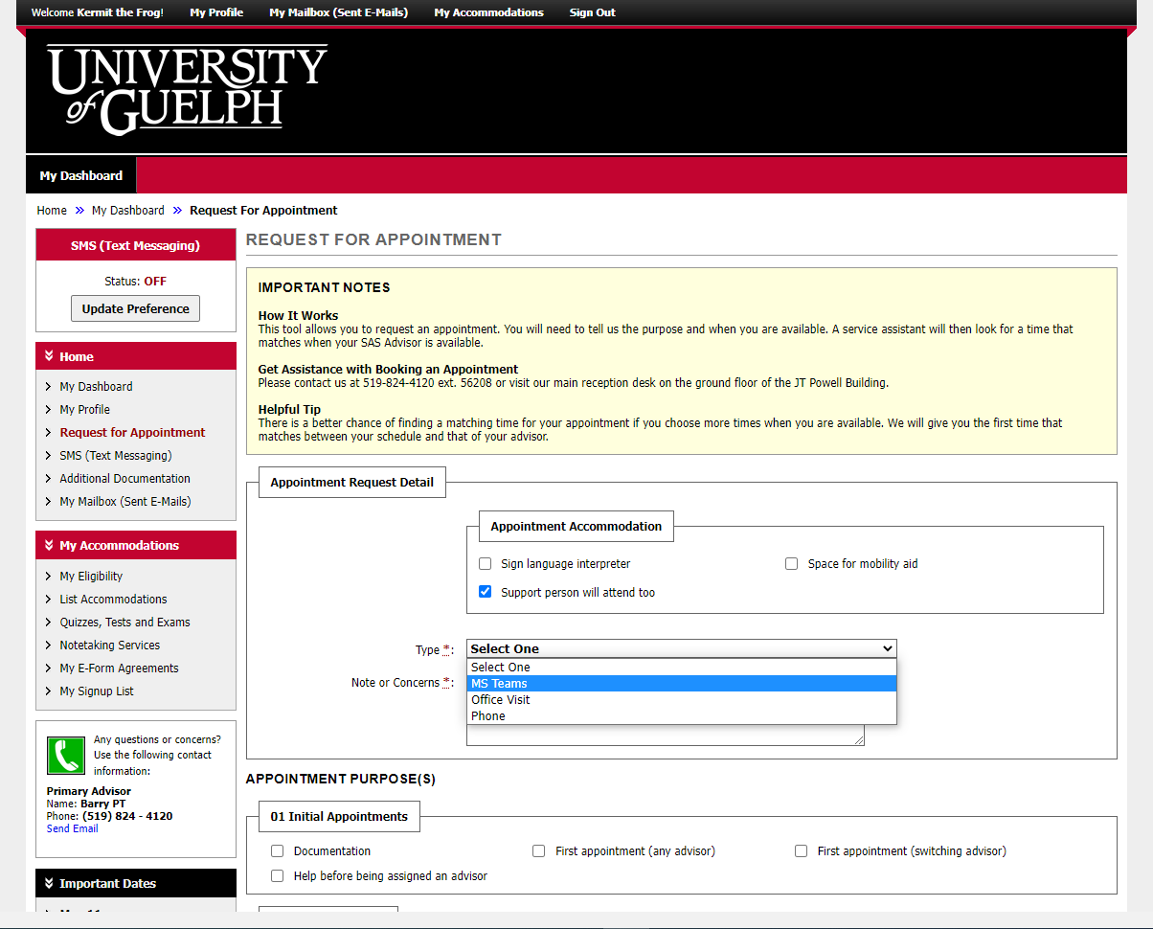
Notes:
Indicate the type of appointment you would like: Microsoft Teams (virtual), an office visit (in-person) or over the phone.

Slide 7
Notes:
You must provide a brief note indicate what you hope to discuss.

Slide 8
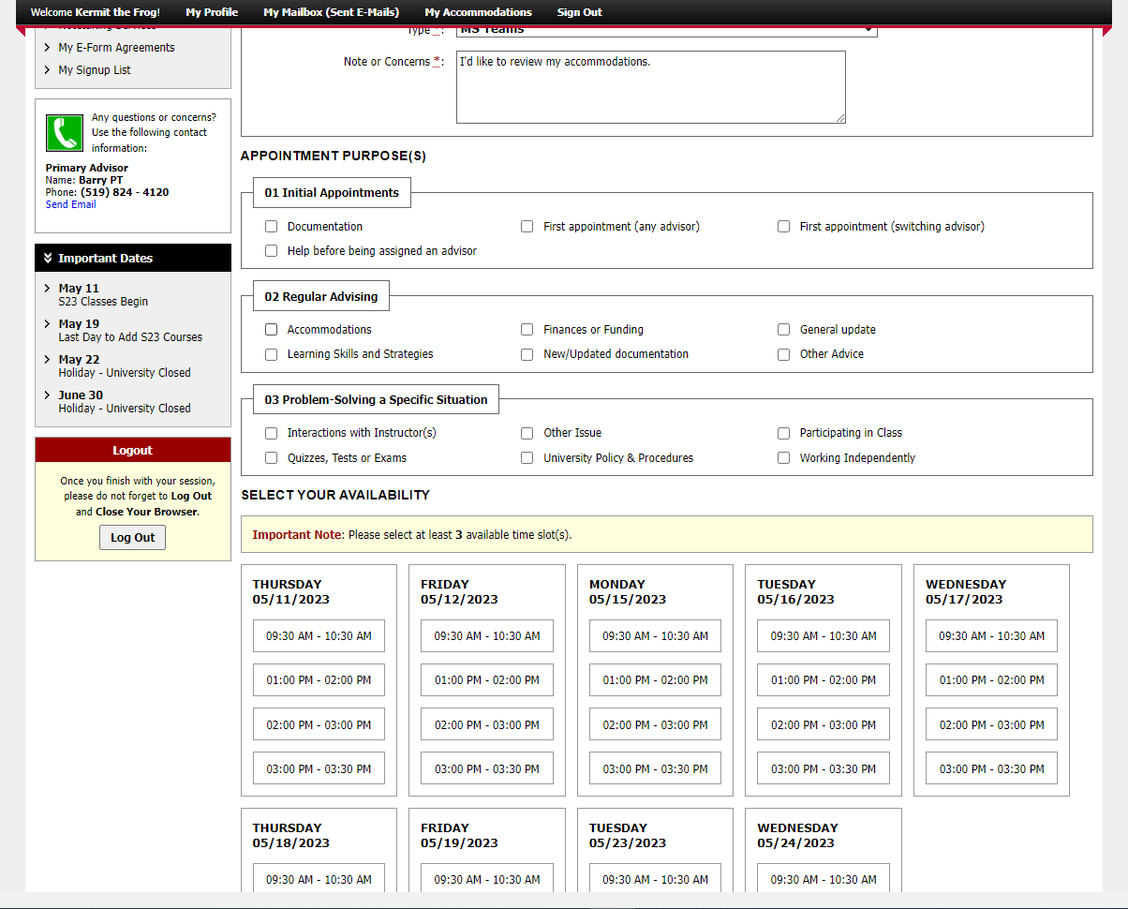
Notes:
There are three categories of appointment purposes: initial appointments, regular appointments, and problem-solving a specific situation. Under each category, there are multiple options.

Slide 9
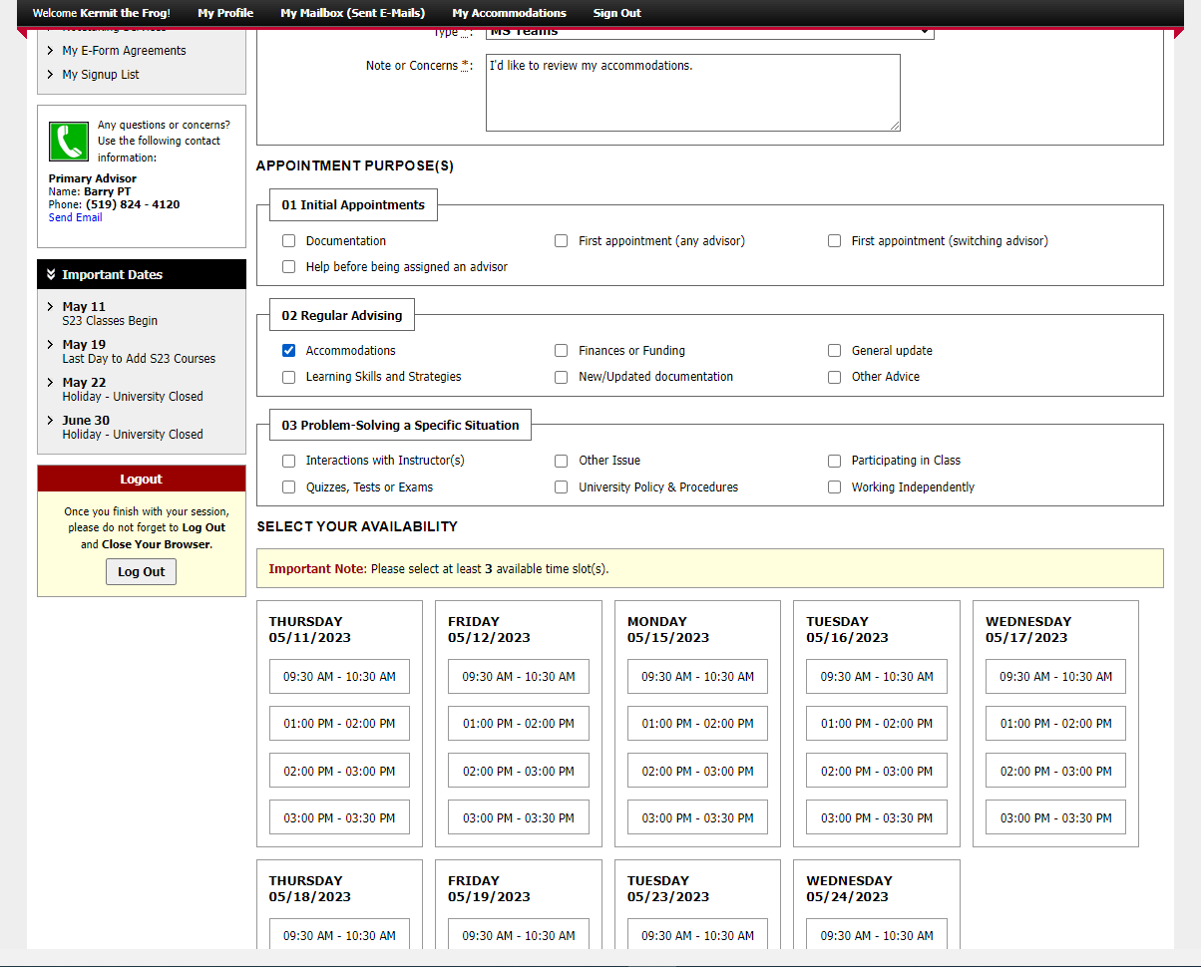
Notes:
This student has indicated that they would like to meet to discuss accommodations. You only need to choose one option.

Slide 10
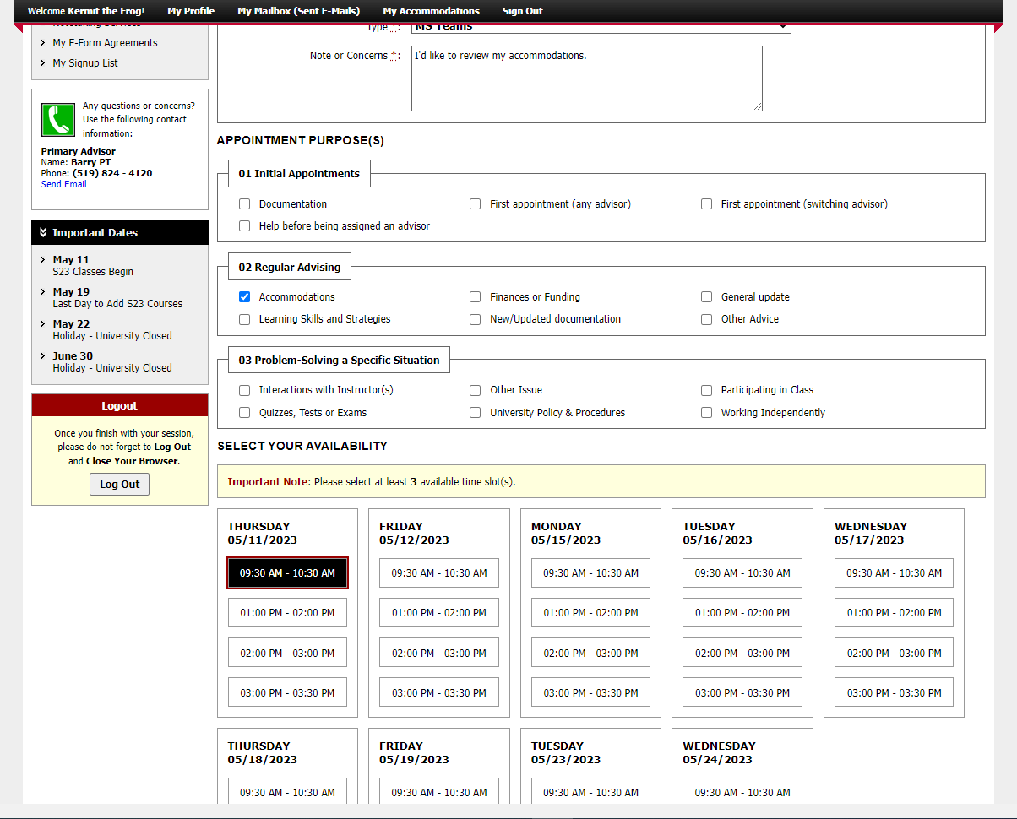
Notes:
Choose blocks of time when you are free. Your appointment will not fill the whole block.

Slide 11
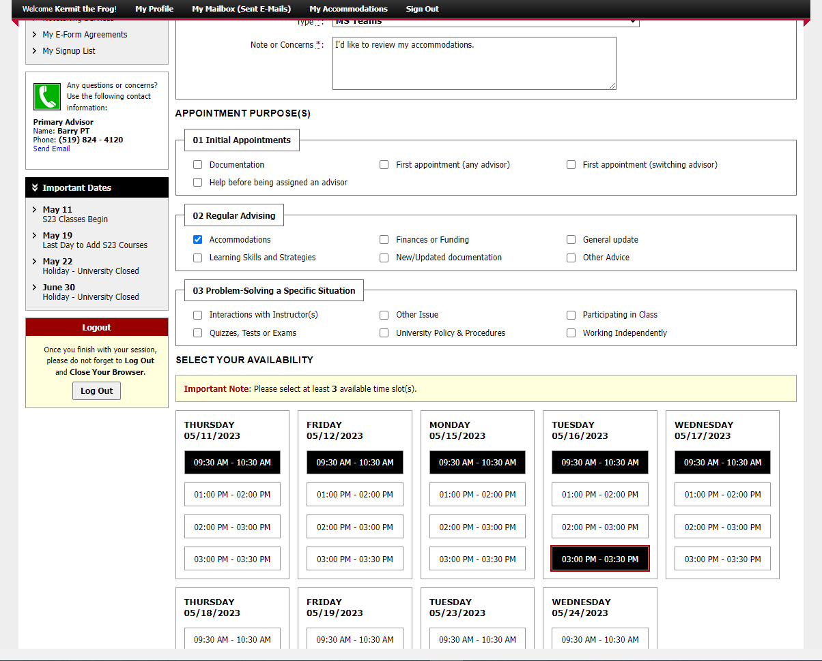
Notes:
You must choose at least three timeslots, but in many cases choosing more options increases the chances of a match with your SAS advisor. We will always choose the first available timeslot that matches.

Slide 12
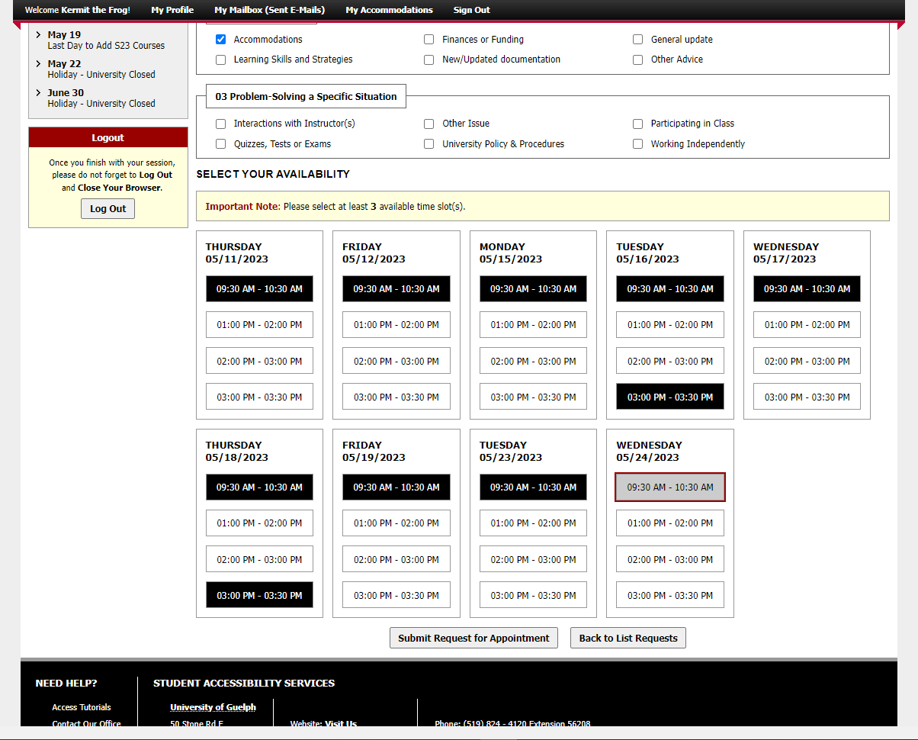
Notes:
At the bottom of the page, there is a button to “submit request for appointment”

Slide 13
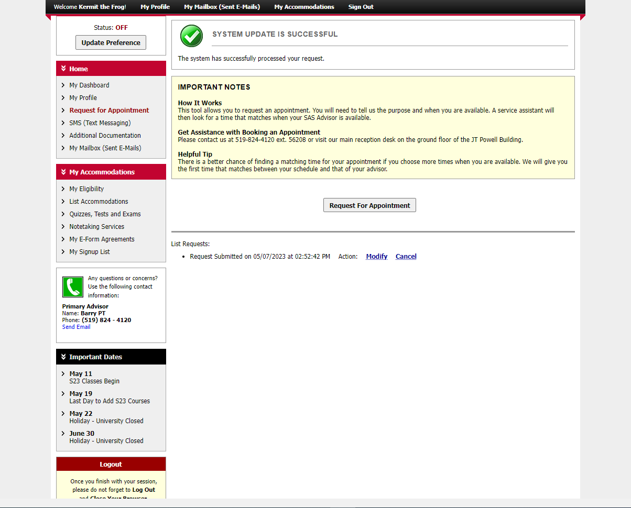
Notes:
Once you have submitted your request, you’ll see a message that says: “system update was successful”. You can also see a list of requests you’ve submitted at the bottom of the main body of the page.
From here, a service assistant will look at your request and find the first available time that matches when your SAS Advisor is available.

Slide 14
An Update is Coming
There will be some changes to colours and layout when the new version is released.
It will be mobile friendly and has some helpful new tools.
We don’t know the date yet.
When more information is available, it will be posted on the SAS website.

Slide 15
wellness.uoguelph.ca /accessibility
Contact Information

