Slide 1
SAS Student Portal Request Accommodations
Student Accessibility Services

Slide 2
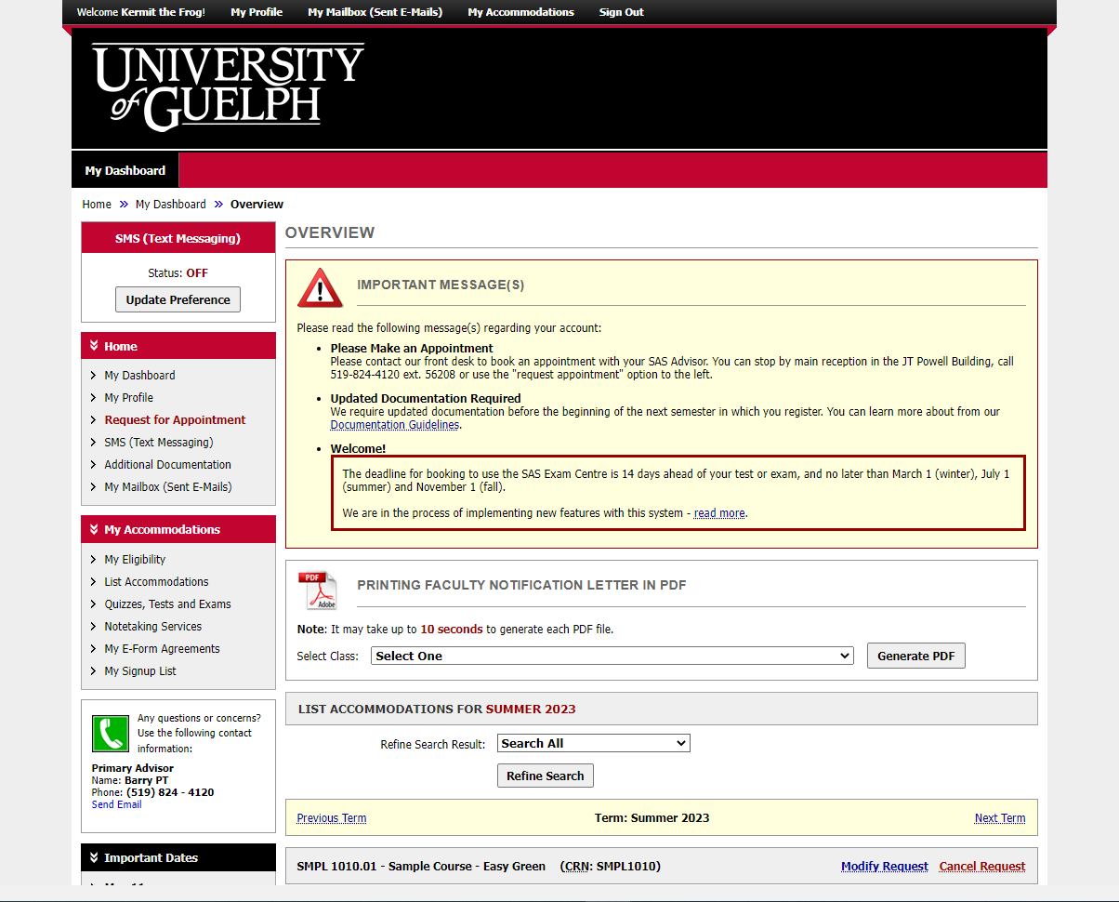
Notes:
This is your dashboard, which you will see when you login. You’re looking for the option on the left that says: “List Accommodations.”

Slide 3
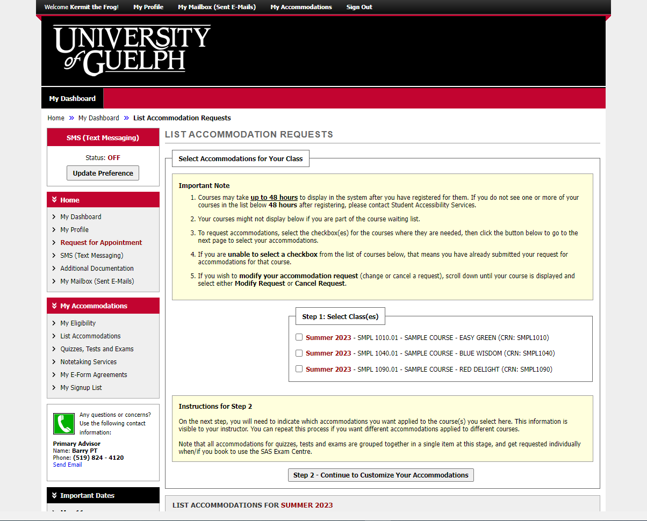
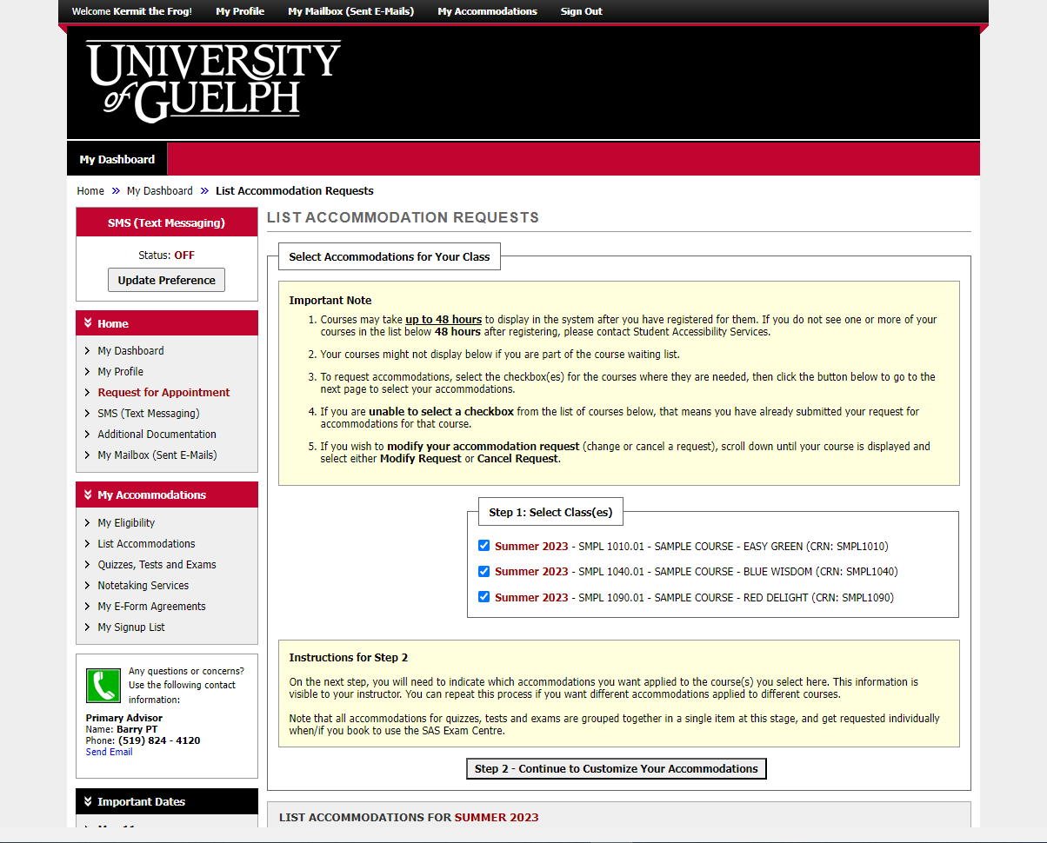
Notes:
Start by selecting which courses you would like to include in this accommodation request.
In the important notes section, there is a reference to a course waiting list. This does not apply at U of G.
There is some key information in the instructions for step 2. Your instructor will be able to see which accommodations you have selected for their course. All accommodations for quizzes, tests and exams will be grouped together.

Slide 4
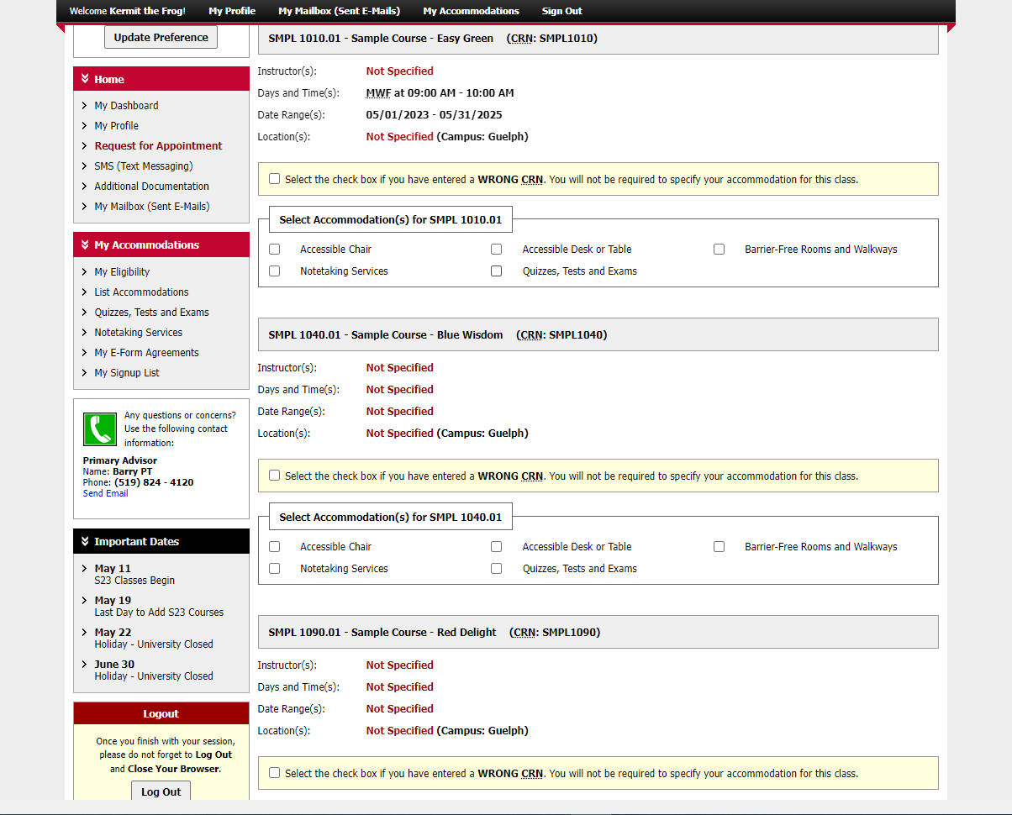
Notes:
Each course is listed with an option to select the accommodations relevant to that course. You an choose different accommodations for different courses.
Again, all accommodations for quizzes, tests and exams are grouped together as one option.

Slide 5
Course 1
Course 2
Course 3
Notes:
Each course is listed with an option to select the accommodations relevant to that course. You an choose different accommodations for different courses.
Again, all accommodations for quizzes, tests and exams are grouped together as one option.

Slide 6
Notes:
This student has selected all of their accommodations for the first course.

Slide 7
Notes:
They have now selected all of their accommodations for the second course.

Slide 8
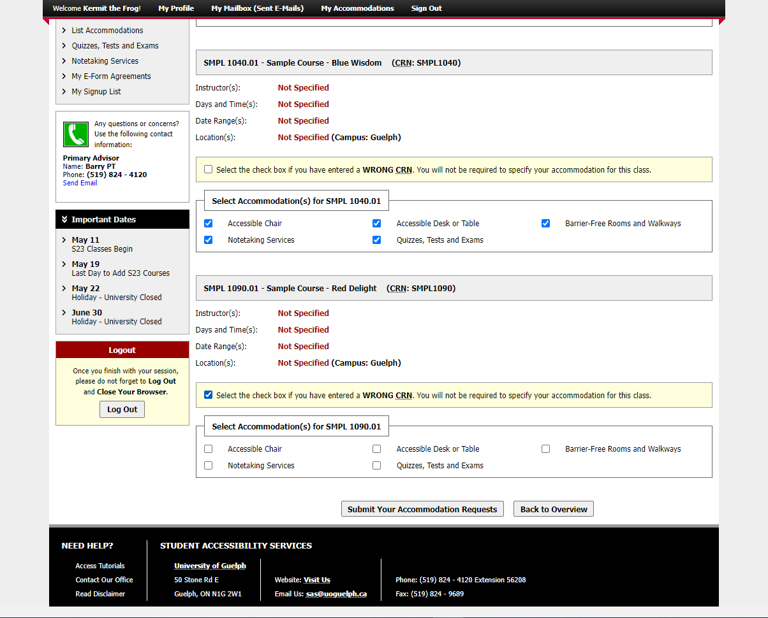
Notes:
If you decide not to request accommodations for one course, choose the option that references the “wrong CRN”.

Slide 9
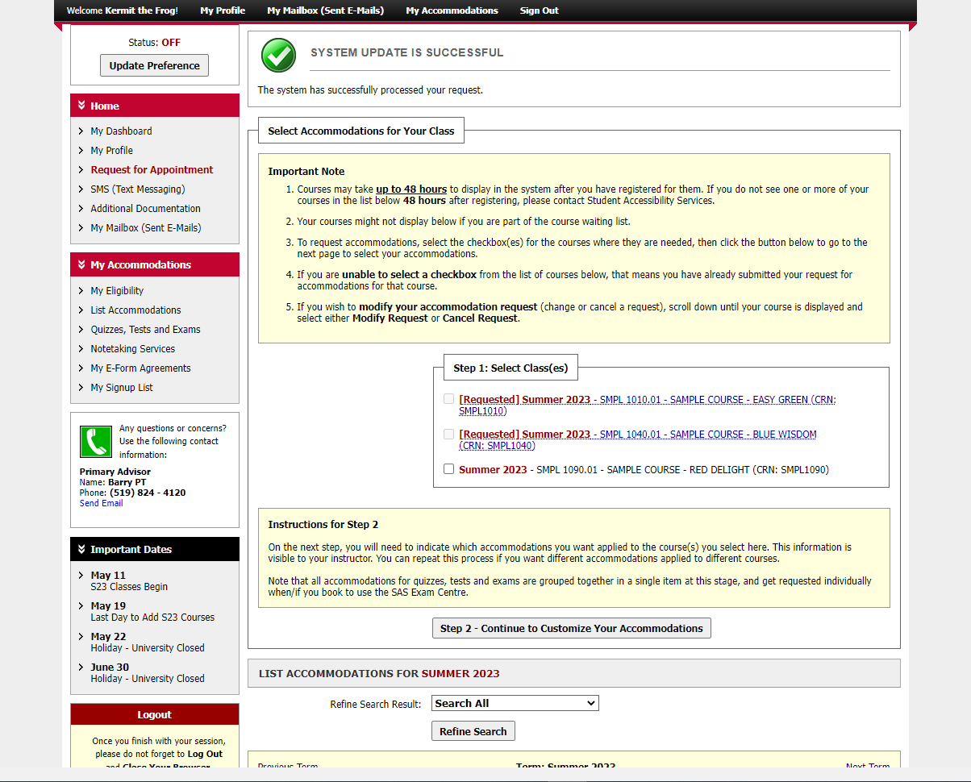
Notes:
After making a submission, we are back at the starting point. There is a message at the top saying “system update is successful.”
Note how the courses look different – we requested accommodations for the first two, but not the third one.

Slide 10
Modify
Request
Notes:
If you decide to add accommodations for the third course later, follow the same steps.

Slide 11
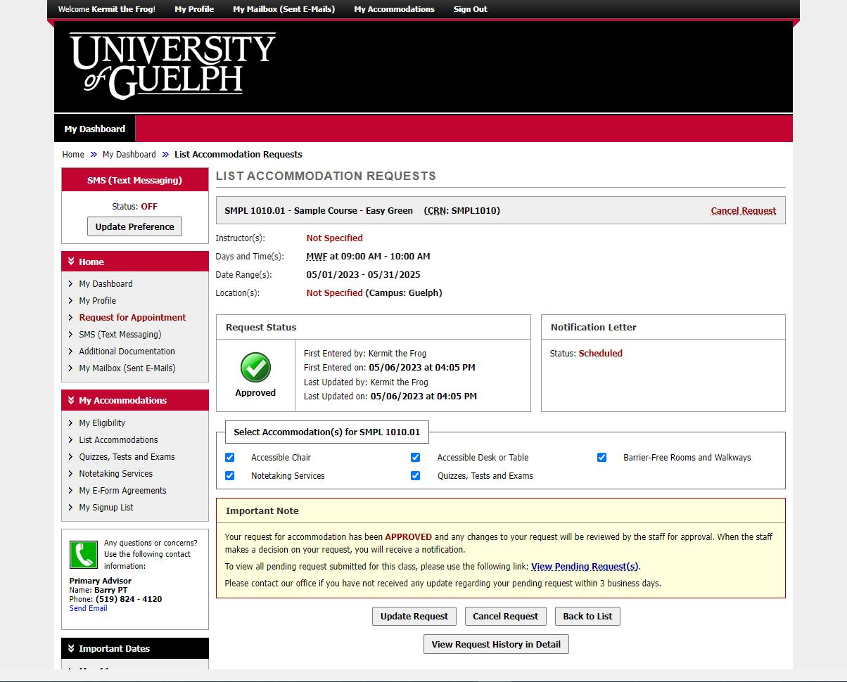
Notes:
If we click on a course where we’ve already requested accommodations, we can see the details. This includes the date it was submitted as well as any changes. You can also modify which accommodations you would like to request.

Slide 12
An Update is Coming
There will be some changes to colours and layout when the new version is released.
It will be mobile friendly and has some helpful new tools.
We don’t know the date yet.
When more information is available, it will be posted on the SAS website.

Slide 13
wellness.uoguelph.ca /accessibility
Contact Information

