Slide 1
SAS Student Portal Quick Tour
Student Accessibility Services

Slide 2
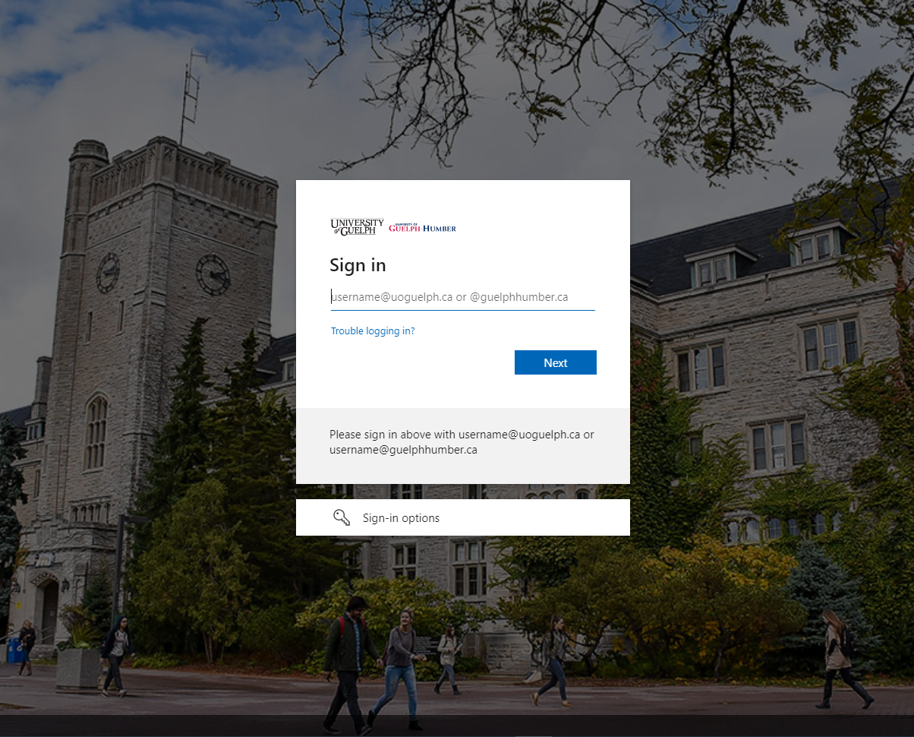
Notes:
You will need to login using your U of G email address and password.

Slide 3
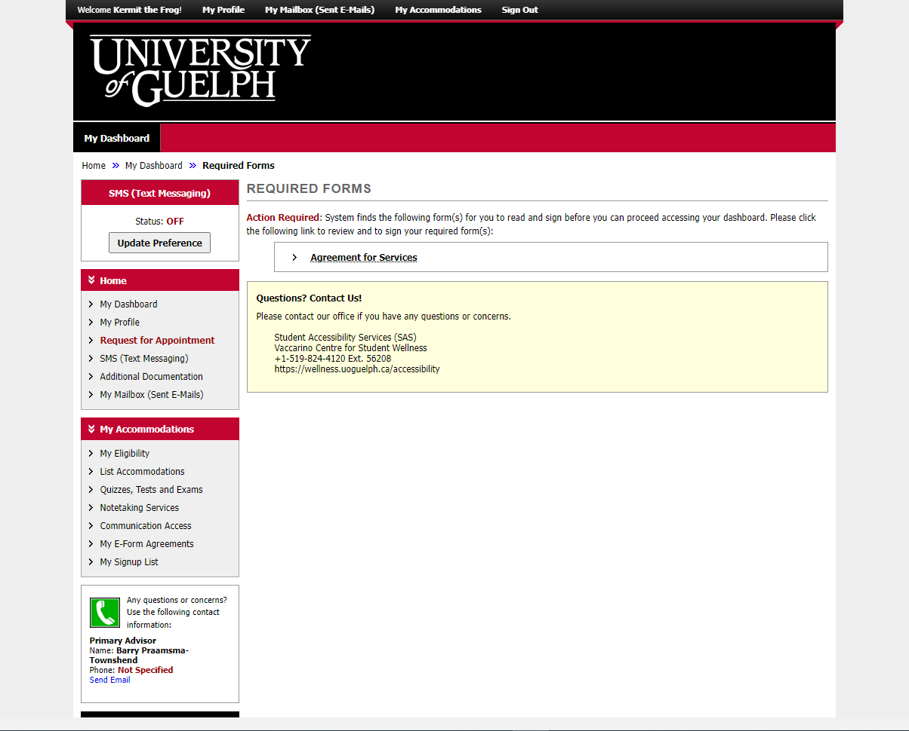
Notes:
When you login for the first time, you’ll see a heading called “Required Forms”

Slide 4
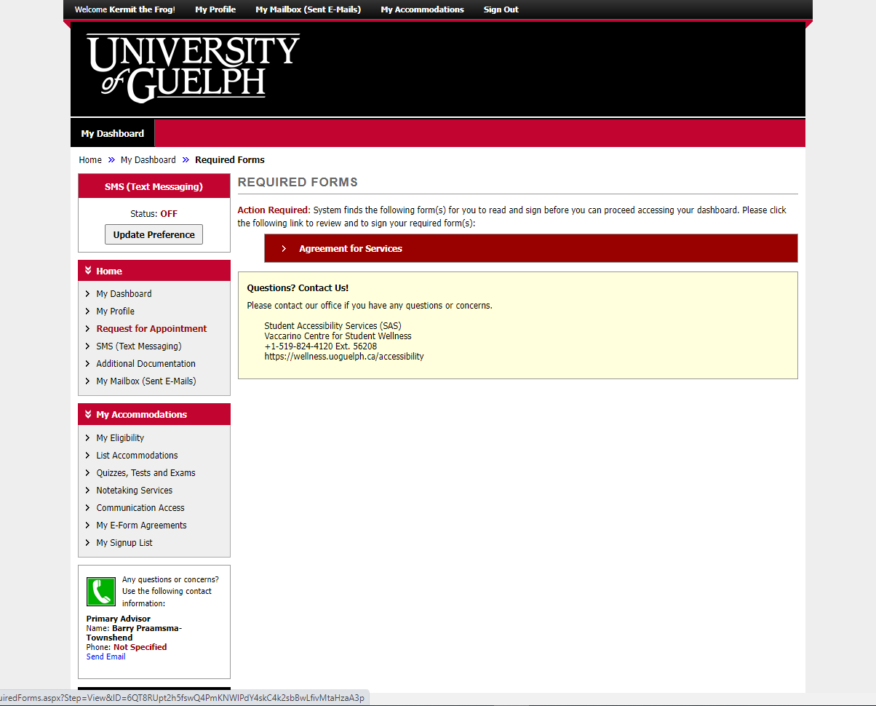
Notes:
Click on the item. In this case, it’s called “Agreement for Services” which needs to be completed once per year.

Slide 5
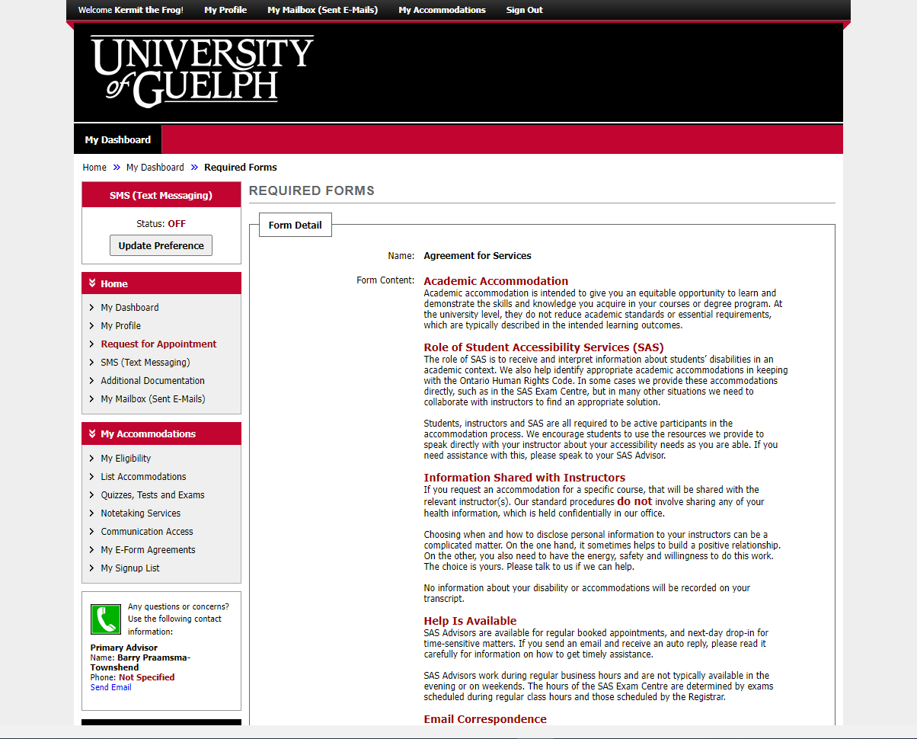
Notes:
The Agreement for Services highlights key information about how SAS works. When something goes wrong, it’s often because of a misunderstanding about one of these principles. We’ve used plain language to try to make it accessible for everyone.

Slide 6
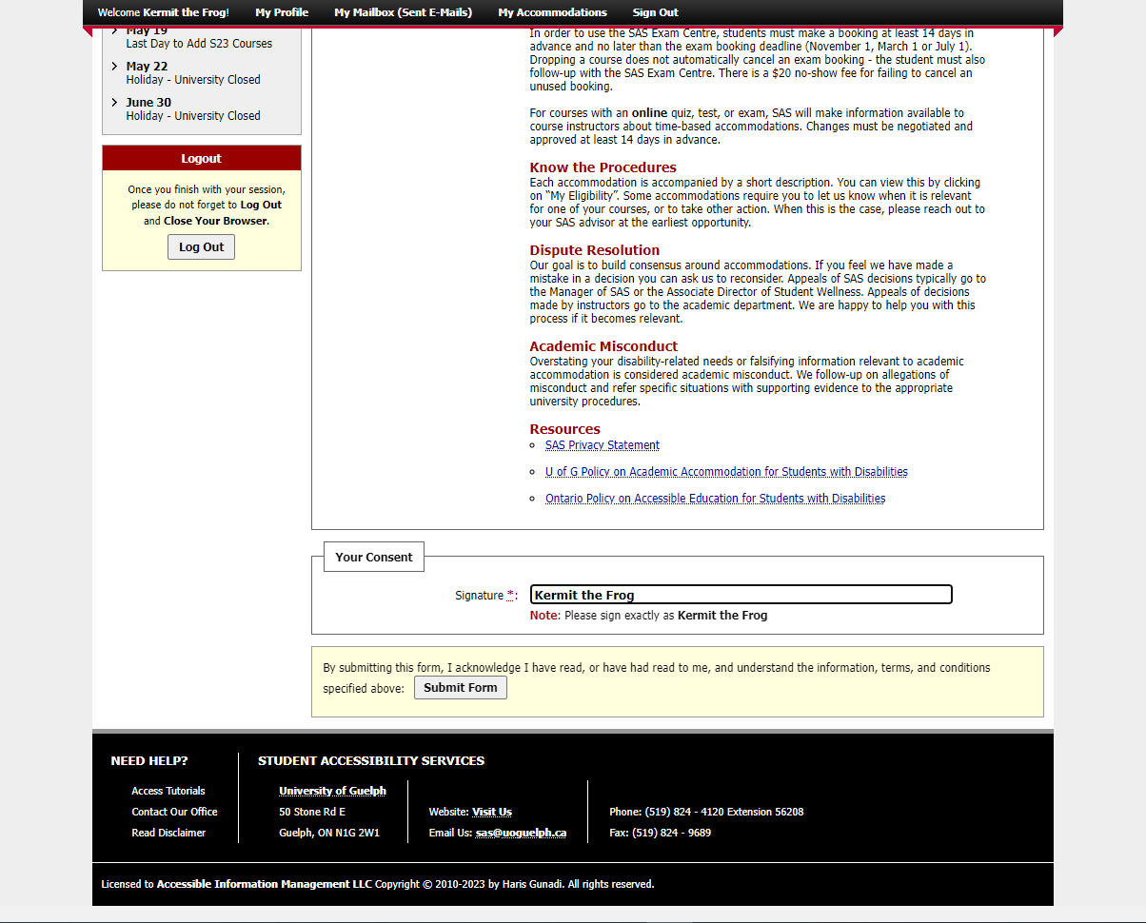
1
2
Notes:
At the bottom, type your name in the consent box.

Slide 7
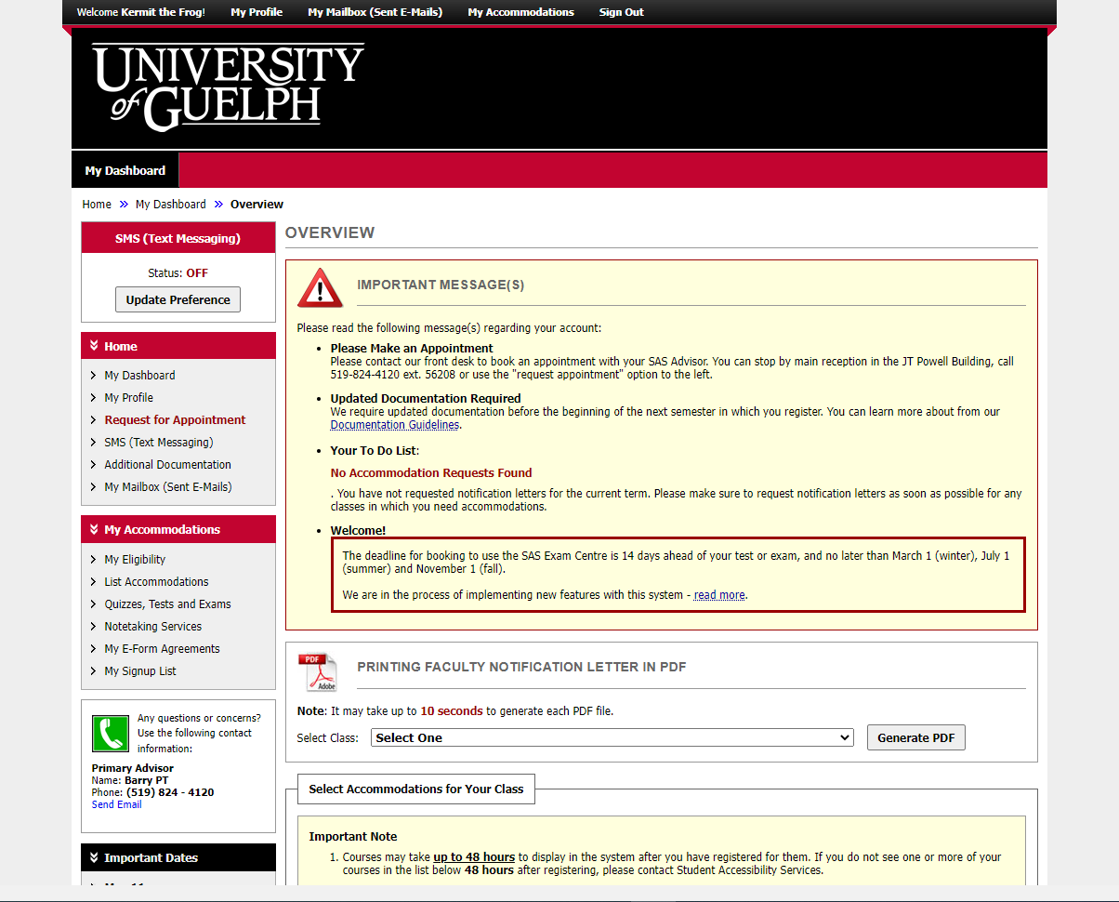
Notes:
This is your dashboard, which is what you will usually see when you first login.

Slide 8
Notes:
“My profile” shows some basic information such as your name, student ID and email address. Please let us know if any of these things need to be changed.

Slide 9
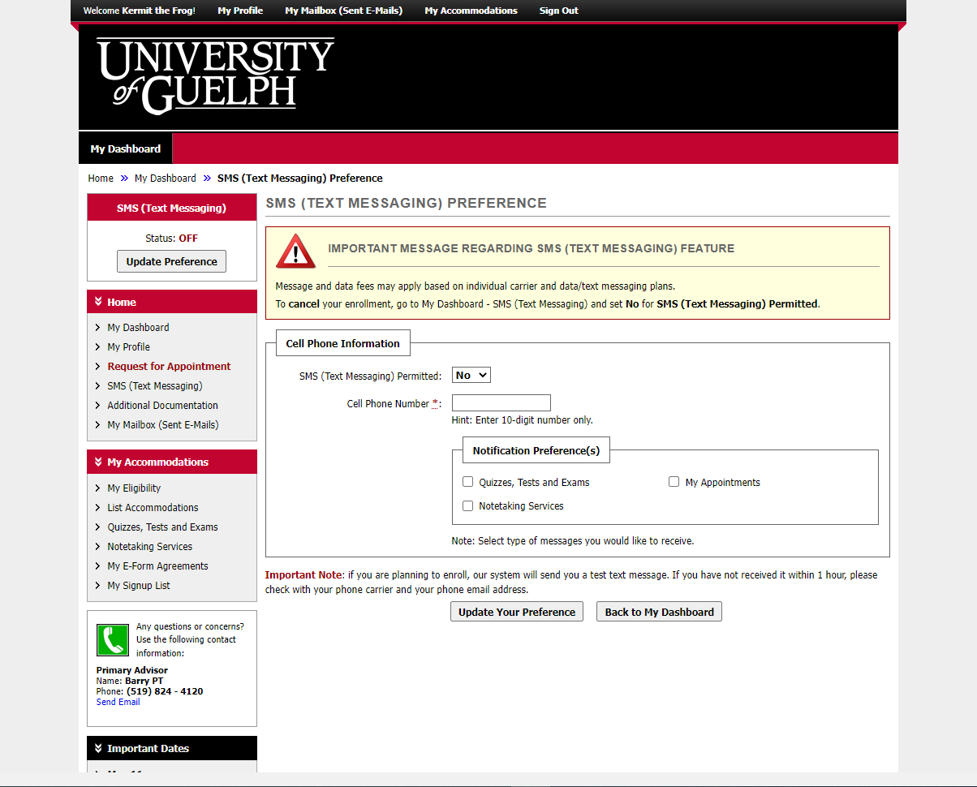
Notes:
Use the “SMS (Text Messaging)” feature to receive notifications about appointments and exam bookings.

Slide 10
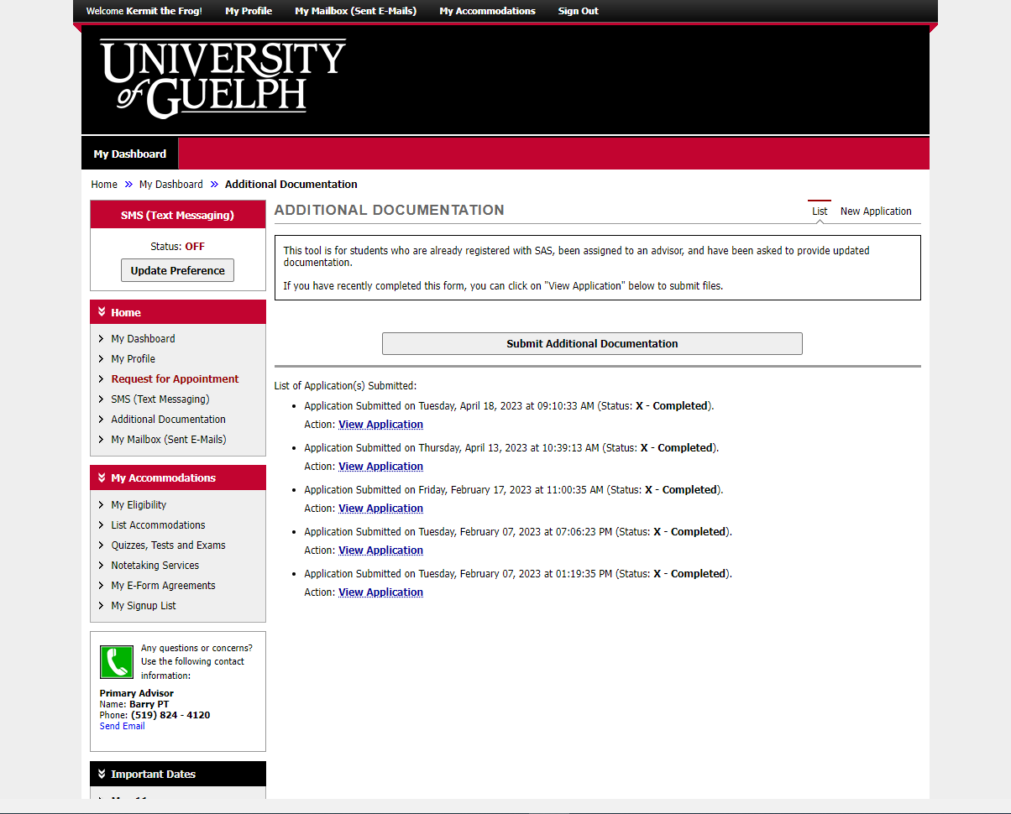
Notes:
Use the “Additional Documentation” feature if you are already assigned to an on-going SAS advisor and have been asked to provide updated or additional documentation. There is a separate video about how to use this tool.

Slide 11
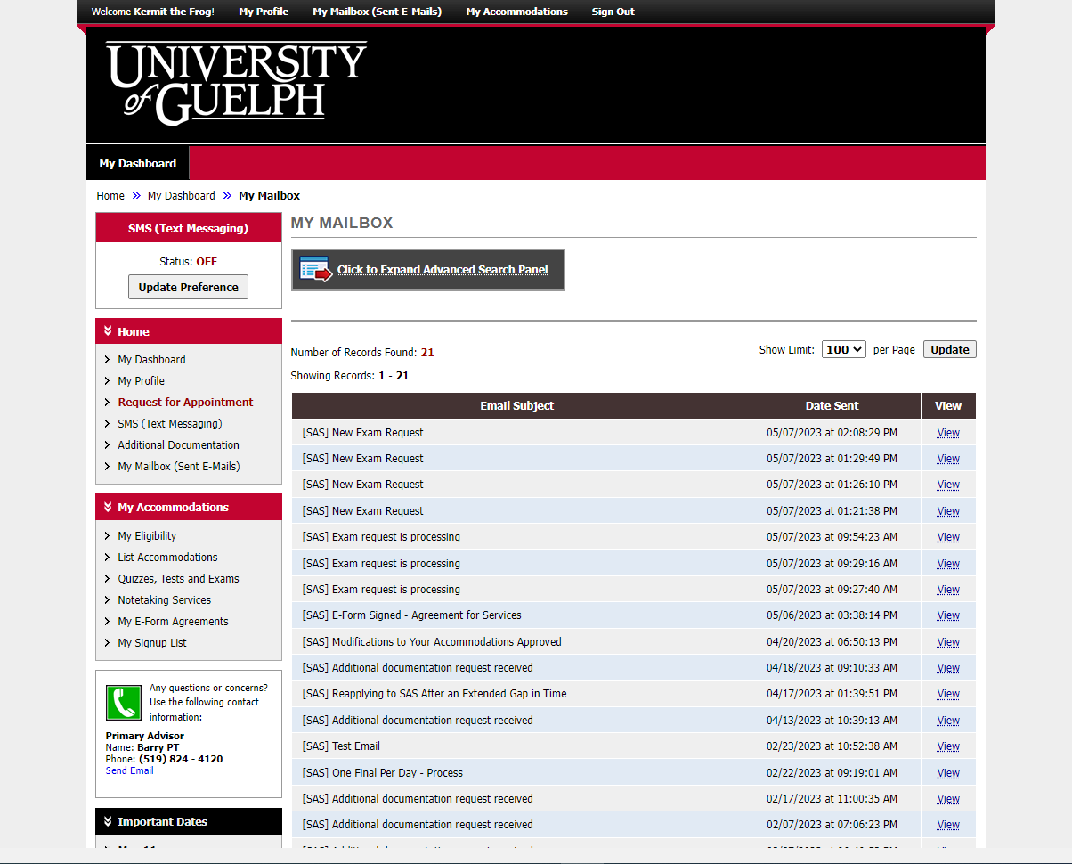
Notes:
The “My Mailbox (Sent E-Mails)” shows you all messages sent to your U of G email address using the system. If your SAS Advisor emailed you privately, it will not appear here.

Slide 12
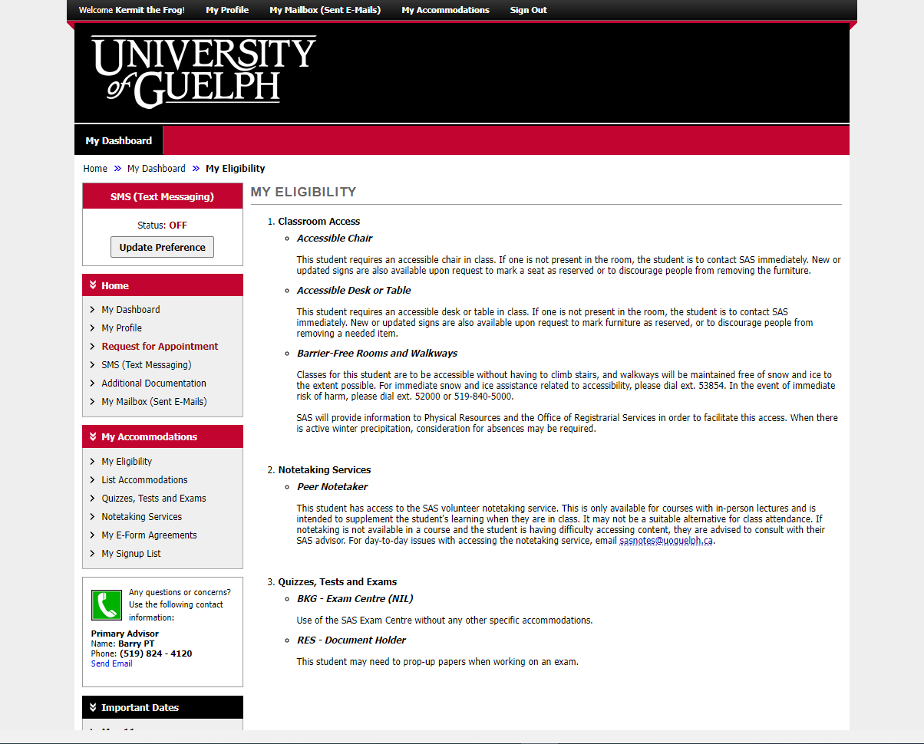
Notes:
“My Eligibility” is a list of each of the accommodations that have been agreed upon with your SAS Advisor. There is a short description of how each one works.

Slide 13
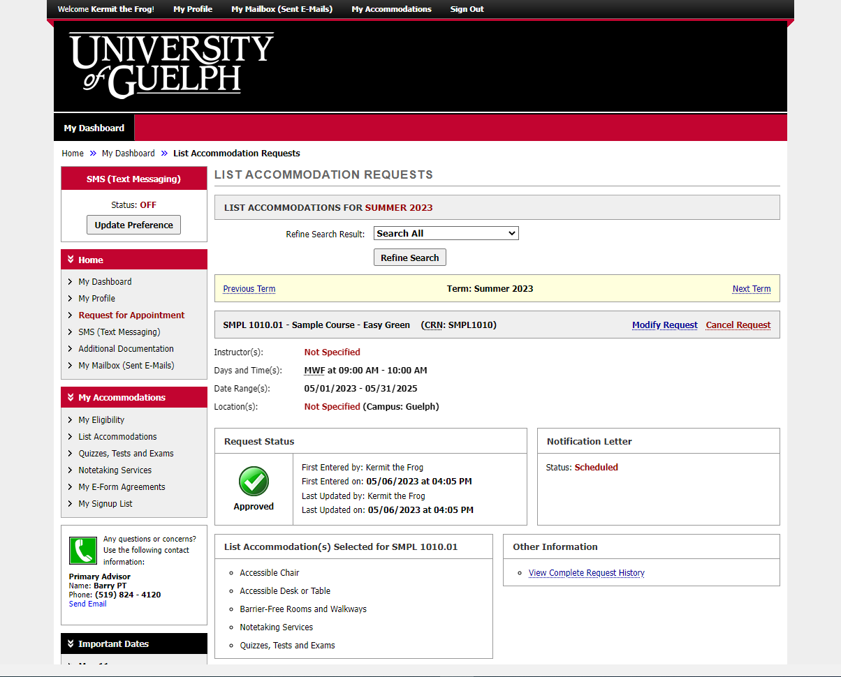
Notes:
When you click on “List Accommodations” you will see the accommodations that have been requested for the current semester. This will be covered in greater depth in another video.

Slide 14
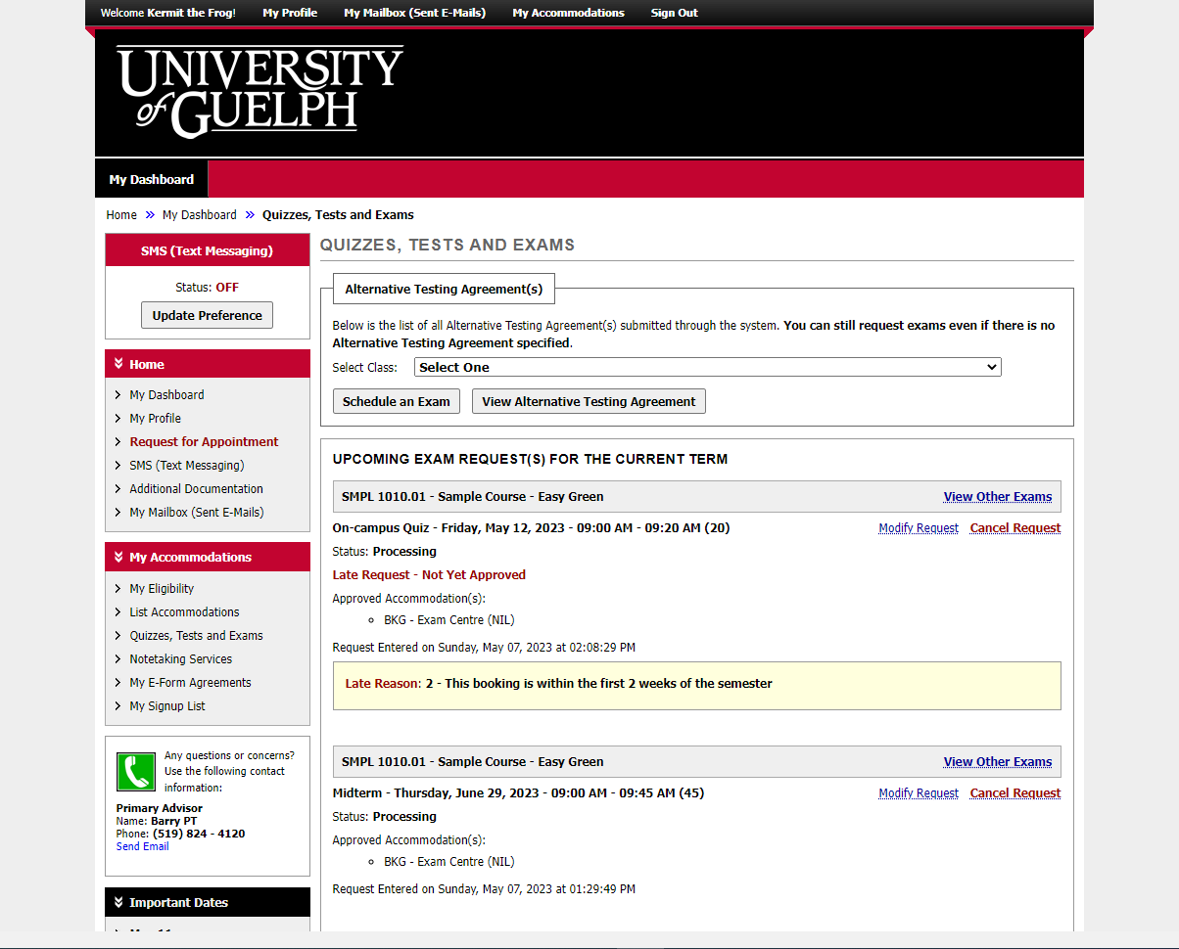
Notes:
“Quizzes, Tests and Exams” allows you to book to use the SAS Exam Centre and see the status of your current bookings. Again, this is covered in another video.

Slide 15
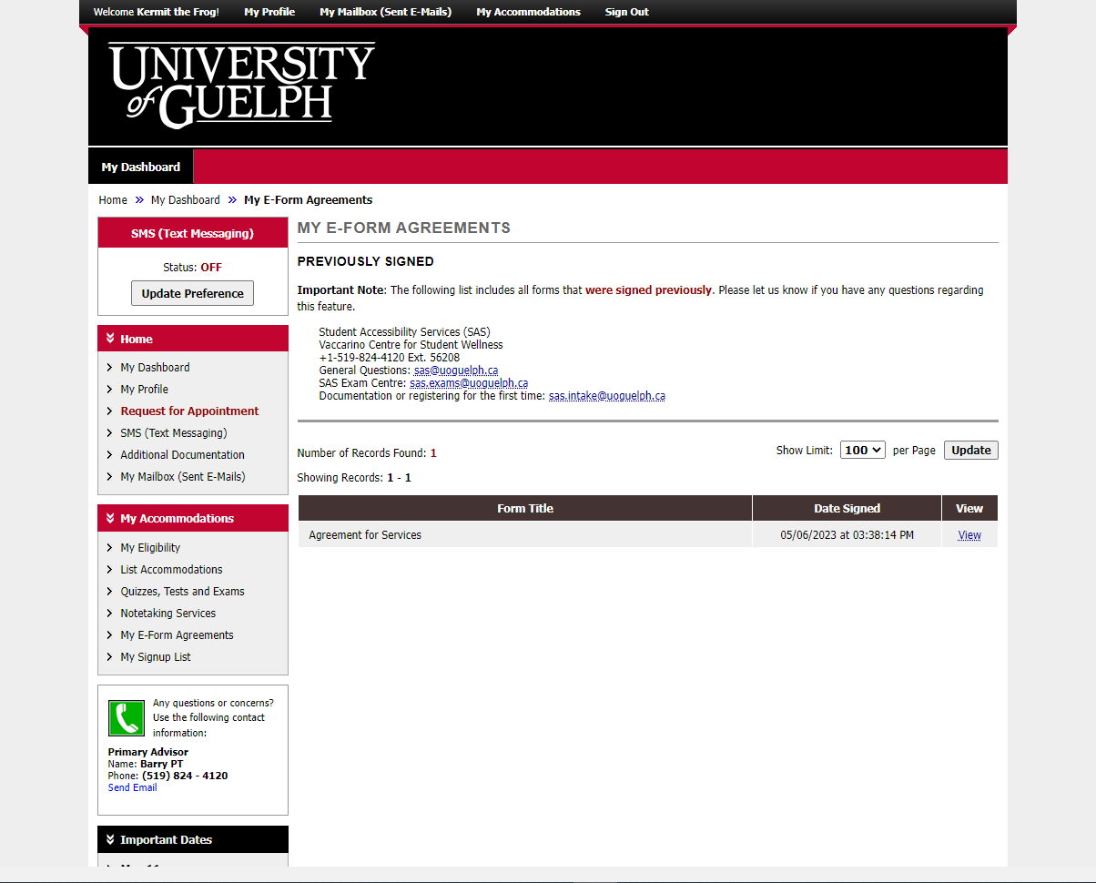
Notes:
“My E-Form Agreements” shows you items you have already signed, like the Agreement for Services we saw at the start. You can click on “view” to review the details.”

Slide 16
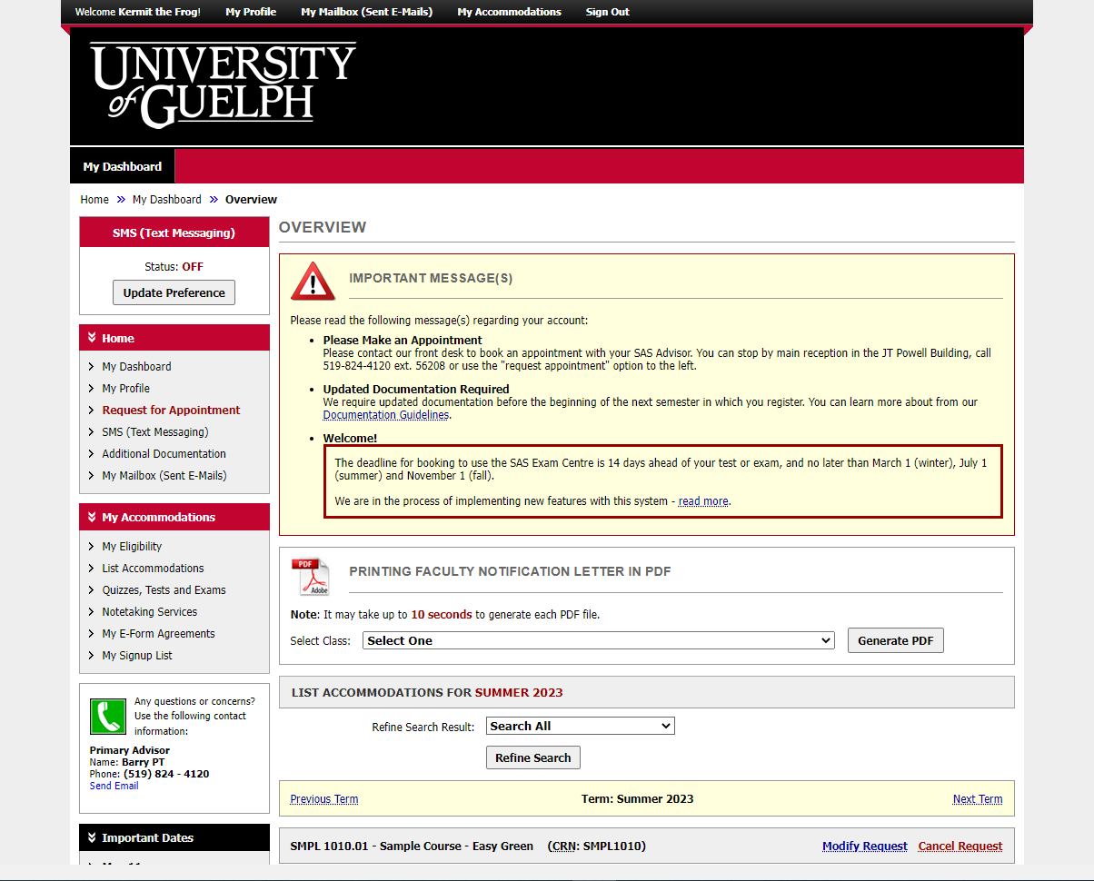
Notes:
SAS does not currently require students to print a copy of their accommodation letter for instructors. However, if you would like a copy for your own records, use the tool in the middle of the screen. Choose the relevant course, then click “Generate PDF”.

Slide 17
An Update is Coming
There will be some changes to colours and layout when the new version is released.
It will be mobile friendly and has some helpful new tools.
We don’t know the date yet.
When more information is available, it will be posted on the SAS website.

Slide 18
wellness.uoguelph.ca /accessibility
Contact Information

