Slide 1
SAS Student Portal Exam Booking with Details
Student Accessibility Services
Notes:
In these slides, we will demonstrate how to make a booking when an “alternative testing agreement” (ATA) has already been submitted by the instructor. The ATA provides all of the details we need, such as the date, time and format of the exams in this course.

Slide 2
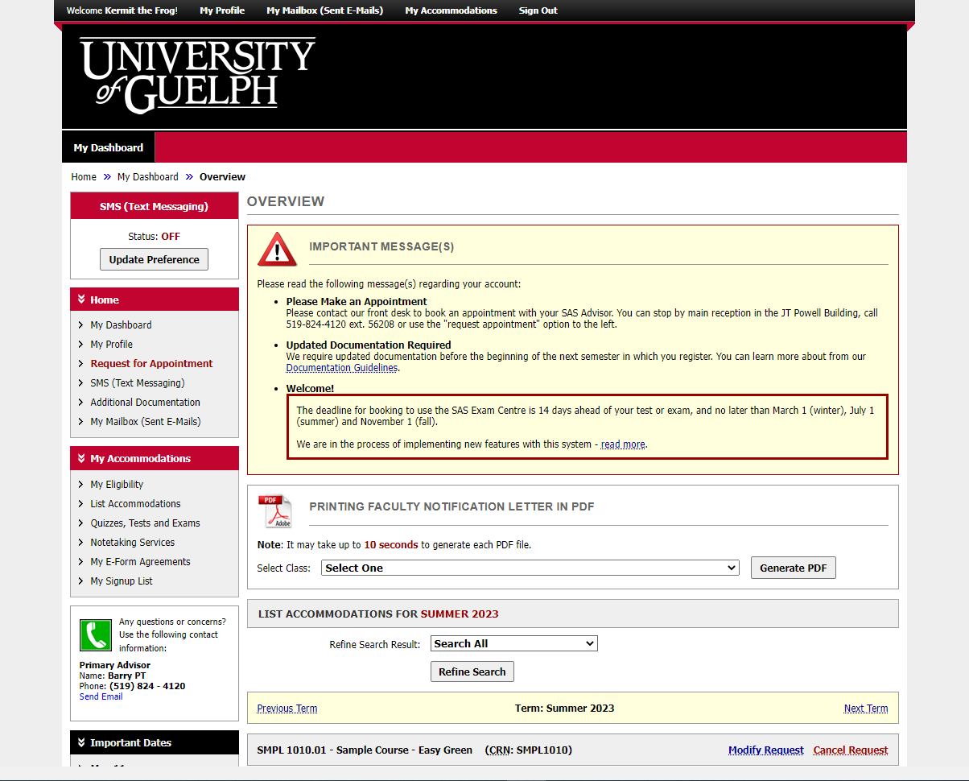
Notes:
This is the same dashboard you will always see when you login.

Slide 3
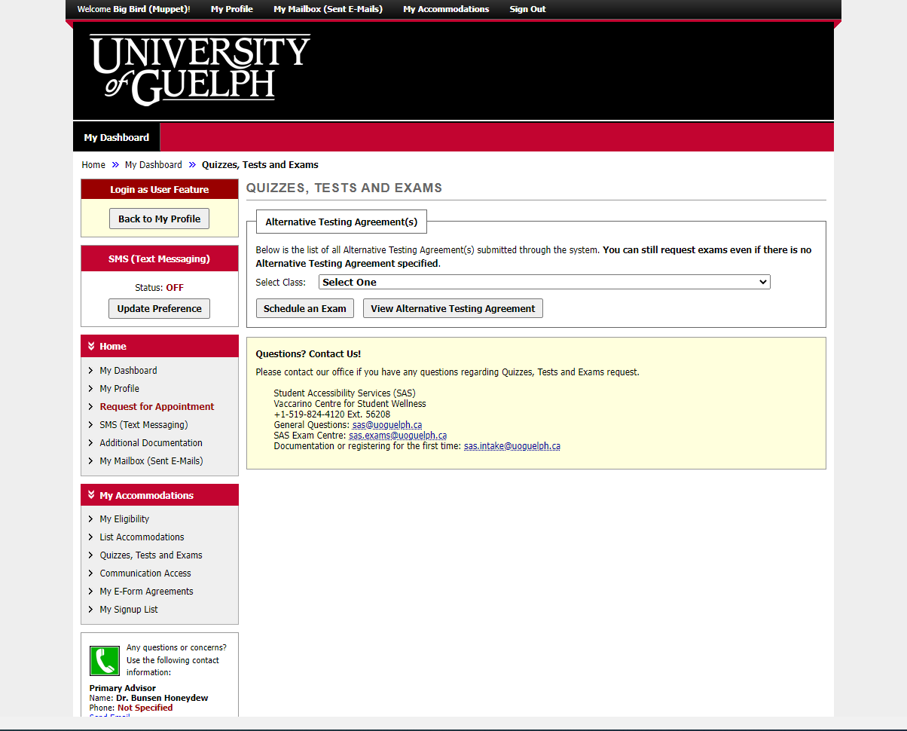
Notes:
In these slides, we will demonstrate how to make a booking when an “alternative testing agreement” (ATA) has already been submitted by the instructor. The ATA provides all the details we need, such as the date, time and format of the exams in this course.
There is a separate slide deck and video explaining the process when we have not received an alternative testing agreement.

Slide 4
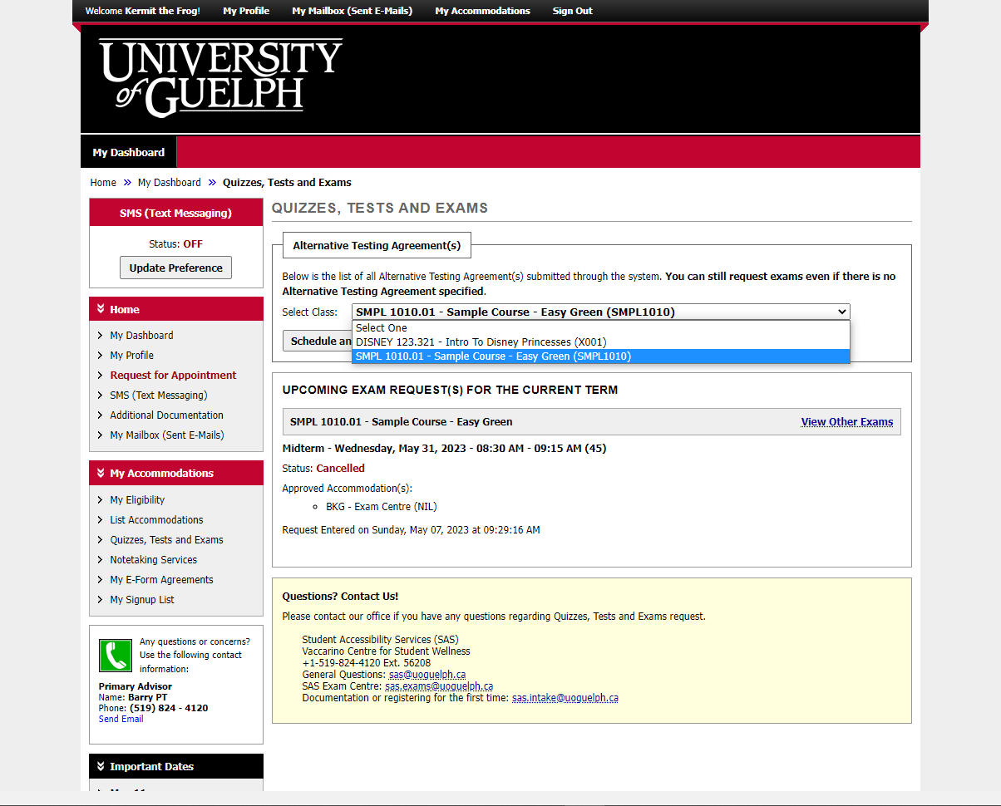
Notes:
Start by choosing one of your current courses.

Slide 5
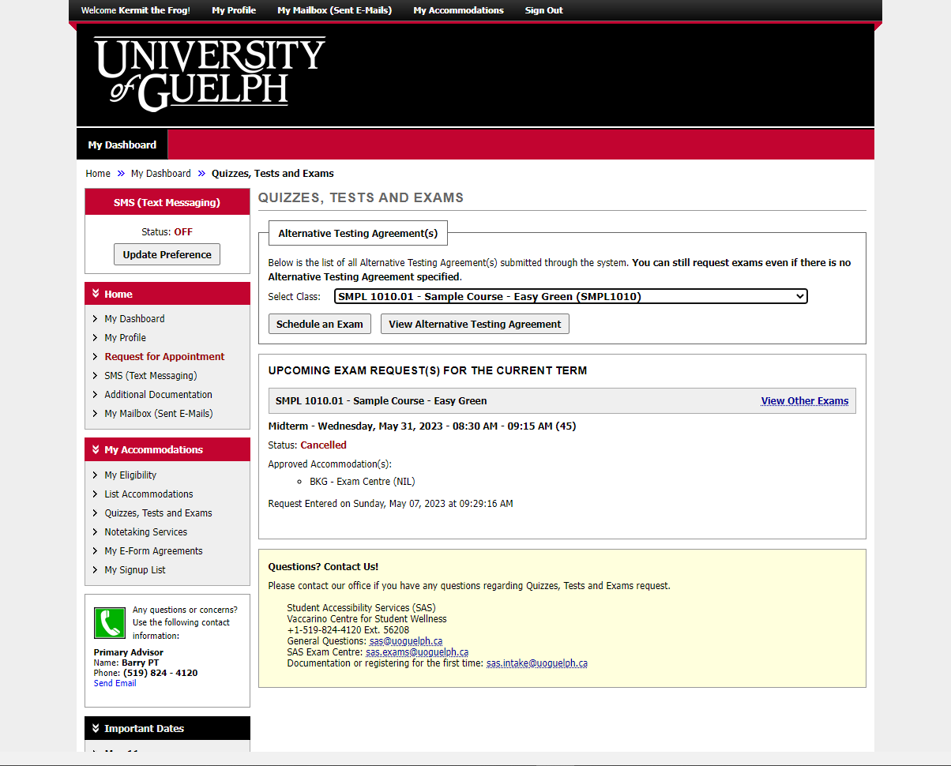
Notes:
Then click on the “Schedule an Exam” button.

Slide 6
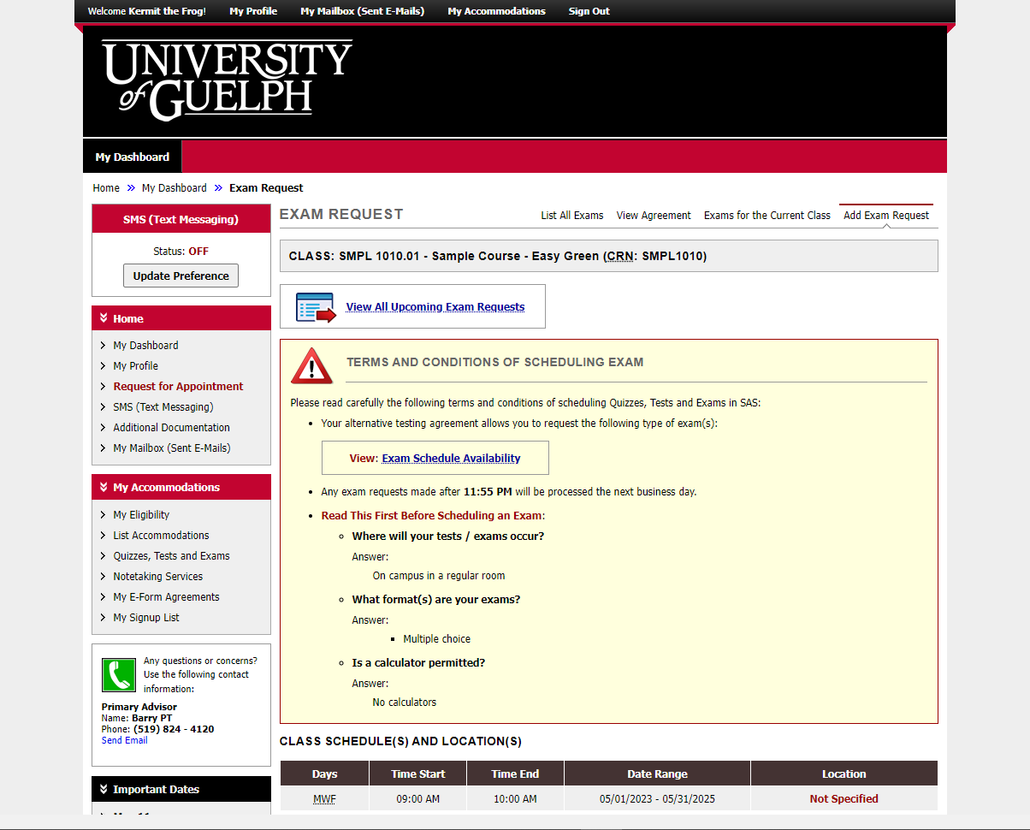
Notes:
The big yellow box in the centre of the screen includes instructions.
Unless you get an error message saying the exam centre is closed or the time you selected is unavailable, you probably won’t need the “exam schedule availability” tool.
In the middle of the screen is a message that says: “read this before scheduling an exam”. This is where you will find the details provided by the instructor.

Slide 7
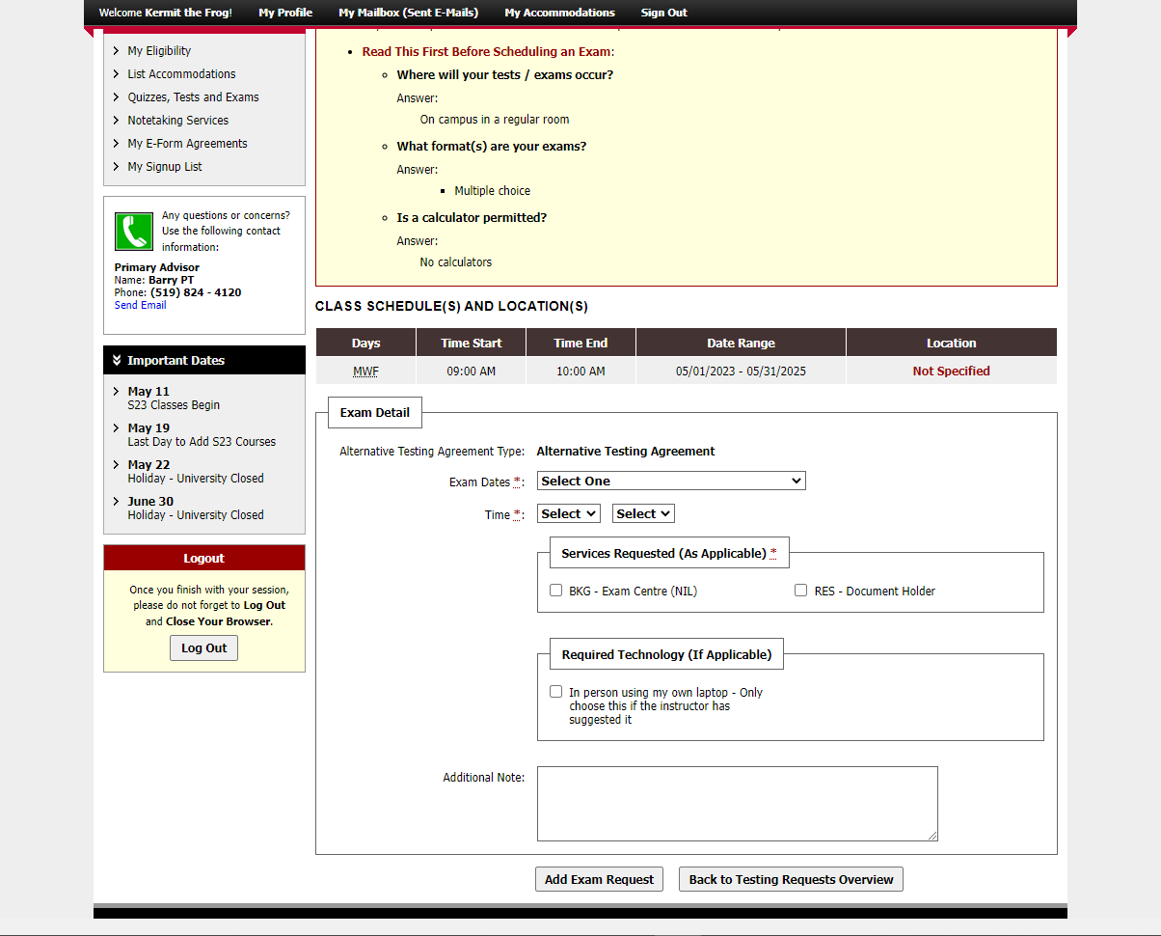
Notes:
We have scrolled down a little further and now we an see where you enter the exam details for you booking.

Slide 8
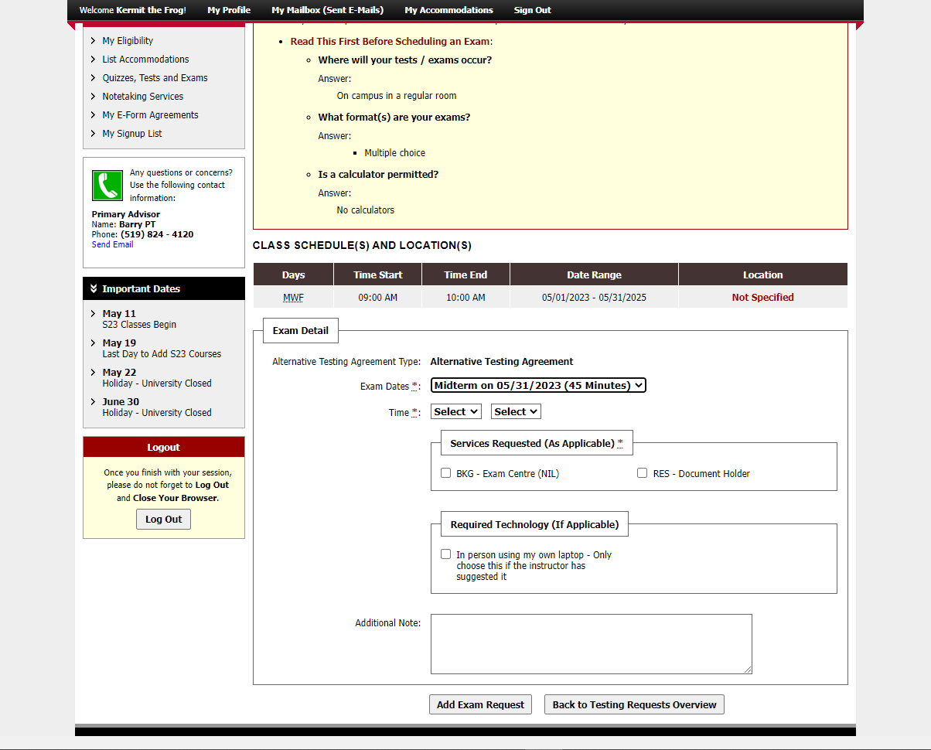
Notes:
In the “exam dates” field, choose the one you wish to book.

Slide 9
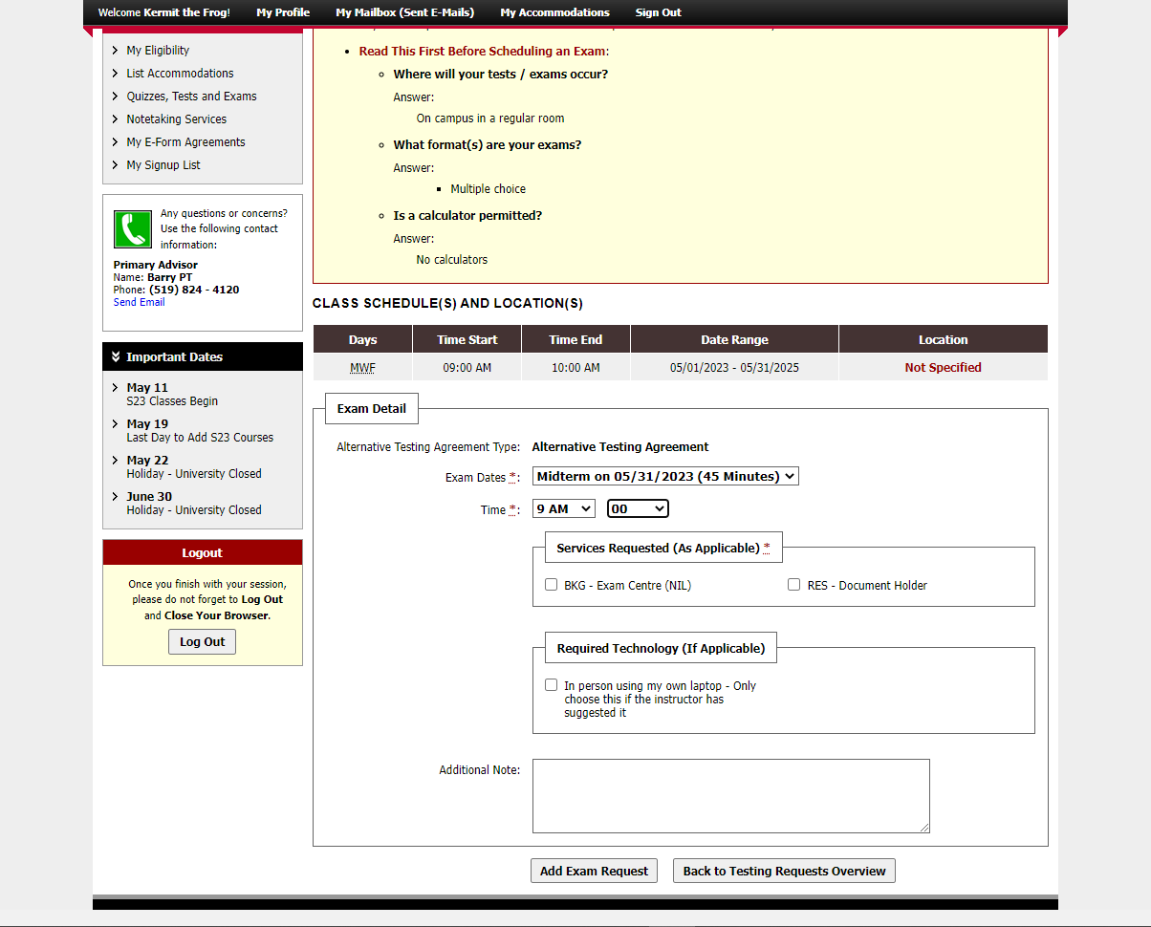
Notes:
Select the time when you will start writing. In general, you are required to choose the start time of the class, which should be indicated above.
All exams must finish by 9pm, so if you have extra time as an accommodation, you might need to start earlier.
Apart from starting earlier in order to finish by 9pm, you must get approval from the instructor if you are starting at a different time from the class.
Be sure to forward an email to sas.exams@uoguelph.ca from the instructor showing they have approved the alternate time, or your booking will be cancelled.

Slide 10
!
Notes:
In the “services requested” box, choose the accommodations you will require for this exam. If you are not sure what any of them mean, click on “My eligibility” in the navigation bar at the left to review the details.
In the “required technology” box, there is only one option: “in-person using my own laptop – only choose this if the instructor has suggested it.” This means the instructor is allowing students in the class to write the exam on their own laptops and you require an appropriate seat for this.

Slide 11
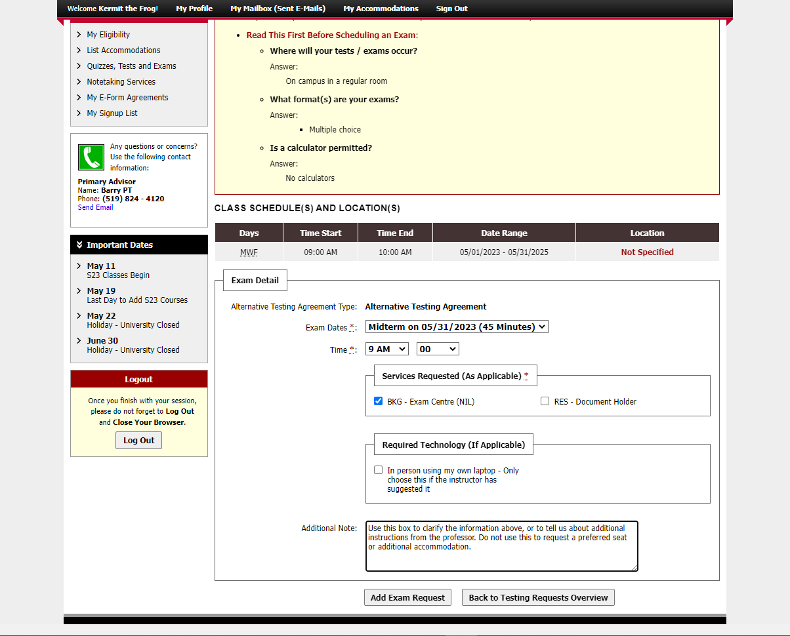
Notes:
Use the additional notes box to clarify the information above or to tell us about additional instructions from the professor. Do not use this to request a preferred seat or additional accommodation.
Click on “add exam request” when you have entered all the necessary details.

Slide 12
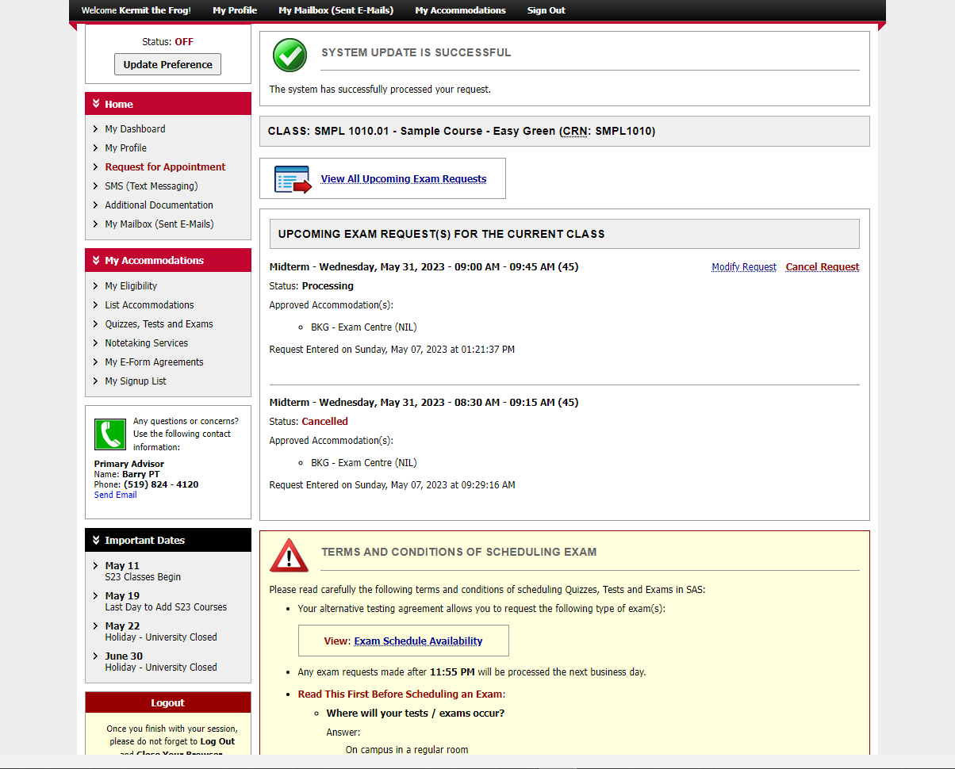
Notes:
You will see a green checkbox and message saying: “system update successful.”
You can now see the booking that was just submitted in the middle of the screen. From here you can modify or cancel the booking as needed. There is a separate video about modifying a booking.

Slide 13
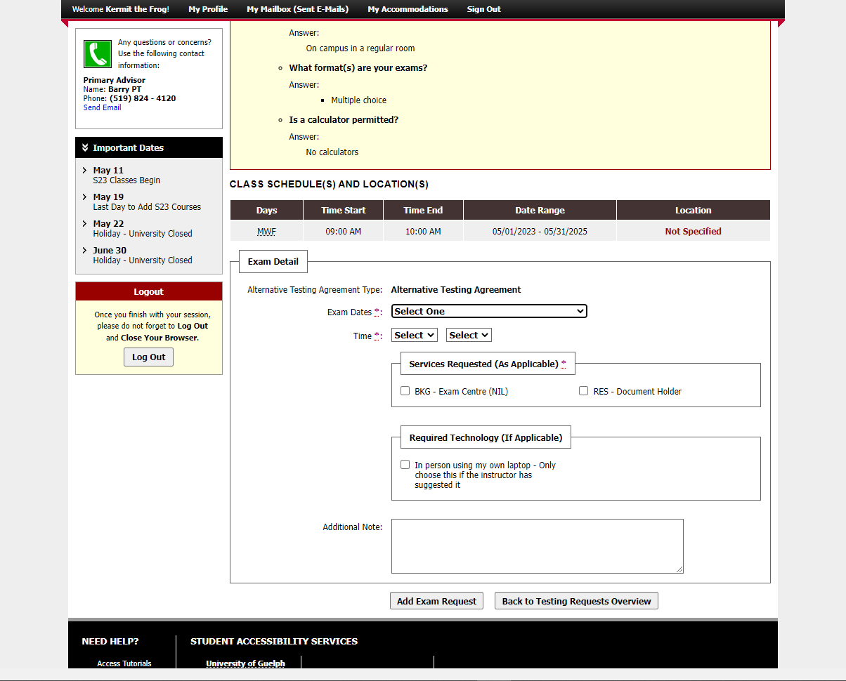
Notes:
If we scroll down, we can enter another booking for the same course (e.g. another midterm or the final exam).

Slide 14
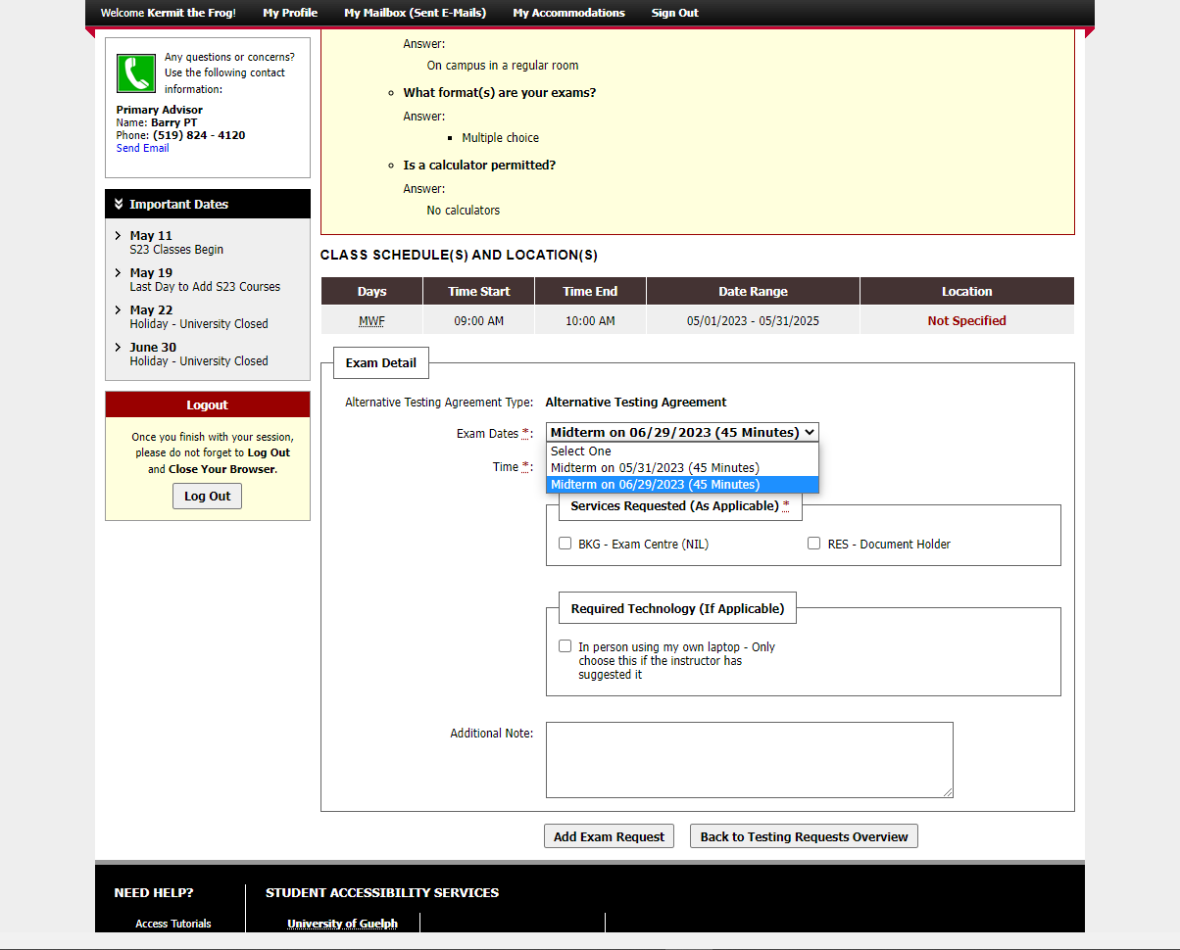
Notes:
Once again, choose the date from those provided.

Slide 15
Notes:
Enter the starting time.

Slide 16
Notes:
Choose the accommodations you require for this exam.

Slide 17
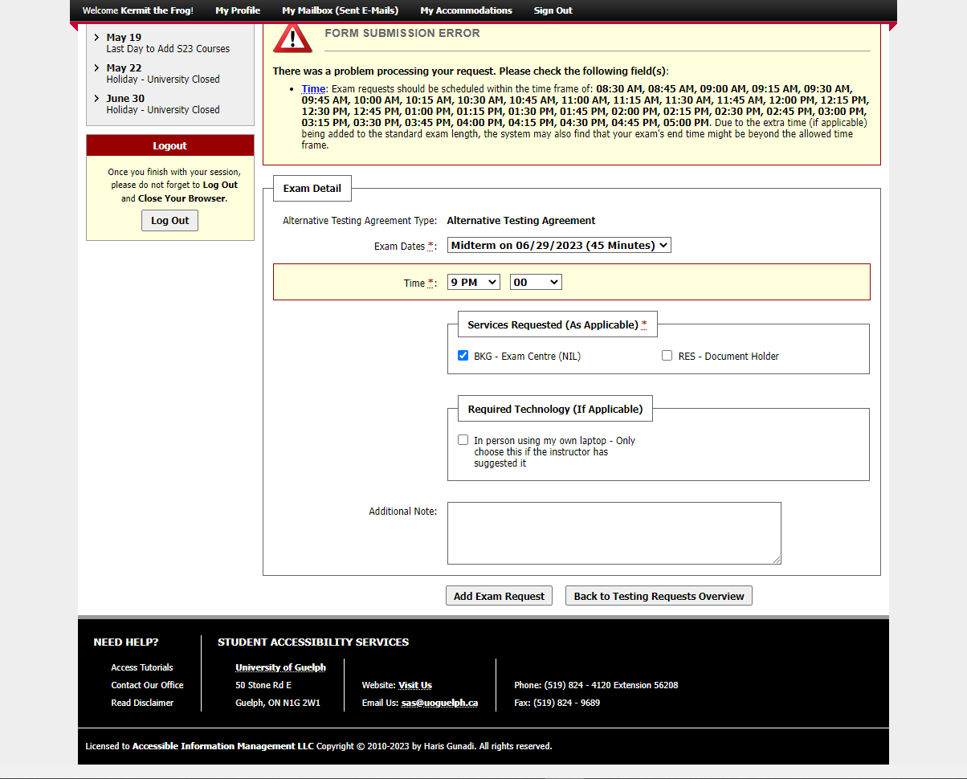
Notes:
Oops! There’s an error message caused by the time we chose. In this case, we chose 9 pm which is when the exam centre closes.

Slide 18
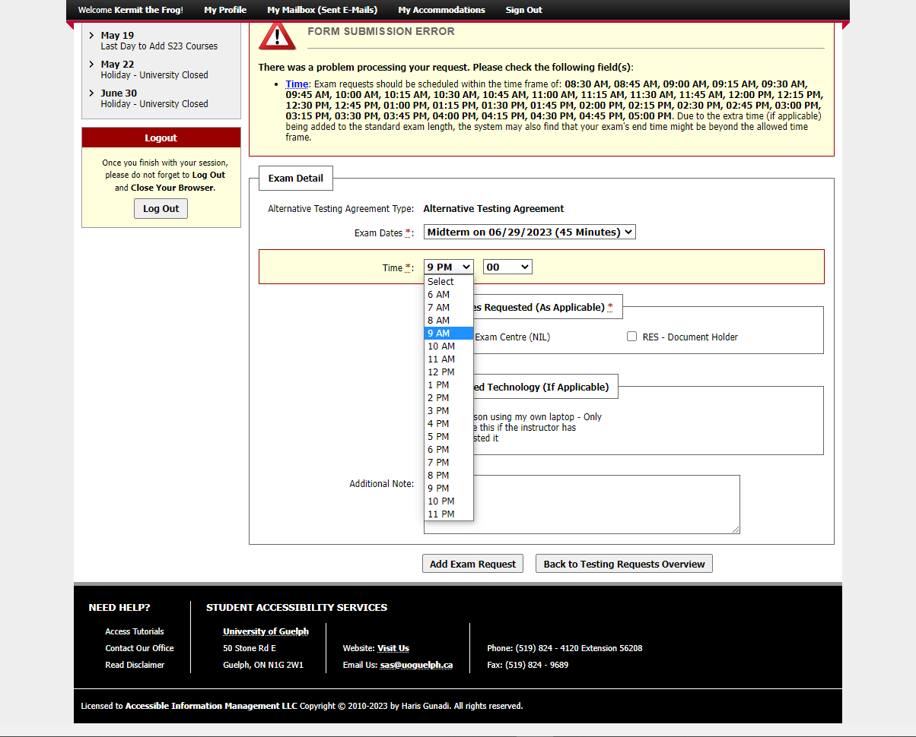
Notes:
Correct the error by changing the time to 9 am.

Slide 19
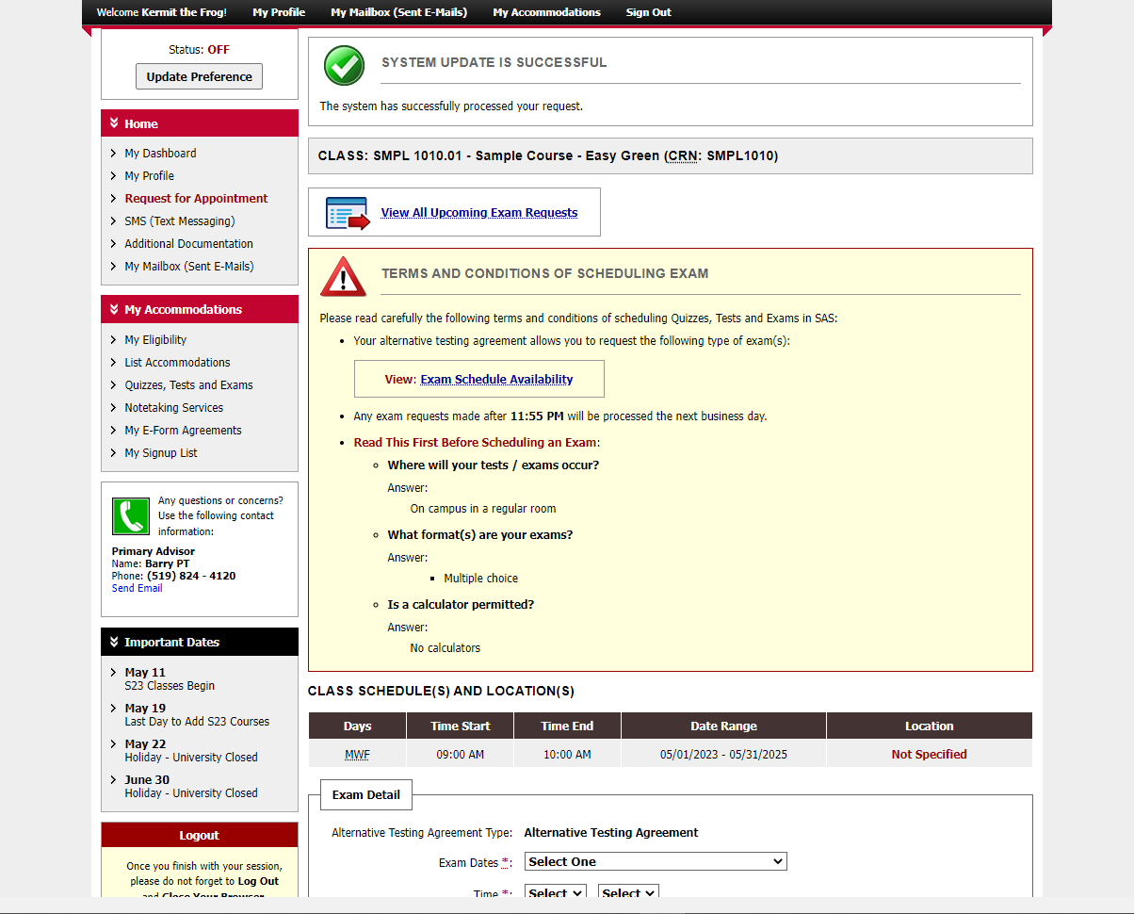
Notes:
Once again, after you submit your exam request, you’ll see the “system update is successful message”.

Slide 20
Notes:
You can always review your bookings by clicking on the “quizzes, tests and exams” button in the navigation bar on the left.

Slide 21
An Update is Coming
There will be some changes to colours and layout when the new version is released.
It will be mobile friendly and has some helpful new tools.
We don’t know the date yet.
When more information is available, it will be posted on the SAS website.

Slide 22
wellness.uoguelph.ca /accessibility
Contact Information

