Slide 1
SAS Student Portal Exam Booking without Details
Student Accessibility Services

Slide 2
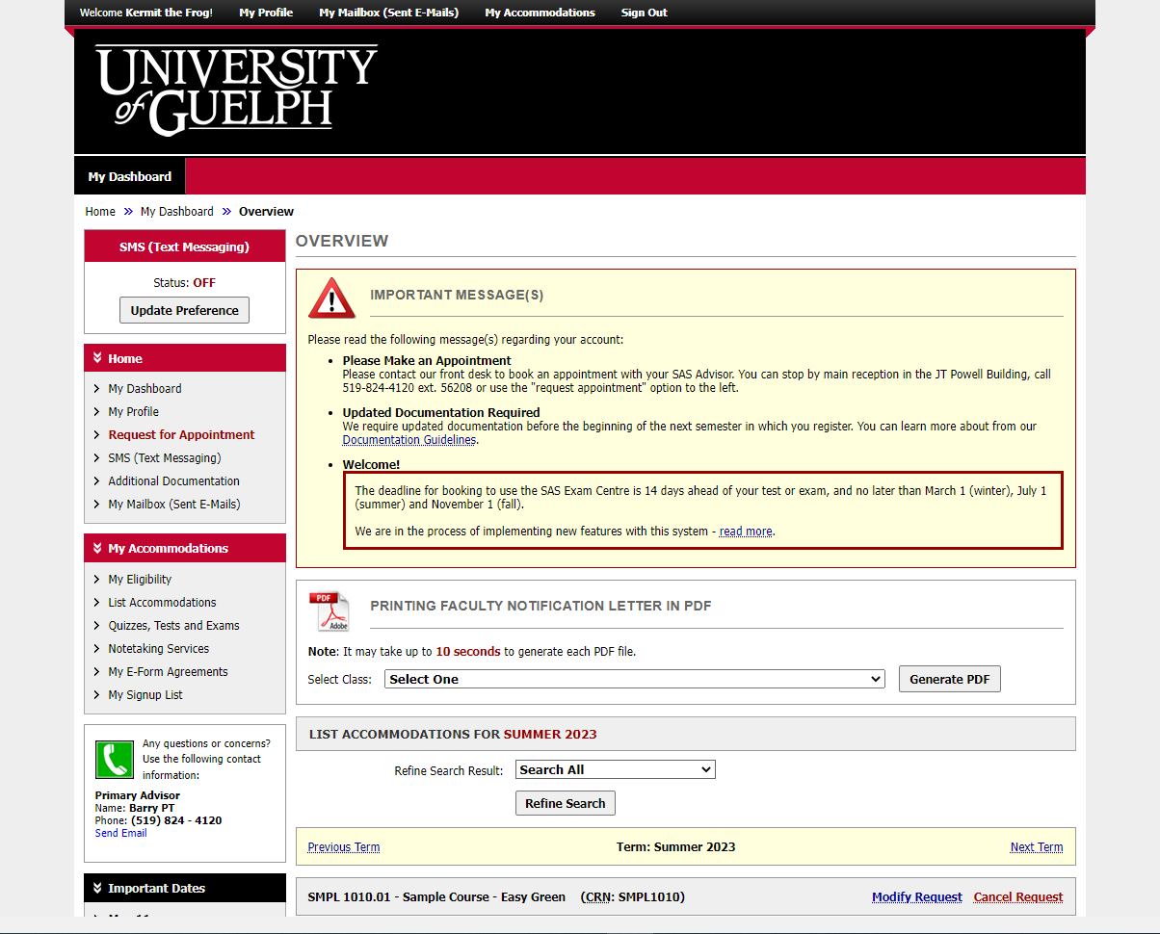
Notes:
This is the same dashboard you will always see when you login.

Slide 3
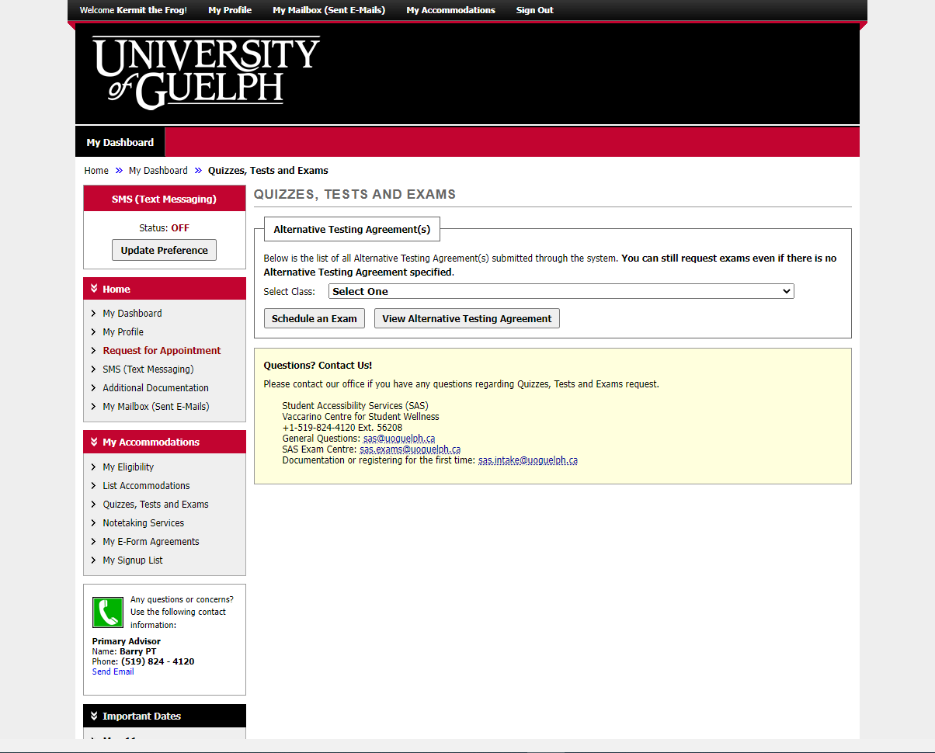
Notes:
In these slides, we will demonstrate how to make a booking when an “alternative testing agreement” (ATA) has NOT YET been submitted by the instructor.
The ATA provides all the details we need, such as the date, time and format of the exams in this course. The process is similar to when we do have an ATA but it looks a little different on screen and you cannot make changes until we receive the necessary details.
There is a separate slide deck and video demonstrating the process when we have an alternative testing agreement.

Slide 4
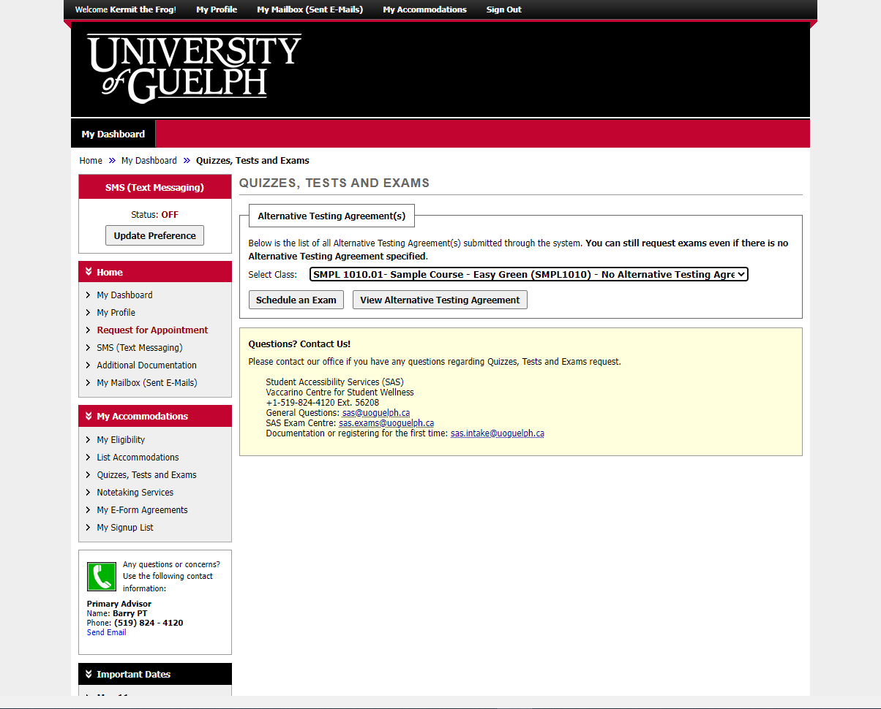
Notes:
Begin by selecting a course, then click on “schedule an exam.”

Slide 5
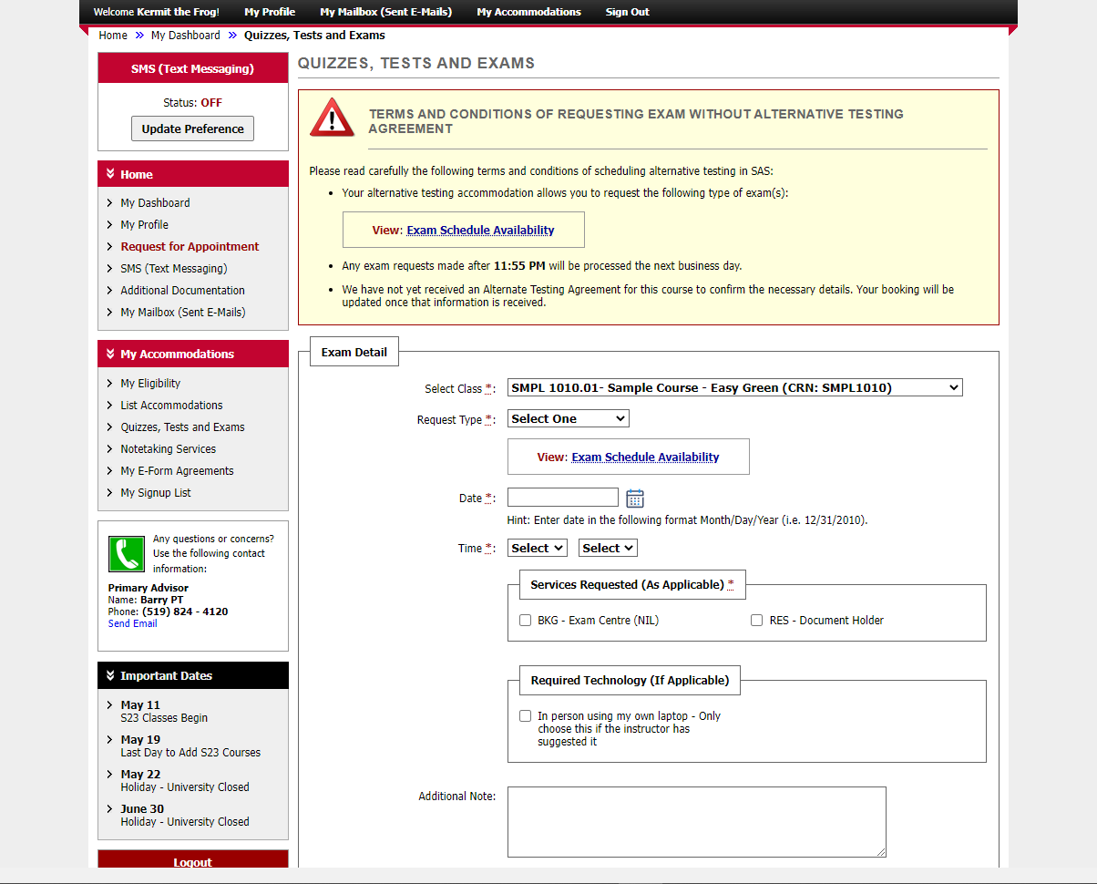
Notes:
The big yellow box in the centre of the screen includes instructions.
Unless you get an error message saying the exam centre is closed or the time you selected is unavailable, you probably won’t need the “exam schedule availability” tool.

Slide 6
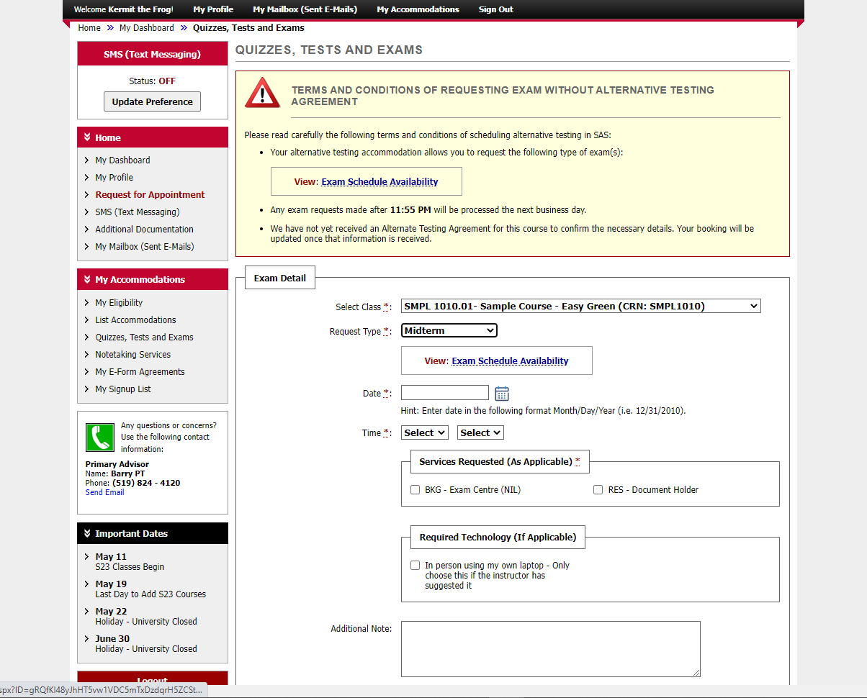
Notes:
In the “request type” field, one of these options: midterm or test, in-person quiz, or final exam.

Slide 7
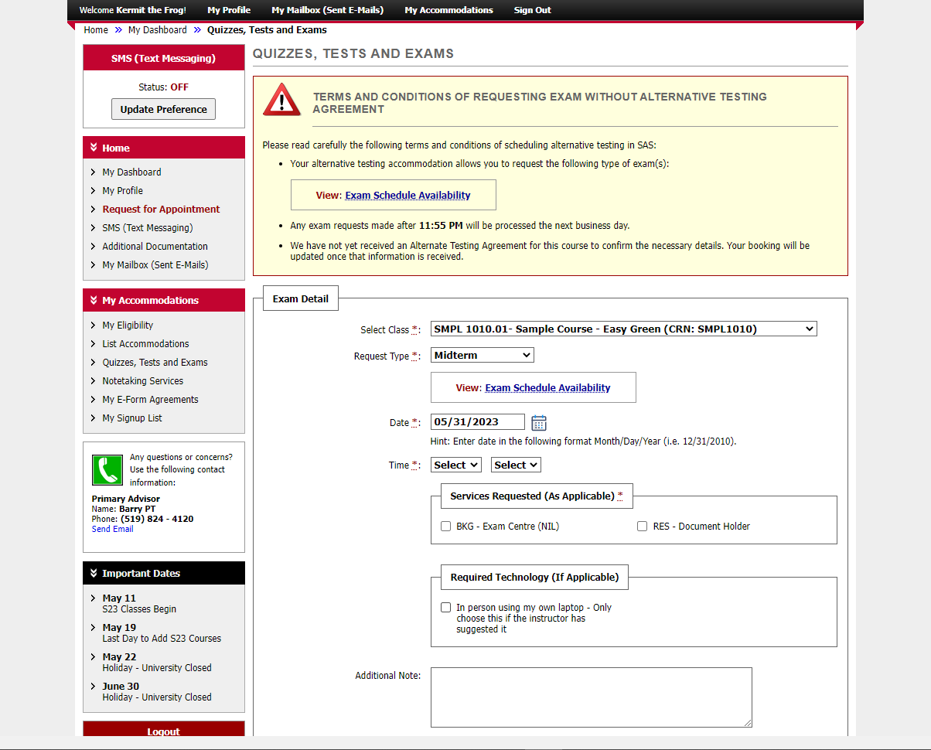
Notes:
Select the date.

Slide 8
Notes:
Indicate the time.

Slide 9
Notes:
Indicate the time when you need to start writing. All exams must finish by 9pm, so if you have extra time as an accommodation, you might need to start earlier.
Apart from starting earlier in order to finish by 9pm, you must get approval from the instructor if you are starting at a different time from the class.
Be sure to forward an email to sas.exams@uoguelph.ca from the instructor showing they have approved the alternate time, or your booking will be cancelled.

Slide 10
Notes:
In the “required technology” box, there is only one option: “in-person using my own laptop – only choose this if the instructor has suggested it.” This means the instructor is allowing students in the class to write the exam on their own laptops and you require an appropriate seat for this.

Slide 11
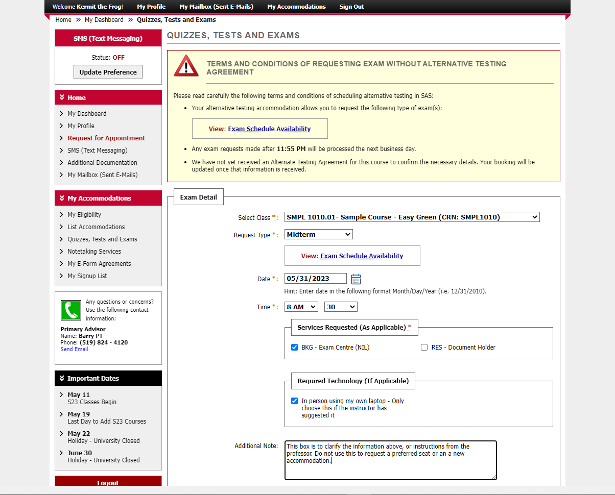
Notes:
Use the additional notes box to clarify the information above or to tell us about additional instructions from the professor. Do not use this to request a preferred seat or additional accommodation.

Slide 12
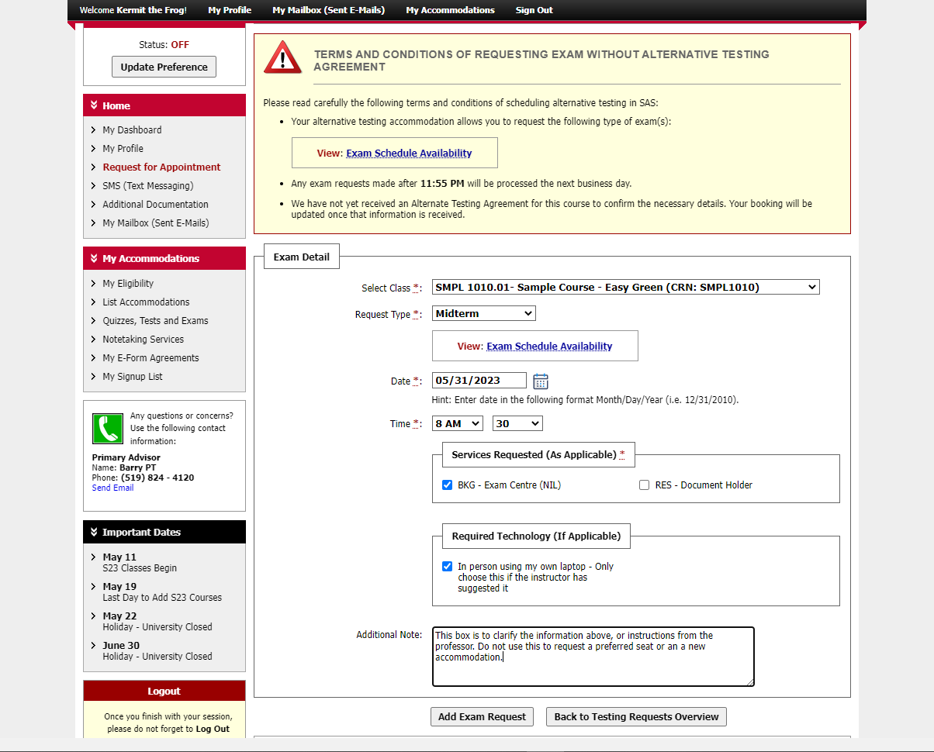
Notes:
Click on “add exam request” when you have entered all the necessary details.

Slide 13
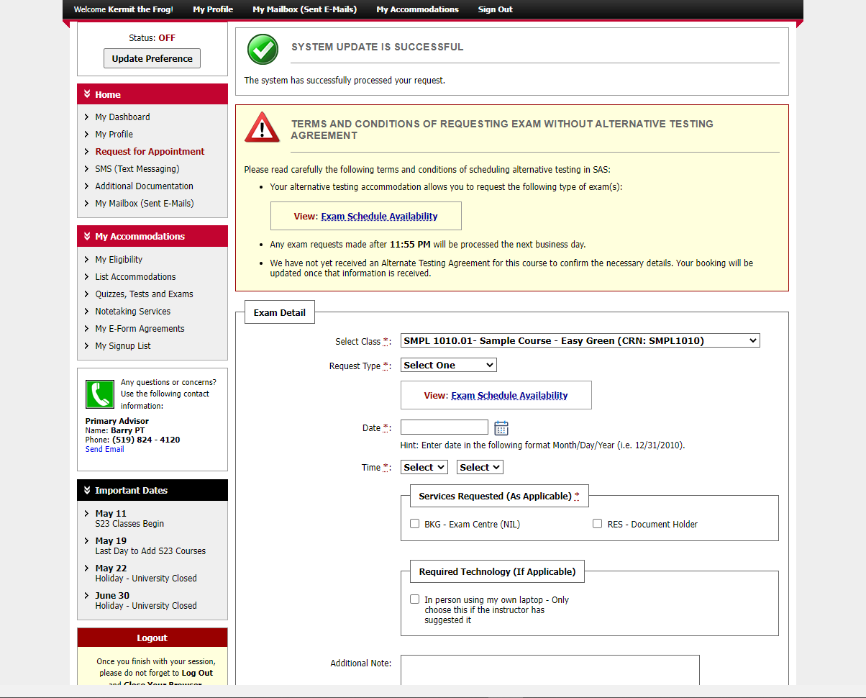
Notes:
You will see a green checkbox and message saying: “system update successful.”
You can now add another booking as needed.

Slide 14
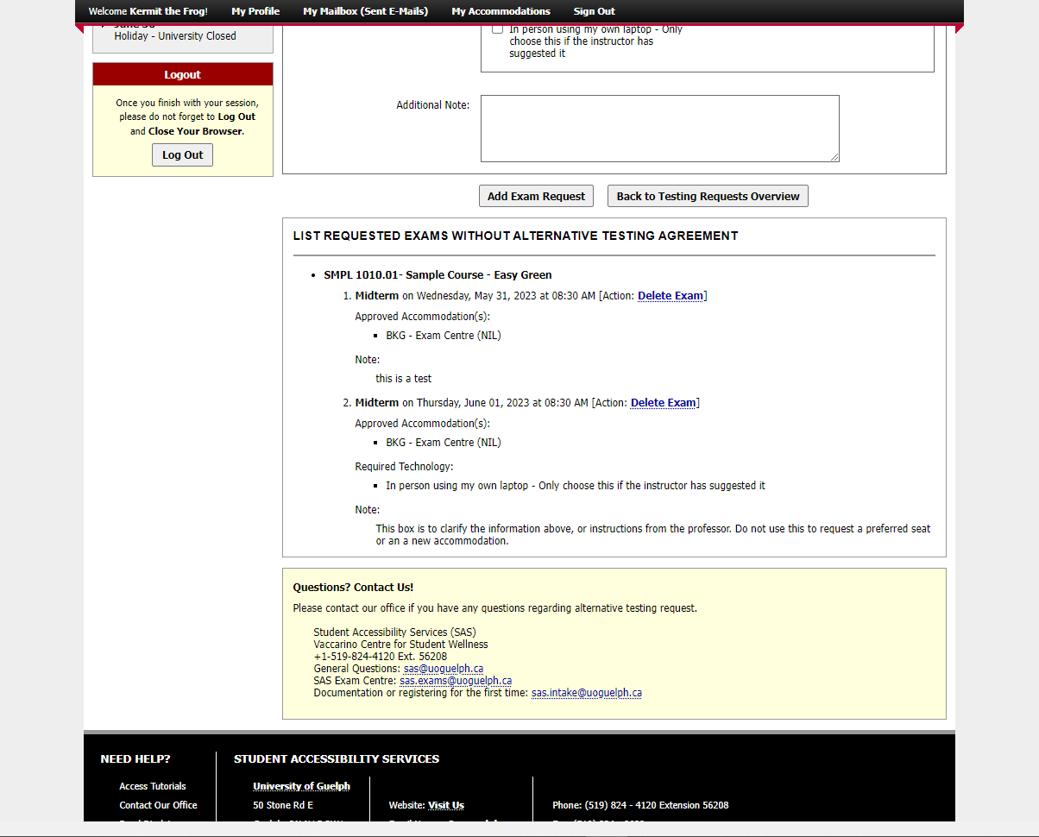
Notes:
If you scroll to the bottom of the page, you’ll see the bookings you have submitted already for this course.
Click on “delete exam” if it is no longer needed. Use this with caution as there is no confirmation step – the booking is simply cancelled when you click on “delete exam”. If you do this by mistake, you’ll have to enter a new booking.

Slide 15
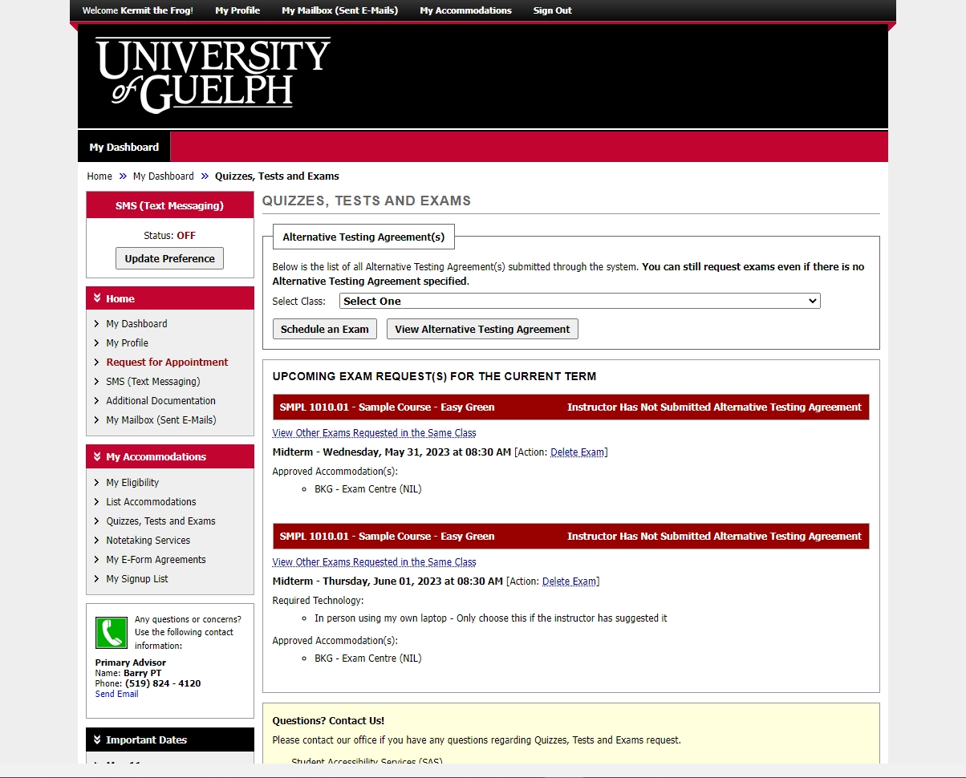
Notes:
If you click on the “quizzes, tests and exams” option in the navigation bar, again you’ll see any bookings you’ve made. There is a red heading above each one that is not yet connected to an alternative testing agreement. This will change once we receive and have processed the details from the instructor.

Slide 16
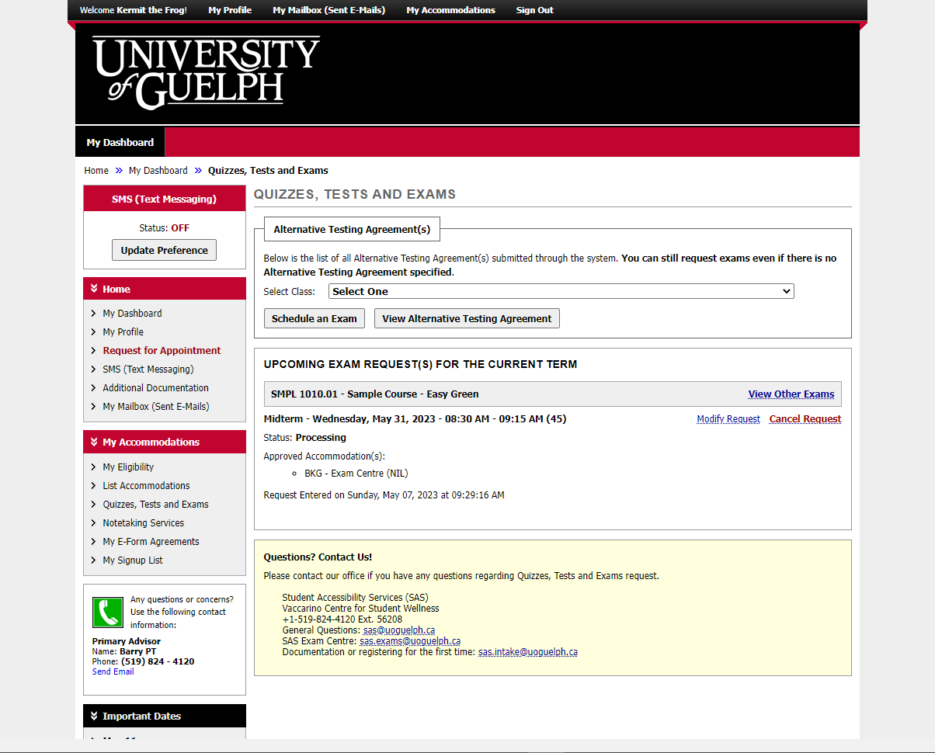
Notes:
This is what a booking looks like after an alternative testing agreement has been received.

Slide 17
An Update is Coming
There will be some changes to colours and layout when the new version is released.
It will be mobile friendly and has some helpful new tools.
We don’t know the date yet.
When more information is available, it will be posted on the SAS website.

Slide 18
wellness.uoguelph.ca /accessibility
Contact Information

