Slide 1
SAS Student Portal Modifying an Exam Booking
Student Accessibility Services

Slide 2
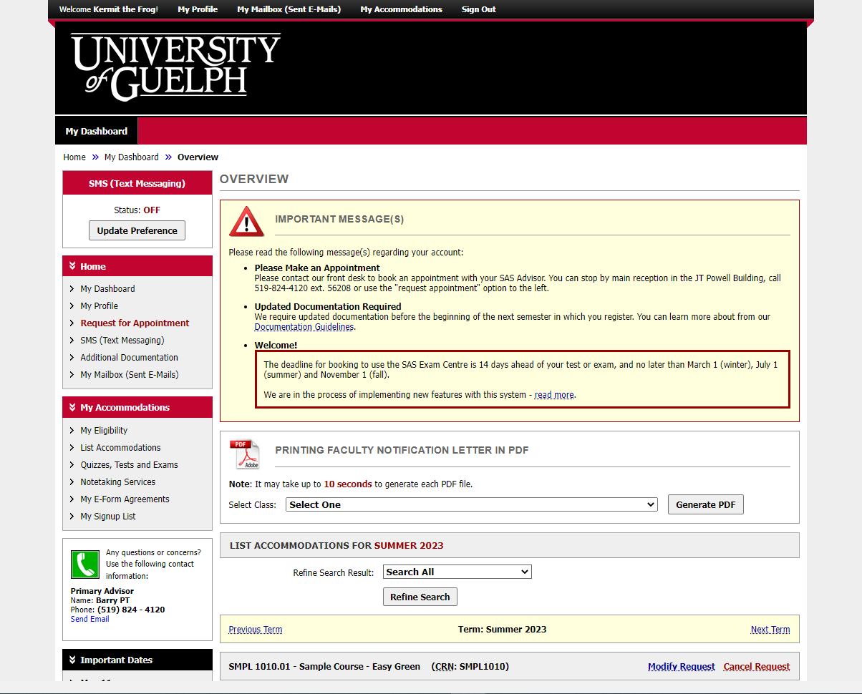
Notes:
This is the same dashboard you will always see when you login.

Slide 3
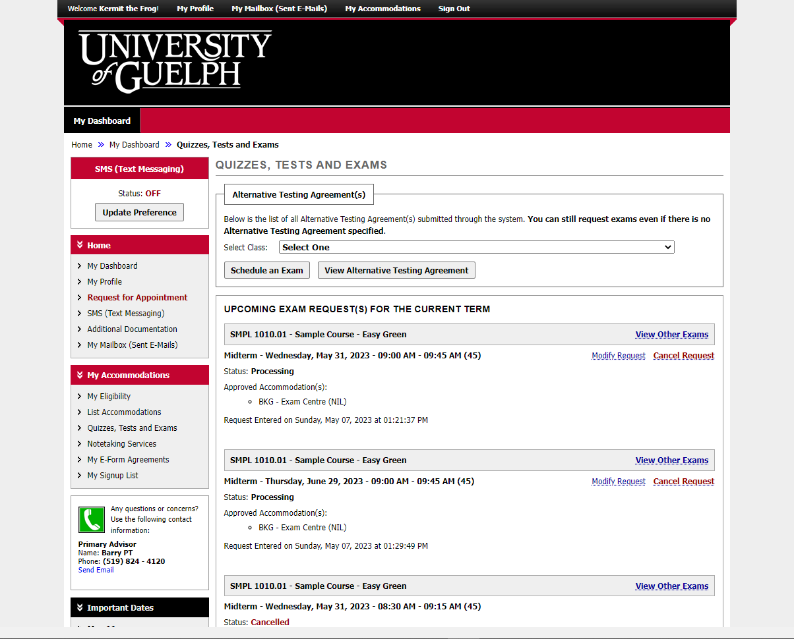
Notes:
Review the bookings you have already submitted and click on “modify” next to the one you wish to change. This is only possible if an alternative testing agreement has been submitted by the instructor.

Slide 4
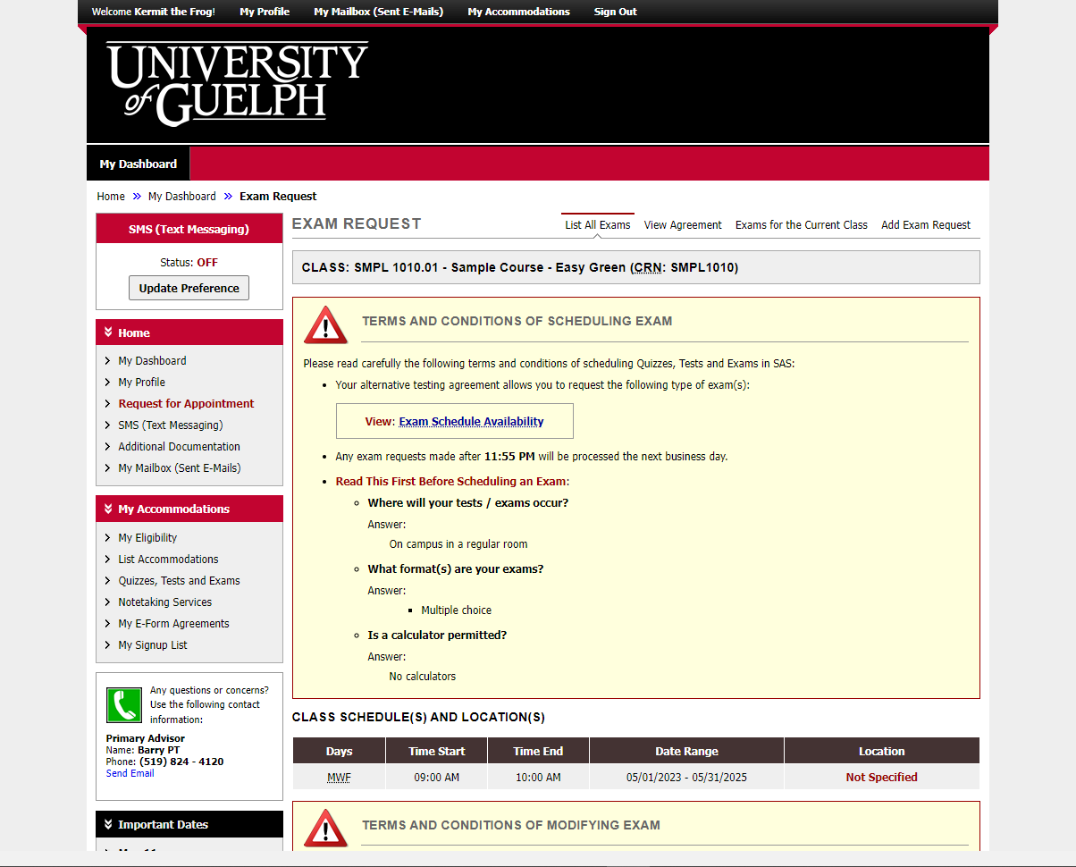
Notes:
Similar to when you made the initial booking, you will first see the terms and conditions box with details from the instructor.

Slide 5
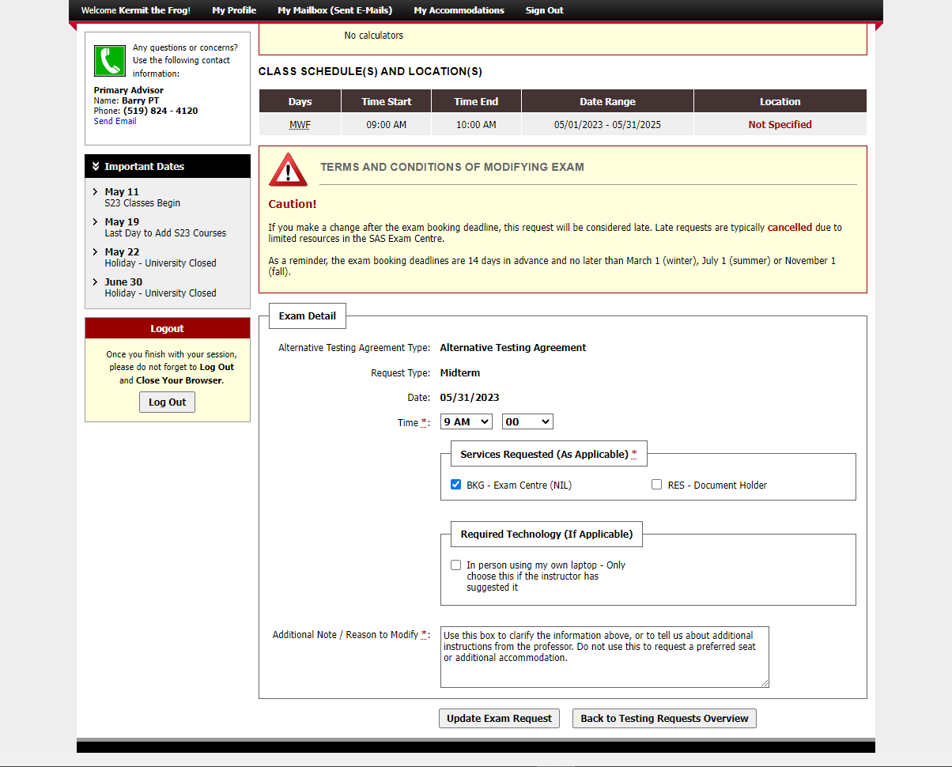
Notes:
When you scroll down, you will see an additional box that contains a caution. It tells you that making a change after a booking deadline results in the request being considered late. Late requests are typically cancelled due to limited resources in the SAS Exam Centre.
If this booking has already been confirmed, the status may also be reset to “processing” as the changes will need to be reviewed in case it changes where you are to be seated.
There is also a reminder of the exam booking deadlines.

Slide 6
Notes:
In the bottom section, you can make changes to the details you submitted. For example, you can change the time, which accommodations you require, or the note for the exam centre staff. You cannot change the date.
When you are finished, click “update exam request”.

Slide 7
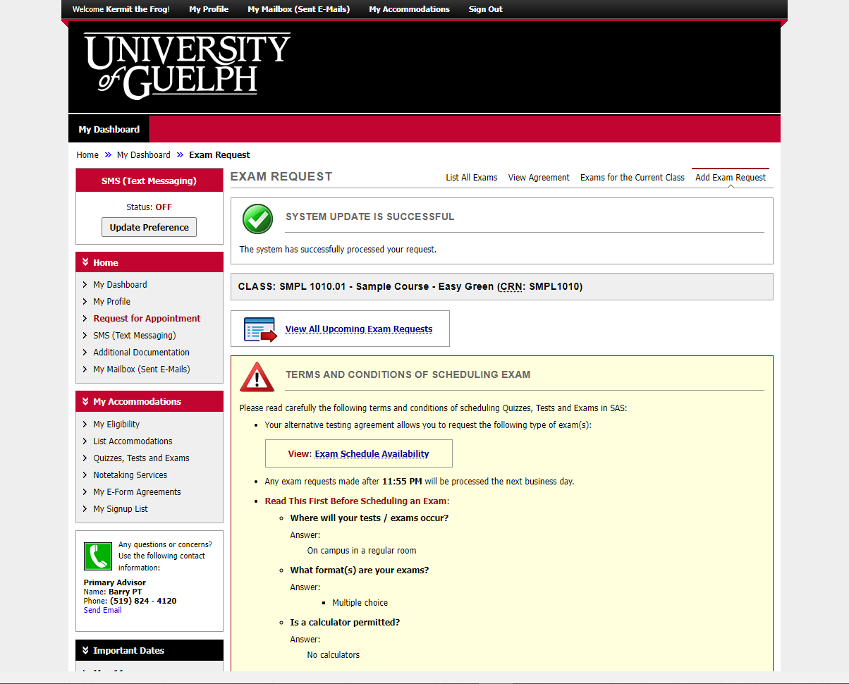
Notes:
At the top of the screen there is now a message that says: “system update is successful.

Slide 8
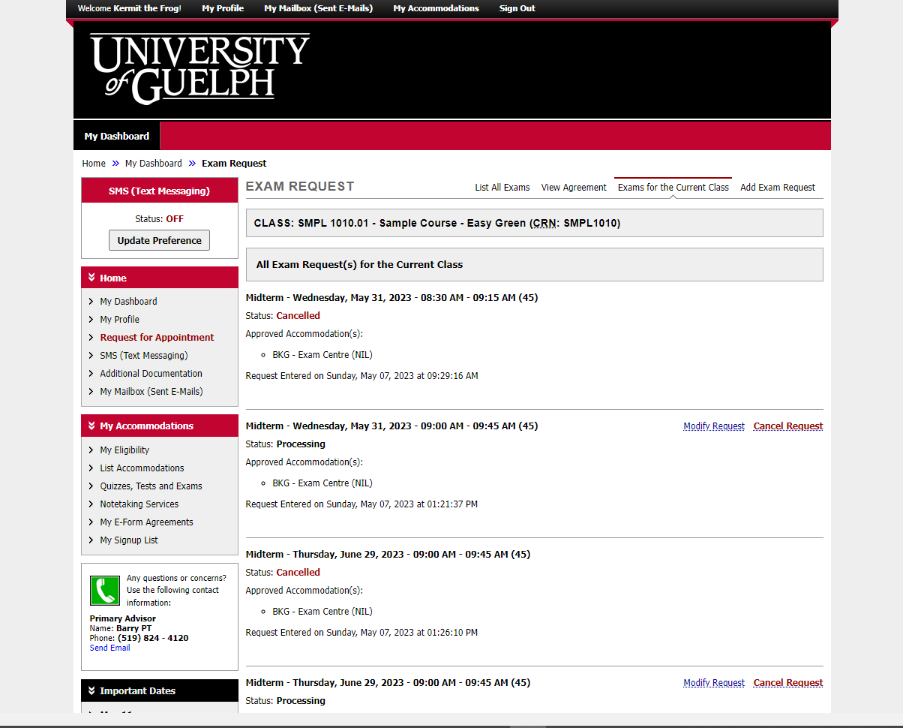
Notes:
You can also choose to cancel an exam booking, if it is no longer needed (e.g. if you have dropped the course).
There is a $20 no-show fee if you do not attend your exam booking and do not cancel.

Slide 9
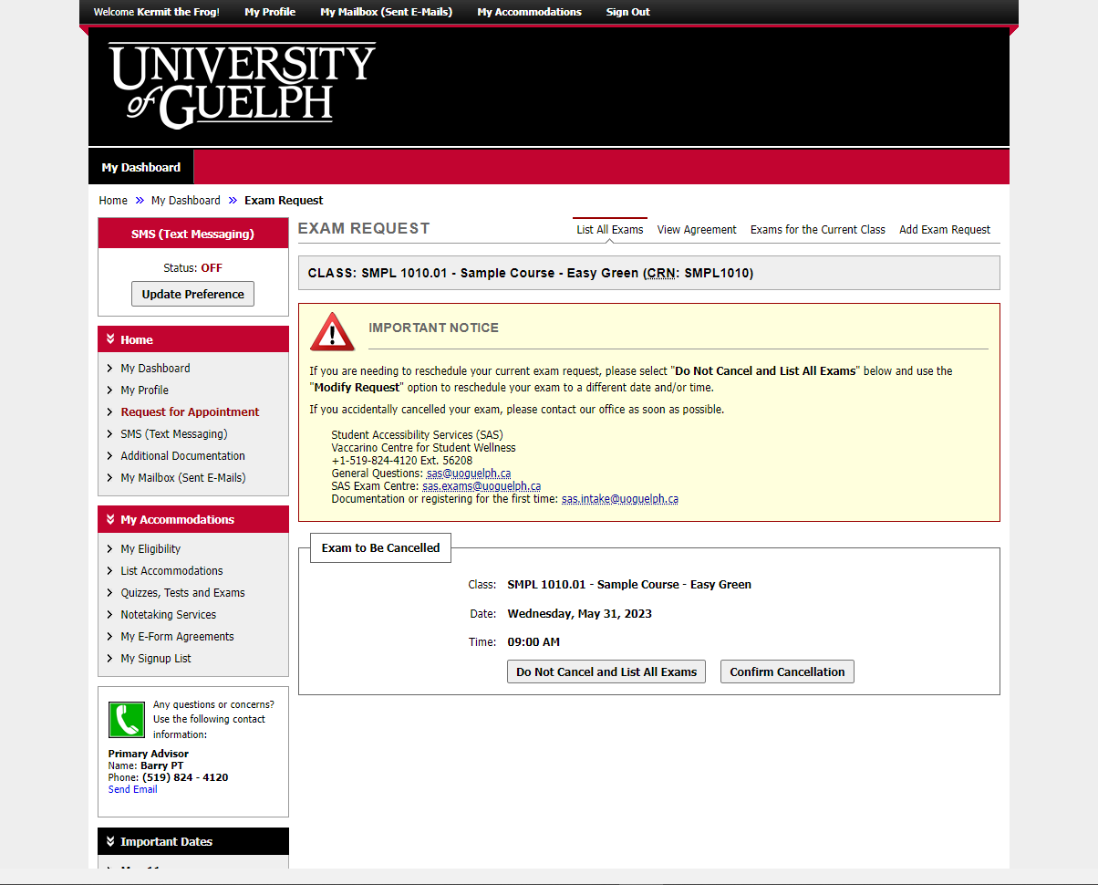
Notes:
The system will ask you to confirm that you want to cancel this booking.
The Important notice box reminds you not to cancel if you simply need to make a change. Instead, go back and use the “modify request” option.

Slide 10
An Update is Coming
There will be some changes to colours and layout when the new version is released.
It will be mobile friendly and has some helpful new tools.
We don’t know the date yet.
When more information is available, it will be posted on the SAS website.

Slide 11
wellness.uoguelph.ca /accessibility
Contact Information

