Slide 1
SAS Student Portal Late Exam Requests
Student Accessibility Services
Notes:
In these slides, we will review what happens when you submit a late exam request.

Slide 2
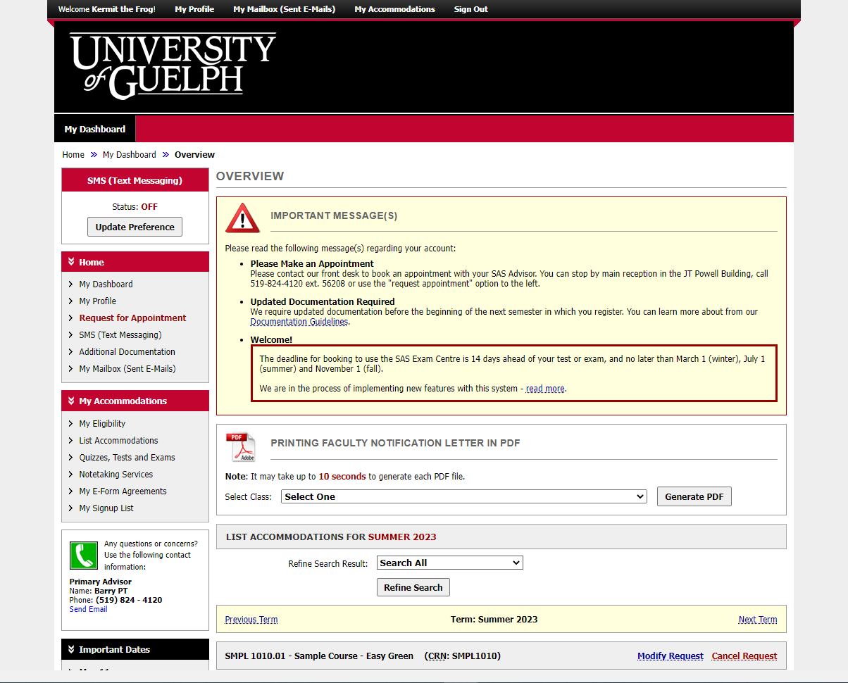
Notes:
This is the same dashboard you will always see when you login.

Slide 3
Modifying a Booking After the Deadline

Slide 4
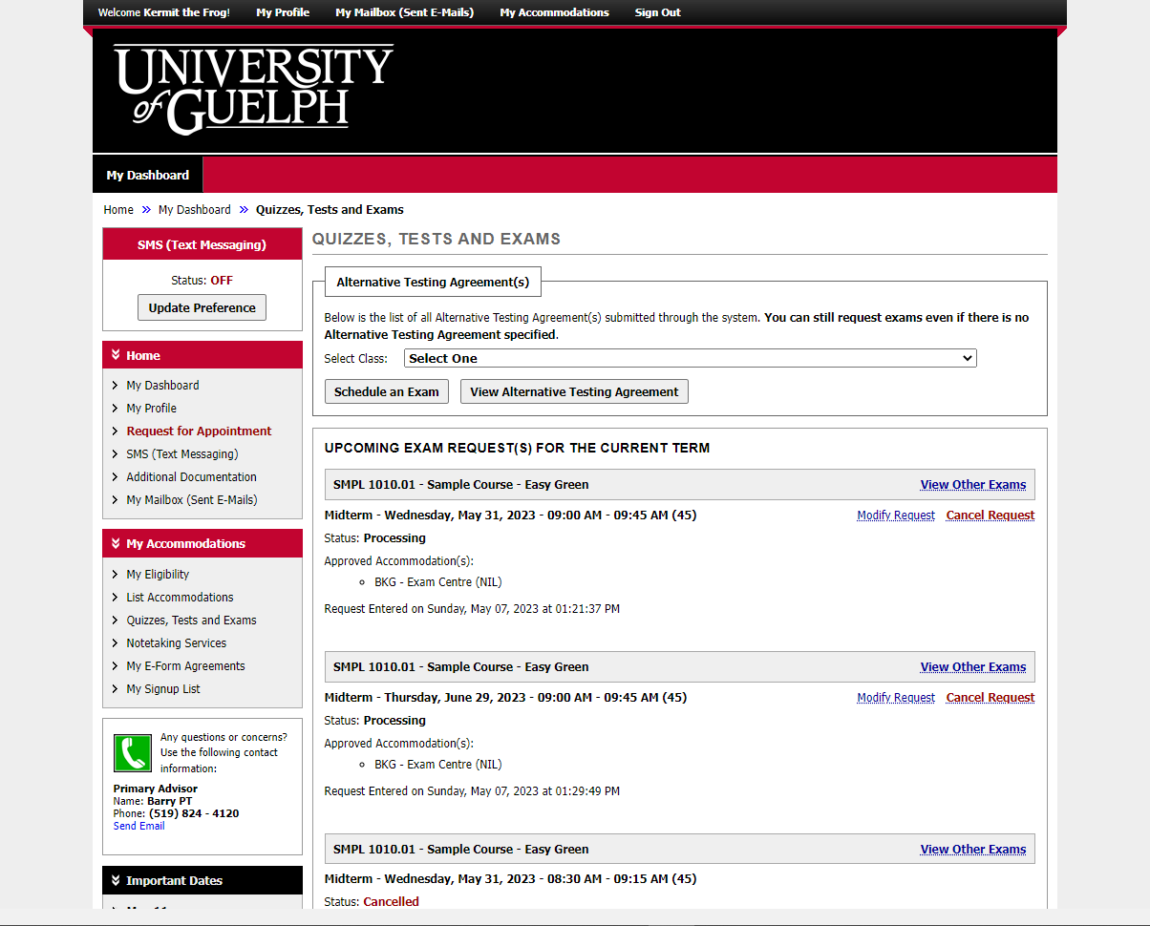
Notes:
Begin by selecting the course for which you want to make a booking. Then click on “schedule an exam.”
You can also click on “modify request” next to an existing exam booking. If it is after the booking deadline, this will be considered late.

Slide 5
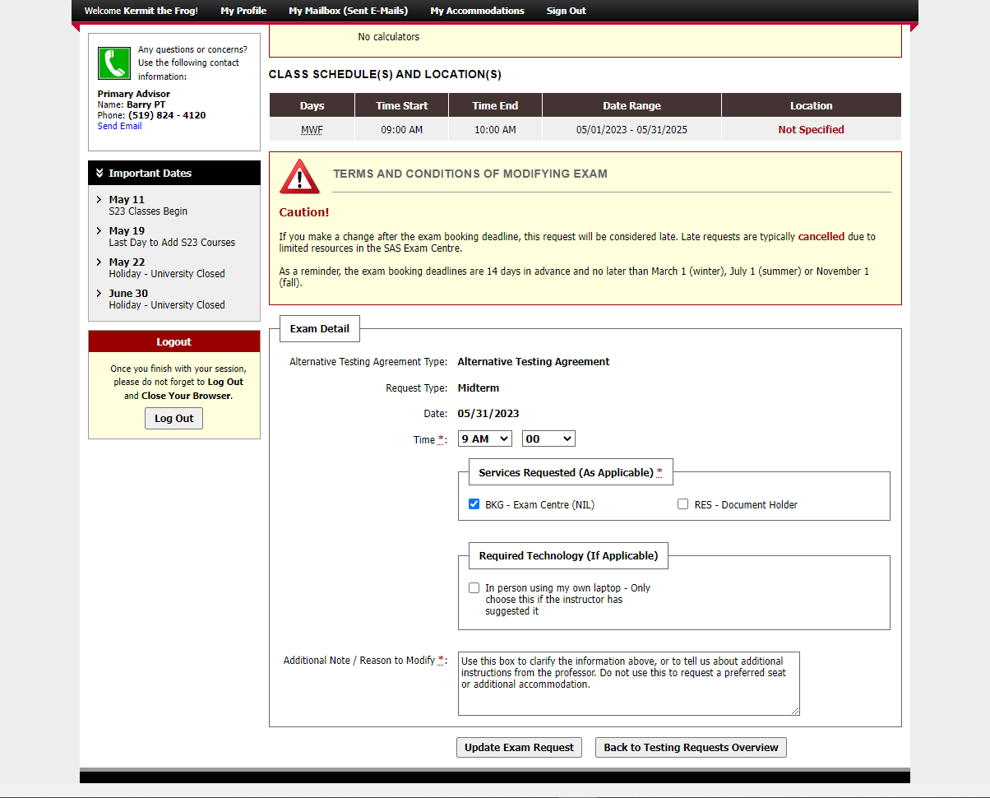
Notes:
Note there is a message indicating that if you modify an exam booking after the deadline, it will be considered late. Late requests are typically cancelled due to limited resources in the SAS Exam Centre.
We have selected the option to modify an existing booking. When you scroll down on the page, you can see all the details you entered, and you can change any of them except the date.

Slide 6
Notes:
This student has chosen to add an additional accommodation.
You must add an explanation to the “additional note” box about why you are making a change.
When you are finished making changes, click on “update exam request.”

Slide 7
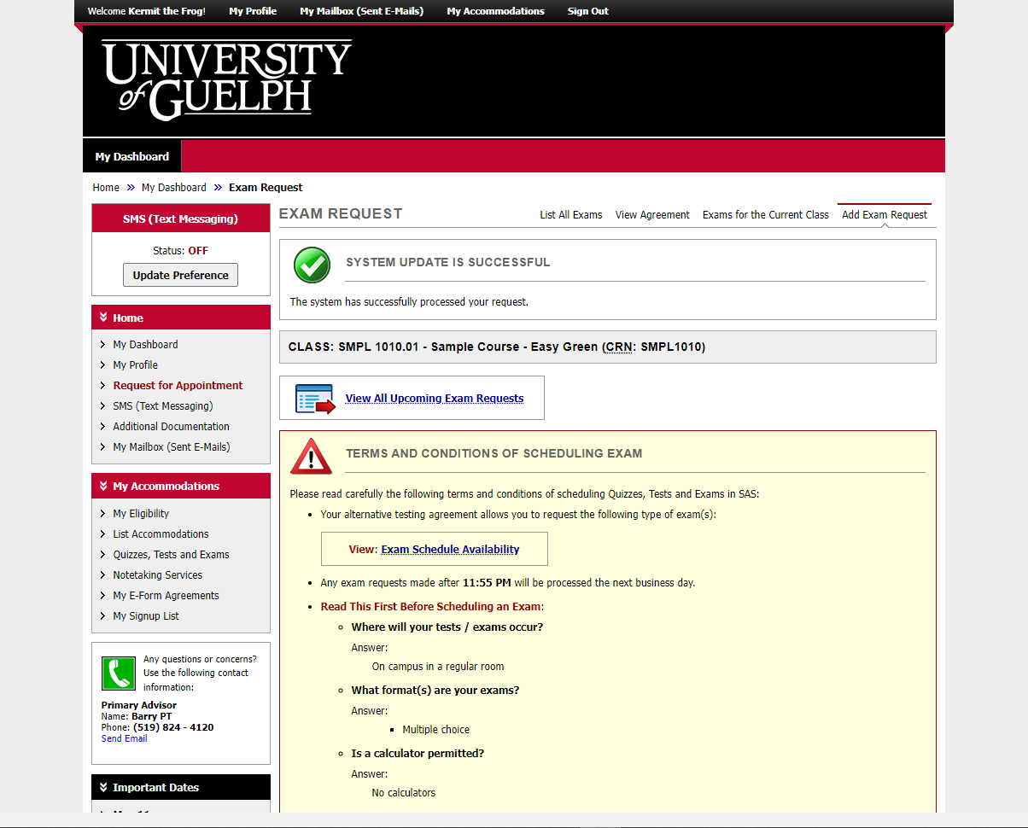
Notes:
You will see a green checkmark icon and the “system update is successful” message when your information has been recorded.

Slide 8
Requesting a Booking After the Deadline

Slide 9
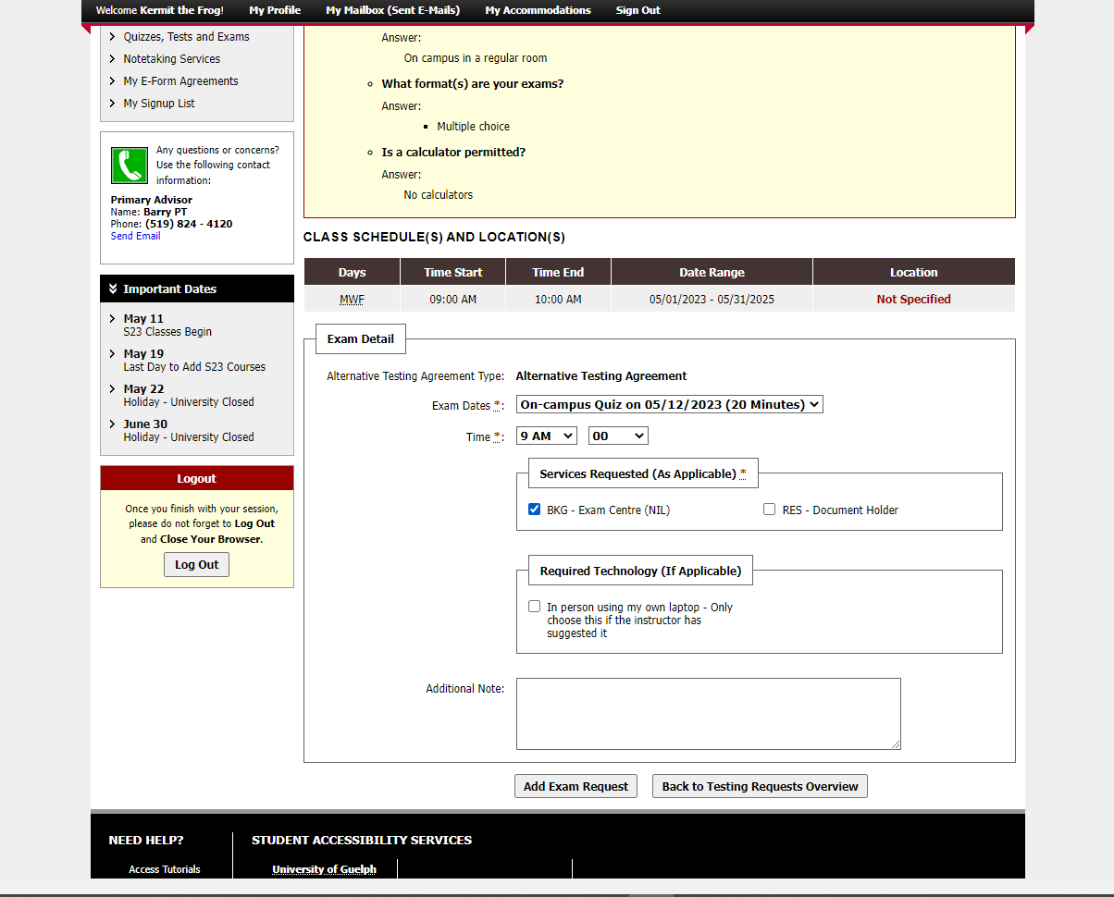
1
2
3
4
Notes:
As discussed in other videos, complete each of the necessary fields. This includes the date, time, accommodations, whether you will be using your own laptop (with permission) and any additional notes.
When you are finished, click on “add exam request”

Slide 10
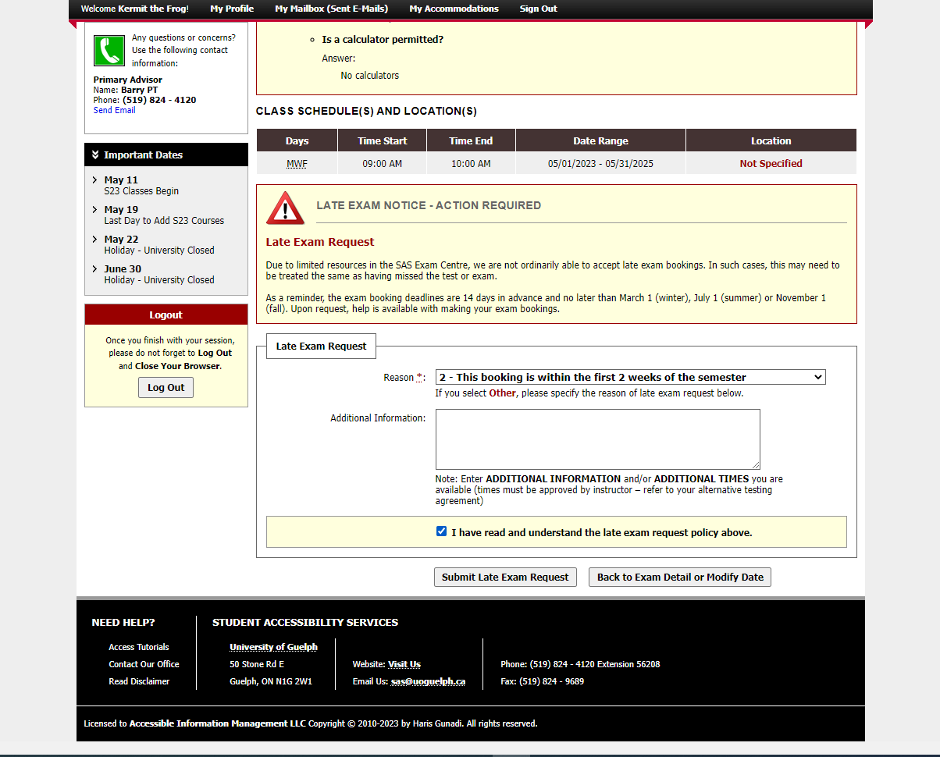
Notes:
You may add additional information if needed. This is only to clarify information about the required change – requests for preferred seating or a change in accommodations will be ignored.
Select the option that says you have read and understood the late exam request policy above.

Slide 11
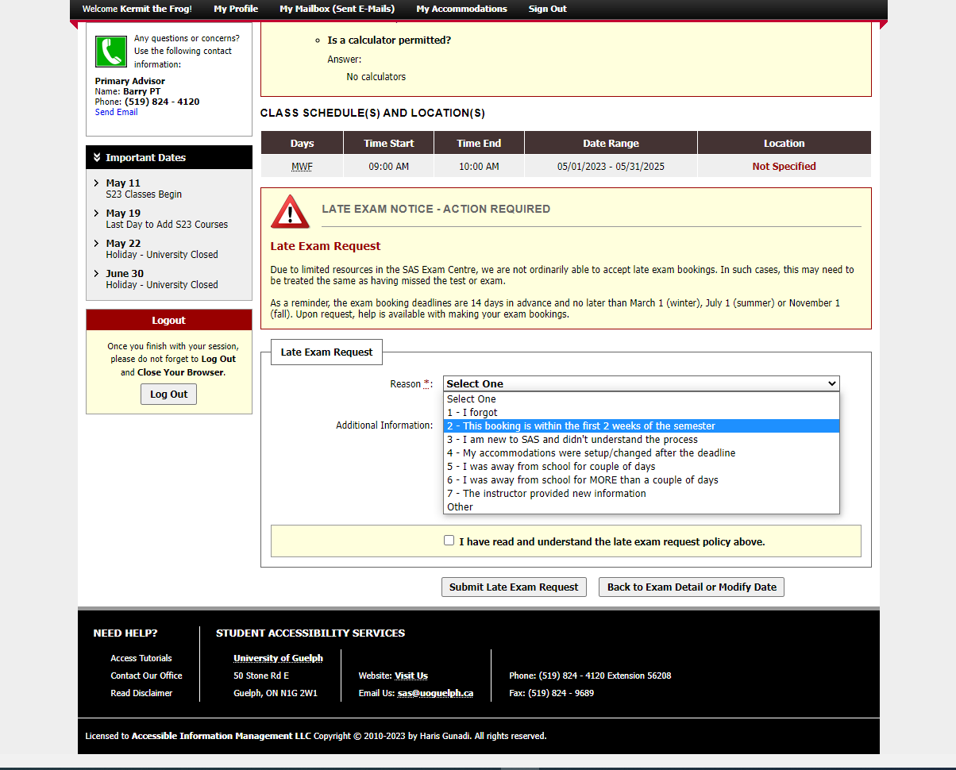
Notes:
Select the reason for the late booking from the options provided.

Slide 12
Notes:
You may add additional information if needed. This is only to clarify information about the required change – requests for preferred seating or a change in accommodations will be ignored.
Select the option that says you have read and understood the late exam request policy above.

Slide 13
Notes:
Select the option that says you have read and understood the late exam request policy above.

Slide 14
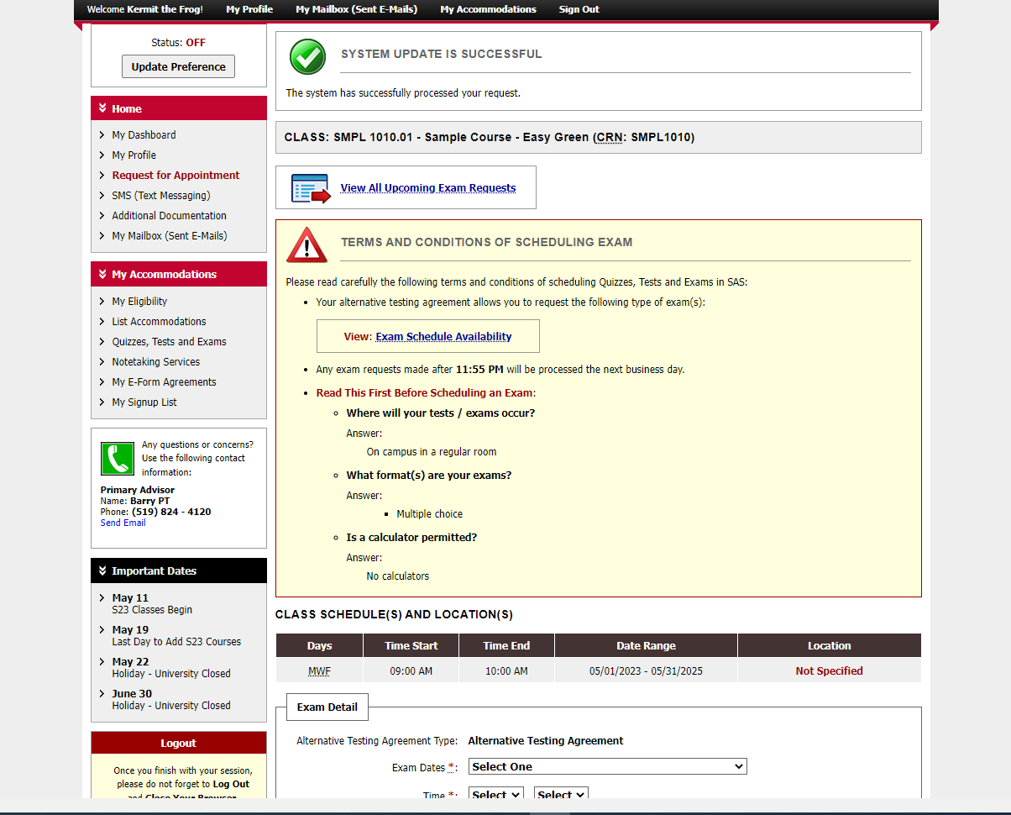
Notes:
Once again, we see a green checkmark icon and message saying: “system update is successful.”

Slide 15
An Update is Coming
There will be some changes to colours and layout when the new version is released.
It will be mobile friendly and has some helpful new tools.
We don’t know the date yet.
When more information is available, it will be posted on the SAS website.

Slide 16
wellness.uoguelph.ca /accessibility
Contact Information

